Slide 1
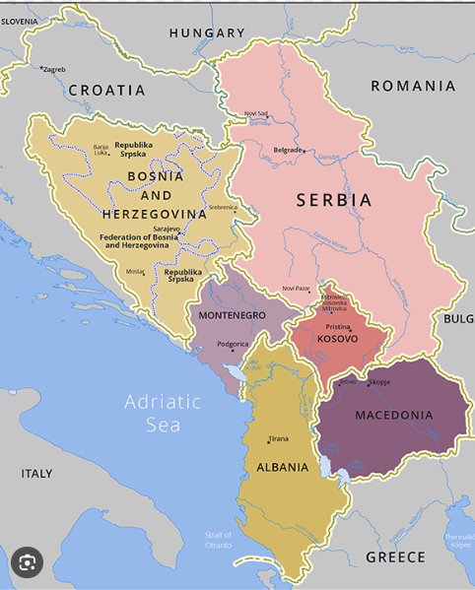
EU and UK Initiatives on Green Agenda for the Western Balkans Region:
Their Impact on Local Company Practices in Developing Sustainable ESG Financial Reporting
29 October 2025
Prepared by:
Dr. Nereida Polovina Ph.D.
Syed Mustafa Zamin PGT
Dr. Steven Wynne Ph.D.
Department of Finance and Economics
Manchester Metropolitan University

Slide 2






EU Green Agenda
Key Highlights of EU Green Agenda for Western Balkans
Five Pillars of EU Green Agenda
(3) Circular Economy
Implement industrial policies to improve sustainable production and consumption cycle practice
Uplifting local SMEs with efficient business operation techniques
EU Financial Initiatives (WBIF)
Under EU multi-annual financial budget (2021-2027) (i) Instrument for Pre-Accession (IPA) III of up to € 9 bn funding and (ii) Guarantee Facility for up to € 20 bn of investments .
Investment preference in Infrastructure, Energy, Climate, Digitalization, Human and Entrepreneurial Capacity, Good Governance and Rule of Law, Common Regional Market
(1) Decarbonization & (2) De-pollution
Reiteration of Paris Agreement climate goals and carbon-neutral policies and goals
Development and implementation of “BAT” for Air, Water and Soil
(4) Biodiversity & (5) Sustainable Food System
Support development of “Western Balkan 2030 Biodiversity Action Plan
Support alignment of agri-food and production sector with EU standards
Source:
https://enlargement.ec.europa.eu/system/files/2020-10/green_agenda_for_the_western_balkans_en.pdf
https://www.wbif.eu/eip
https://www.europarl.europa.eu/RegData/etudes/STUD/2022/702561/EXPO_STU(2022)702561_EN.pdf
Notes:
(1) climate action, including decarbonisation, energy and mobility,
(2) circular economy, addressing in particular waste, recycling, sustainable production and efficient use of resources,
(3) biodiversity, aiming to protect and restore the natural wealth of the region,
(4) fighting pollution of air, water and soil and
(5) sustainable food systems and rural areas.
Instrument for Pre-Accession Assistance IPA III €9 bn
To support: (9 bn euro)
economic convergence with the EU
competitiveness and inclusive growth
sustainable connectivity
twin green and digital transition
Western Balkans Guarantee Facility (20 bn euros)
To reduce:
the cost of financing for public and private investments
the risk for investors
The Western Balkans Investment Framework (WBIF) is a joint initiative of the EU, financial institutions, bilateral donor and beneficiaries, aimed at enhancing harmonisation and cooperation in investments for the socio-economic development of the region and contributing to the European perspective of the Western Balkans.

Slide 3



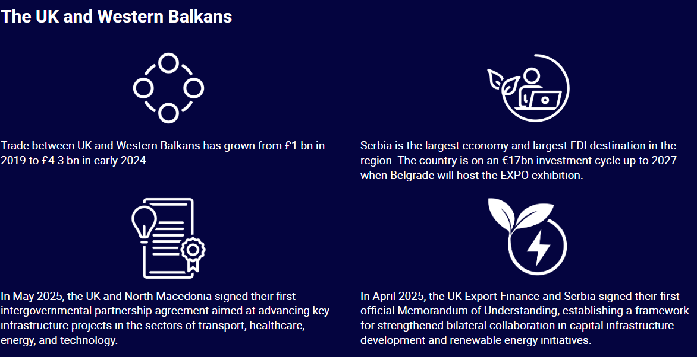
UK initiatives
In 2018
  UK hosted Western Balkans Summit as part of the Berlin Process, when it committed to increased engagement and funding with the Western Balkans.
In 2024
  UK announced a support package £10 Mn for Western Balkan’s green transition
  £4.2 Mn to develop wind power to transition away from coal
  £15.75 Bn in export finance scheme which provides guarantees for UK companies to trade overseas with confidence in Western Balkans
    Example - the £363 million for the Morava Corridor Motorway in Serbia, which connect the industrial city of Kruševac to important regional commercial centres of Sarajevo, Bosnia and Herzegovina and the port city of Bar, Montenegro.
Source:
https://www.gov.uk/government/news/uk-announces-new-support-to-boost-british-exports-and-investment-in-the-western-balkans
https://www.events.great.gov.uk/website/17693/home/#why-uk-western-balkans
Notes:
Population of Western Balkans 20 million for all the 6 countries.

Slide 4
ESG and Sustainability Reporting Initiatives – Understanding Sample Universe and Data
Timeframe Selection 2013 - 2025
Country-Wise Distribution of Sample Universe
2014
Implementation of the EU’s Non-Financial Reporting Directive (NFRD), began shaping ESG expectations across Europe.
2016 - 2018
Increased alignment of GRI Standards with the UN SDGs and the launch of the Task Force on Climate-related Financial Disclosures (TCFD).
2021 – 2022
Announcement of EU Green Agenda for the Western Balkans. A step towards aligning the region with European green deal and sustainable environmental practices.
The European Commission’s proposal of the Corporate Sustainability Reporting Directive (CSRD) (European Commission, 2025) and the release of revised GRI 2022 Standards, including sector-specific standards for Oil & Gas, Mining, and Financial Services.

Slide 5
Annexure I – Sample Universe Table
S.No | Company Name | Sector | Country | S.No | Company Name | Sector | Country
1 | Banca Intesa Beograd | Financial Services | Serbia | 26 | ProCredit Bank - Albania | Financial Services | Albania
2 | Erste Bank - Serbia | Financial Services | Serbia | 27 | ProCredit Bank - Serbia | Financial Services | Serbia
3 | Erste Bank - Montenegro | Financial Services | Montenegro | 28 | ProCredit Bank - Kosovo | Financial Services | Kosovo
4 | Sparkasee Bank Skopje | Financial Services | North Macedonia | 29 | ProCredit Bank - BiH | Financial Services | Bosnia
5 | Sparkasee Bank BiH | Financial Services | Bosnia | 30 | ProCredit Bank - MK | Financial Services | North Macedonia
6 | NOA Finance | Financial Services | Albania | 31 | Tara Resource | Mining | Montenegro
7 | Banka Kombëtare Tregtare - KOS | Financial Services | Kosovo | 32 | Addiko Bank Banja Sarajevo | Financial Services | Bosnia
8 | Banka Kombëtare Tregtare - Al | Financial Services | Albania | 33 | Addiko Bank Banja Luka | Financial Services | Bosnia
9 | Elixir Group | Chemical | Serbia | 34 | OTP Bank Serbia | Financial Services | Serbia
10 | Makedonija Osiguruvanje | Financial Services | North Macedonia | 35 | Komercijalna Banka ad. Skopje | Financial Services | North Macedonia
11 | Replek ad Skopje | Pharmaceutical | North Macedonia | 36 | HBIS Steel - Serbia | Steel | Serbia
12 | Coca-Cola Bottling Shqipëria | Food and Beverages | Albania | 37 | Telemach MK | Telecommunication | North Macedonia
13 | Bankers Petroleum Limited | Oil & Gas | Albania | 38 | Telemach BiH | Telecommunication | Bosnia
14 | VV Tikves AD Kavadarci | Food and Beverages | North Macedonia | 39 | HIP-Petrohemija | Oil & Gas | Serbia
15 | UNIQA Osiguranje | Financial Services | Serbia | 40 | Rafiessen Bank - KOS | Financial Services | Kosovo
16 | Sigal UNIQA - KOS | Financial Services | Kosovo | 41 | Rafiessen Bank - BiH | Financial Services | Bosnia
17 | UNIQA osiguranje u BiH | Financial Services | Bosnia | 42 | Rafiessen Bank - RS | Financial Services | Serbia
18 | Sigal Uniqa - Albania | Financial Services | Albania | 43 | Rafiessen Bank - ALB | Financial Services | Albania
19 | UNIQA osiguranje ad Podgorica | Financial Services | Montenegro | 44 | Titan Cementara | Construction | Serbia
20 | Alkaloid ad. Skopje | Pharmaceutical | North Macedonia | 45 | Cementarnica USJE AD Skopje | Construction | North Macedonia
21 | Aluminij d.d. Mostar | Steel | Bosnia | 46 | Titan Sharrcem - Kosovo | Construction | Kosovo
22 | Energopetrol | Oil & Gas | Bosnia | 47 | Titan ANTEA Cement | Construction | Albania
23 | Granit ad. Skopje | Construction | North Macedonia | 48 | UniCredit Bank - Serbia | Financial Services | Serbia
24 | Makpetrol ad. Skopje | Oil & Gas | North Macedonia | 49 | UniCredit Bank - BiH | Financial Services | Bosnia
25 | Makstil ad. Skopje | Steel | North Macedonia | 50 | NIS - Serbia | Oil & Gas | Serbia

Slide 6
ESG and Sustainability Reporting Initiatives – Understanding Sample Universe and Data
Sample Universe Companies Ownership Breakdown
Sector-Wise Distribution of Sample Universe
This includes both direct and indirect shareholding, i.e. Parent Company or Ultimate Beneficiary

Slide 7
















ESG and Sustainability Reporting Initiatives – Methodology and ESG Scoring
Approach Overview
Longitudinal panel study of ESG reporting trends
Time frame: 2013–2025
Geographic scope: Western Balkans Region
Sample: 50 companies across sectors (focus on consistency and disclosure maturity)
GRI Standard Scoring & ESG Score Calculation
A total of 113 Unique GRI Standards were observed
98 Universal Standards and 15 sector specific standards for Financial Services and Oil & Gas Sector
Scoring was based on the number of SDGs covered in each GRI code and further categorized based on E, S and G.
SDG Mapping
S.No | GRI Code | GRI Score | SDG Coverage | Environment Coverage | Social Coverage | Governance Coverage
1 | 203-1 | 1 | 2,5,7,9,11 | 4 | 2 | 1
2 | 305-1 | 1 | 3,11,12,13,14,15 | 5 | 2 | 1
Sectors | Base Score Environment | Base Score Social | Base Score Governance
Financial Services | 166 | 168 | 59
Oil & Gas Sector | 203 | 187 | 79
Other Manufacturing Sectors | 162 | 165 | 59
Year | Absolute Score |  |  | Percentage Score |  |  | Overall ESG Score
 | Environment Score | Social Score | Governance Score | Environment Score | Social Score | Governance Score
2023 | 53 | 23 | 8 | 33% | 14% | 14% | 20%
Environment
Social
Governance

Slide 8
Annexure I – GRI Standard Scoring as per the SDG Goals
GRI Code | GRI Standard | SDG Linkage | SDG Measure
GRI 203-1 | Indirect Economic Impact | Goal 2: Zero Hunger | Examples of significant identified indirect economic impacts of the organization, including positive and negative impacts. Significance of the indirect economic impacts in the context of external benchmarks and stakeholder priorities, such as national and international standards, protocols, and policy agendas.
 |  | SDG 5: Gender Equality | Extent of development of significant infrastructure investments and services supported. Current or expected impacts on communities and local economies, including positive and negative impacts, where relevant. Whether these investments and services are commercial, in-kind, or pro bono engagements.
 |  | SDG 7: Affordable & Clean Energy | Ensure universal access to affordable, reliable, and modern energy services. Increase the share of renewable energy in the global energy mix.
 |  | SDG 9: Industry, Innovation and Infrastructure | Extent of development of significant infrastructure investments and services supported. Current or expected impacts on communities and local economies, including positive and negative impacts, where relevant. Whether these investments and services are commercial, in-kind, or pro bono engagements.
 |  | SDG 11: Sustainable Cities & Communities | Extent of development of significant infrastructure investments and services supported. Current or expected impacts on communities and local economies, including positive and negative impacts, where relevant. Whether these investments and services are commercial, in-kind, or pro bono engagements.

Slide 9
Annexure II – Sector Specific Codes
GRI Code | Sector | GRI Indicator
GRI FS13 | Financial Services | Access points in low-populated or economically disadvantaged areas by type
GRI FS14 | Financial Services | Initiatives to improve access to financial services for disadvantaged people
GRI FS7 | Financial Services | Monetary value of products and services designed to deliver a specific social benefit for each business line
GRI OG 11.2.3 | Oil & Gas | Emissions potential of reserves
GRI OG 11.5.1 | Oil & Gas | Volume of hydrocarbons produced & processed
GRI OG 11.5.2 | Oil & Gas | Volume of hydrocarbon reserves
GRI OG 11.5.3 | Oil & Gas | Volume of hydrocarbon resource additions
GRI OG 11.5.4 | Oil & Gas | Volume of flared and vented hydrocarbons
GRI OG 11.5.5 | Oil & Gas | Energy intensity of hydrocarbon production
GRI OG 11.5.6 | Oil & Gas | Benzene, lead & sulphur content in fuels
GRI OG 11.5.8 | Oil & Gas | Volume of non-renewable waste generated
GRI OG 11.5.9 | Oil & Gas | Biofuels meeting sustainability criteria
GRI OG 11.6.1 | Oil & Gas | Emergency preparedness & response systems
GRI OG 11.6.2 | Oil & Gas | Process safety management
GRI OG 11.6.3 | Oil & Gas | Closure and rehabilitation of sites

Slide 10
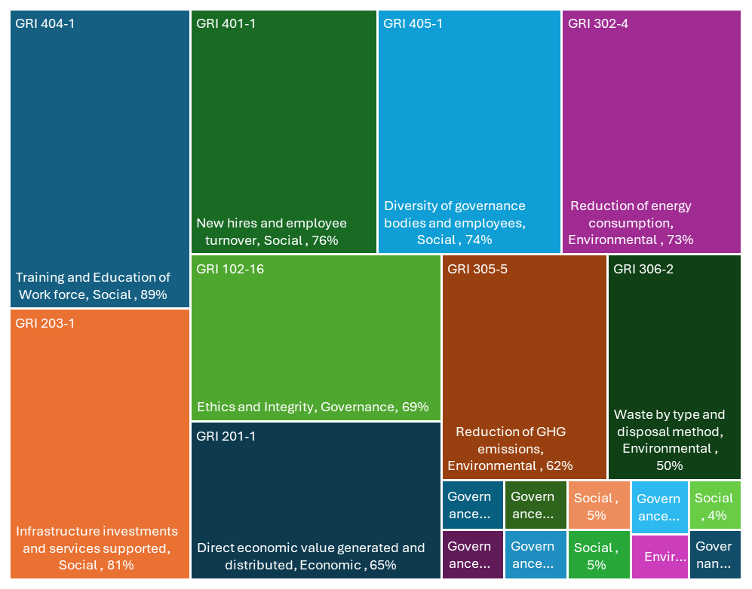


Global Reporting Initiatives – GRI Standards Observed
GRI Standards Timeline Used in Study
Key GRI’s Covered by the Sample Universe
Period | Applicable GRI Framework | Relevance
2013–2016 | GRI G3.1 & GRI G4 (transition period) | Partial adoption, varied quality
2016–2021 | GRI Standards (2016) | Widely adopted, modular format
2022–2025 | GRI Standards (2022 Update) | Stronger linkage to SDGs, clearer materiality focus
2022–2025 | Sector Standards: Oil & Gas, Mining, Financial Services | Industry-specific depth
GRI 102/103/200 – 400 Series (2016)
Governance, Economic, Environmental and Social Disclosures
GRI 2 and GRI 3 (2022)
Updated Universal Standards for Organisational context and material topics
Sector Standards (Post 2022)
GRI 11: Oil and Gas
GRI 12: Coal
GRI 13: Agriculture
GRI 14: Financial Services

Slide 11





Case Study: De-carbonization in the Western Balkans – Elixir Group (Serbia)
Project Context
Sector: Mineral Fertilisers & Phosphoric Acid Production
Relevance: Heavy-industry emitter in a non-EU economy aligning with EU Green Deal standards
Financing: USD 574 Mn Elixir Group ( 77.6%) and EU (22.4%)
Roadmap for Industrial De-carbonisation
Apply Life Cycle Assessment (LCA) and Carbon Footprint (CFP) tools
Evaluate GHG emissions of 4 core products
Identify emission-reduction measures to pre-emptively align with:
  EU Emissions Trading System
  Carbon Border Adjustment Mechanism
Reporting and Compliance Initiatives
Coordination with the EU Green deal resulted in Elixir Group publishing sustainability report starting from 2022
In 2025, the company issued its first green bond of EUR 35 Mn
Prahovo 2027: EUR 300 Mn investment in sustainable transformation, which includes, 3 greenfield plants and a Water to Energy Plant
Actively tracking Scope 1, 2, and preparing for Scope 3 emissions.
50% reduction in energy use per ton of phosphoric acid via advanced tech.
Innovative Aspects
First-of-its-kind LCA/CFP methodology for Serbia’s chemical sector
Potential to scale from product-level to company-wide assessments
Supports long-term climate policy compliance and carbon cost mitigation
Notes:
Prahovo 2027 | Elixir Group
Full decarbonization of production is Elixir Group's strategic goal for 2030
The example of sustainable financing

Slide 12



Case Study: De-carbonization in the Western Balkans – North Macedonia, Bosnia, Kosovo and Albania
North Macedonia
Company Name: Alkaloid ad Skopje
Objective: To align with the EU Green Deal and Climate Action Plan for the Western Balkans
Initiatives:
  Modernization of production facilities with energy-efficient systems
  Transition to renewable energy sources for selected production processes
  Implementation of circular economy principles through waste reduction and water reuse
  Since 2022, the company is reporting on ESG metrics in accordance to General Reporting Initiatives
Progress:
  Achieved measurable reductions in CO₂ emissions (approx. 20% reduction over 5 years)
  Increased use of green energy in operations (solar Park Projects with 11K MW Production)
  Strengthened ESG reporting practices to meet EU CSRD requirements
Bosnia, Kosovo and Albania
Company Name: ProCredit Bank
Strategic ESG Initiatives:
  Environmental Management & Certification: ISO 14001 EMS in Albania; EDGE certification in Kosovo.
  Green Lending & Eco-Credit Lines: Financing for energy efficiency, renewable energy, tech upgrade for SMEs.
  Internal Operations Improvements: Energy saving in branches / head offices.
  Working with Donors / International Partners: EBRD, EFSE, WBIF supporting loans & credit lines linked to environmental criteria.
Impact & Relevance:
  Reduced carbon footprint in operations (e.g., building energy savings, fewer emissions from fleet) in Kosovo via EDGE certification (~294 t CO₂/year).
  Increased accessibility for SMEs & households to finance green upgrades and helping reduce costs and energy consumption.
  Better alignment with EU / international regulatory expectations (Green Agenda, CSRD, CBAM, etc.) through proactive green policies.
Notes:
lkaloid AD Skopje is a publicly traded joint stock company based in North Macedonia that manufactures and distributes pharmaceuticals, cosmetics, chemicals, and botanical products. It operates in two main divisions: Pharmaceuticals and Chemicals, Cosmetics and Botanicals. Has received some of the EU grants
Procredit bank whose fundamental owner is a German bank

Slide 13
The effect of EU Green Agenda on companies involved and their changes in ESG reporting
 | Overall ESG Score |  | Environmental Score |  | Social Score |  | Governance score
EU _ Ownership | 0.031 |  | 0.05* |  | 0.03* |  | 0.013
 | (0.021) |  | (0.028) |  | (0.018) |  | (0.017)
UK _ Ownership | -0.087*** |  | -0.127*** |  | -0.068*** |  | -0.066***
 | (0.024) |  | (0.033) |  | (0.021) |  | (0.020)
US_Ownership | 0.074*** |  | 0.092*** |  | 0.059*** |  | 0.071***
 | (0.023) |  | (0.031) |  | (0.019) |  | (0.019)
EU Green Agenda involvement and reporting before year 2021 | -0.168 *** |  | -0.264*** |  | -0.122*** |  | -0.117***
 | (0.030) |  | (0.041) |  | (0.026) |  | (0.025)
Companies reporting from year 2021 | -0.044* |  | -0.073** |  | -0.036* |  | -0.022**
 | (0.023) |  | (0.031) |  | (0.019) |  | (0.019)
EU Green Agenda involvement and reporting from year 2021 | 0.056 |  | 0.101** |  | 0.038 |  | 0.03
 | (0.034) |  | (0.046) |  | (0.029) |  | (0.028)
Intercept | 0.236 *** |  | 0.345*** |  | 0.2*** |  | 0.164***
 | (0.025) |  | (0.033) |  | (0.021) |  | (0.020)
Nu of Obs | 233 |  | 233 |  | 233 |  | 233
R-square | 0.363 |  | 0.396 |  | 0.316 |  | 0.342
*** p<0.01, ** p<0.05, * p<0.1
Companies involved in EU green agenda are more likely to report on Environmental reporting from 2021 onwards
Why 2021?
  First year of EU Green Agenda implementation created a learning curve for Western Balkan companies.
  Result: 2021 acted as a transition/baseline year — visible ESG reporting improvements appeared mainly in 2022–2023.
  Firms faced delays due to:
    lack of ESG expertise and systems,
    challenges in collecting reliable data,
    COVID-19 financial constraints.
Companies not involved in EU green agenda projects are less likely to improve their reporting in any of the three categories
EU and US ownership positively affect the ESG reporting
UK ownership has a negative effect, but this is based on very few observations.
Notes:
Explain why UK ownership has a negative effect: - private equity funds example from the dataset – to compare it with an example from EU ownership.

Slide 14
GRI specific results
Probit regression | GRI 305-5 | GRI401-1 | GRI403-2 | GRI 404-1 | GRI 405-1 | GRI 413-1
 | Emissions | Employment | Occupational Health and Safety | Training and Education | Diversity and Equal Opportunity | Local communities
EU _ Ownership | -0.157 | 1.415*** | 1.02*** | 0.364 | 0.323 | -1.15***
 | (0.233) | (0.236) | (0.253) | (0.335) | (0.233) | (0.246)
UK _ Ownership | -0.231 | -0.378 | -1.964*** | -0.212 | -0.211 | 0.721**
 | (0.270) | (0.317) | (0.323) | (0.389) | (0.332) | (0.327)
US_Ownership | 0.608** | 0.148 | 0.575** | 0.338 | 0.5 | -1.008***
 | (0.266) | (0.293) | (0.260) | (0.350) | (0.315) | (0.281)
EU Green Agenda involvement and reporting before year 2021 | -0.803 | -0.289 | -1.801 | 0.015 | -1.584 | 0.878
 | (0.340) | (0.393) | (0.368) | (0.544) | (0.480) | (0.383)
Companies reporting from year 2021 | 0.692*** | -0.79*** | -0.203 | -0.755** | -1.146*** | 0.821***
 | (0.264) | (0.300) | (0.264) | (0.365) | (0.394) | (0.296)
EU Green Agenda involvement and reporting from year 2021 | 0.567 | 0.68 | 0.933** | 0.32 | 1.253*** | -1.041**
 | (0.391) | (0.440) | (0.389) | (0.561) | (0.472) | (0.411)
Intercept | 0.155 | 0.146 | 0.058 | 1.325*** | 1.451*** | -0.032
 | (0.264) | (0.308) | (0.269) | (0.396) | (0.415) | (0.287)
Nu of Obs | 233
Wald Chi square | 215.8
*** p<0.01, ** p<0.05, * p<0.1
GRI 305-5 | Emissions | Reduction of GHG emissions
GRI 401-1 | Employment | New employee hires and employee turnover
GRI 403-2 | Occupational Health and Safety | Hazard identification, risk assessment, and incident investigation
GRI 404-1 | Training and Education | Average hours of training per year per employee
GRI 405-1 | Diversity and Equal Opportunity | Diversity of governance bodies and employees
GRI 413-1 | Local Communities | Operations with local community engagement, impact assessments, and development programs
Companies involved in EU Green agenda project are more likely to report an improvement in ESG reporting from 2021 onwards – In this table it is GRI 403-2 (OH&S) and 405-1 (D&EO)
UK ownership has a positive effect on reporting on the impact in local communities and development programs GRI 413-1 which is different for those companies with EU ownership.
EU ownership improves reporting on GR401-1 Employment and GRI 403-2 (OH&S)
Notes:
NOA – US ownership examples ---- how they are mimicking each other...

Slide 15
GRI specific results
Probit regression | GRI102-16 | GRI 102-18 | GRI 201-1 | GRI 203-1 | GRI 302-4
 | Ethics and Integrity | Governance | Economic Performance | Indirect Economic Impact | Energy
EU _ Ownership | -1.256*** | -1.943*** | -0.293 | 0.224 | -0.38
 | (0.303) | (0.322) | (0.224) | (0.259) | (0.238)
UK _ Ownership | 1.582*** | 1.075*** | -0.648** | -0.532* | -0.625**
 | (0.313) | (0.292) | (0.254) | (0.272) | (0.271)
US_Ownership | -1.116*** | -1.088*** | 0.651** | 0.343 | 0.59**
 | (0.292) | (0.296) | (0.257) | (0.267) | (0.285)
EU Green Agenda involvement and reporting before year 2021 | 0.542 | -0.877** | -0.603* | 0.851** | -0.704**
 | (0.398) | (0.417) | (0.320) | (0.409) | (0.345)
Companies reporting from year 2021 | -0.094 | -0.352 | 0.19 | -0.278 | -0.077
 | (0.299) | (0.312) | (0.248) | (0.251) | (0.273)
EU Green Agenda involvement and reporting from year 2021 | 0.282 | 1.511*** | 0.384 | -0.017 | 0.315
 | (0.444) | (0.482) | (0.358) | (0.434) | (0.365)
Intercept | 1.424*** | 1.786*** | 0.652** | 0.591** | 1.166***
 | (0.360) | (0.376) | (0.259) | (0.269) | (0.288)
Nu of Obs | 233
Wald Chi square | 189.67***
*** p<0.01, ** p<0.05, * p<0.1
GRI Code | GRI 2022 Standard | Indicator Title
GRI 102-16 | Ethics and Integrity | Values, principles, standards, and norms of behavior
GRI 102-18 | Governance | Governance structure
GRI 201-1 | Economic Performance | Direct economic value generated and distributed
GRI 203-1 | Indirect Economic Impacts | Infrastructure investments and services supported
GRI 302-4 | Energy | Reduction of energy consumption
Companies involved in EU Green agenda project are more likely to report an improvement in ESG reporting from 2021 onwards in the Governance structure GRI 102-18.
UK owned companies are more likely to report on Ethics and Integrity GRI102-16 and also more likely to report Governance structure GRI 102-18.
Notes:
One can also argue that it is the mandatory effect on 2021 onwards that has led to them reporting, so just being involved in EU green agenda does not necessarily lead to reporting.
Firms not involved in EU agenda and from year 2021 do not report.

Slide 16
GRI specific results –
Probit regression | GRI 404-2 | GRI 415-1
 | Training and Education | Public Policy
EU _ Ownership | 1.243*** | 1.717***
 | (0.298) | (0.324)
UK _ Ownership | 0.154 | -7.293
 | (0.319) | (176.601)
US_Ownership | 0.405 | 0.467
 | (0.264) | (0.316)
EU Green Agenda involvement and reporting before year 2021 | -1.47*** | -2.075***
 | (0.373) | (0.439)
Companies reporting from year 2021 | -1.344*** | -1.34***
 | (0.285) | (0.368)
EU Green Agenda involvement and reporting from year 2021 | 1.105*** | 1.679***
 | (0.404) | (0.469)
Intercept | -0.115 | -0.122
 | (0.295) | (0.324)
Nu of Obs | 233
Wald Chi square | 95.34***
*** p<0.01, ** p<0.05, * p<0.1
GRI 404-2 | Training and Education | Programs for upgrading employee skills and transition assistance programs
GRI 415-1 | Public Policy | total monetary value of direct and indirect financial and in-kind political contributions
Companies involved in Western Balkans project after 2021 are more likely to report on Employee Training programs GRI 404-2 than companies not in involved after 2021.
Companies involved in EU green agenda after 2021 are more likely to report on contributions to Public policy GRI 415-1 when compared to other companies
Companies with EU ownership are more likely to contribute to Training and Education and also to Public Policy

Slide 17
Concluding remarks – policy implications
Companies involved in EU Green Agenda projects for Western Balkans are more likely to engage in ESG reporting
Companies with EU ownership are also more likely to engage with several ESG reporting
Companies with UK ownership are only more likely to focus solely on Governance reporting as opposed to Environmental or Social reporting..

