Slide 1

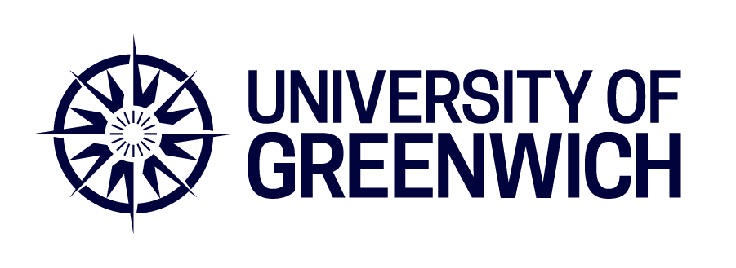
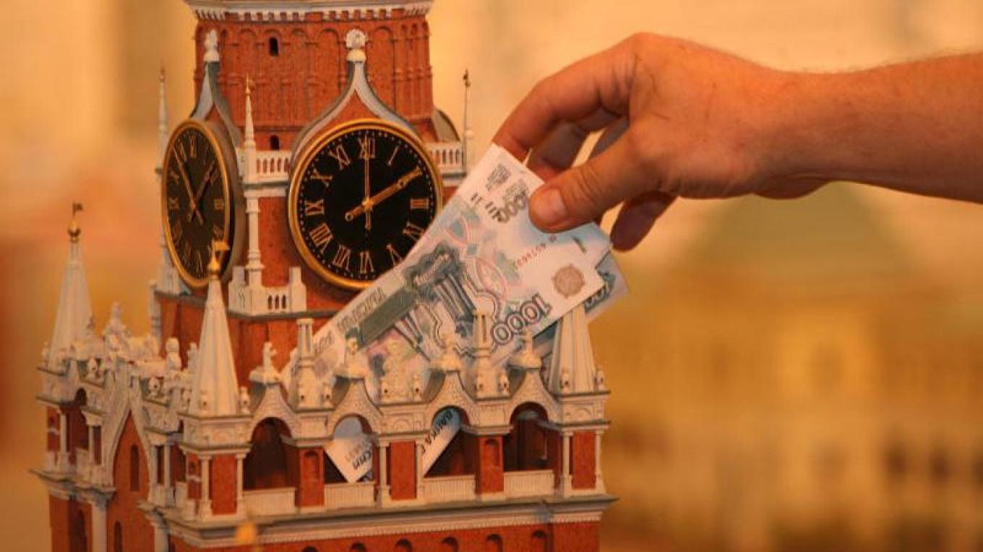
Professor Bruce Cronin
Sergey Sosnovskikh, PhD
Corporate Networks and State Power: Russian State-owned Enterprises and Interlocks
Academy of Management
27 July 2025

Slide 2
Introduction
Definition & Global Prevalence
State capitalism is a system where the government actively intervenes as an economic agent.
It exerts influence over markets and companies through ownership, financial support, and political ties.
This model is increasingly seen worldwide, especially in emerging markets.
Meyer et a. (2023)
Mechanisms of State Control
The state influences businesses through formal means (ownership, subsidies, loans, administrative support).
It also operates via informal networks (political ties, patronage, and personal relationships).
Bracco et al. (2024)
Advantages & Challenges for State-Linked Companies
Companies with state connections benefit from easier access to resources, financial aid, and government support.
However, they also face constraints, such as adherence to political agendas and reduced autonomy.
Estrin et al. (2009)

Slide 3
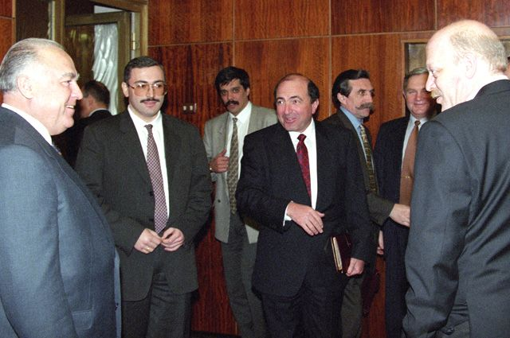
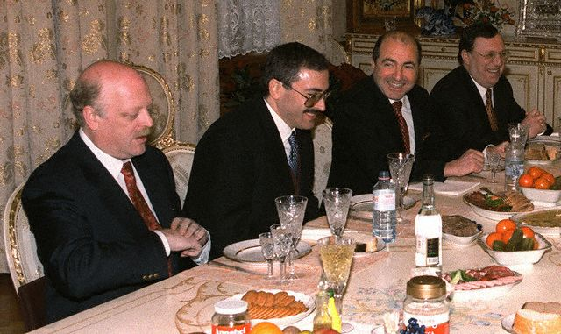
Interlocking directorates
Executive from one firm occupies a board position in another (Mizruchi, 1996; Pombo & Gutiérrez, 2011).
Vertical interlocks traditionally refer to board connections between firms engaged in customer-supplier (buyer-seller) relationships (Arnoldi et al., 2019; Bischoff & Buchwald, 2018).
Directors serve on the boards of competing companies (horizontal) (Mizruchi, 1996; Smith & Sarabi, 2021)
Interlocks are necessary to reduce uncertainty, competition and concentrate power (Carroll & Shaw, 2001; Sonquist & Koenig, 1984)
However, the networks within state-business relations such as (in)formal connections with current or former politicians forming clans; the context of ‘crony capitalism’ (Aslund, 2019) is not well studied.

Slide 4
Research Context
Russia’s economic system relies heavily on personalised state-business networks.
These networks shape business success, policy influence, and economic stability; however, arbitrary state power over private interests
The Russian state controls is dominant through direct ownership and state-owned enterprises (SOEs)
Key industries dominated by the state: infrastructure (transport, pipelines, nuclear energy), defense, finance, and media
(Viktorov & Kryshtanovskaya, 2023; Berezinets et al., 2023; Panibratov & Klishevich, 2023
Concepts like "clans" (Ouchi, 1980) and "network capitalism" (Boisot & Child, 1996) explain how personal relationships, negotiation, and mutual adjustments shape business operations.
Russia inherited the Soviet-era practice of blat (reciprocal favors), which evolved into svyazi (personal networks).
Business success in Russia depends on connections, helping firms access resources, loans, and secure deals while reducing risks (Viktorov & Kryshtanovskaya, 2023; Yakovlev, 2021)

Slide 5
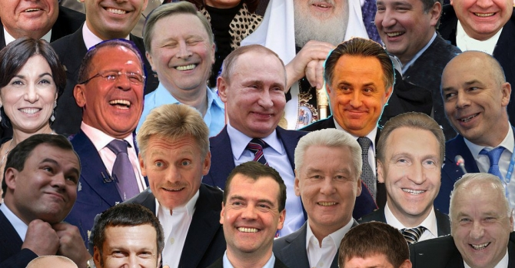
Three Forms of Russian Capitalism: Market, Oligarchic, and Siloviki
Many of Russia’s business elites emerged from Soviet-era managers, particularly from the Komsomol (Communist Youth League) in the 1980s.
The 1990s privatization allowed a small group of individuals (the oligarchs) to accumulate vast wealth, particularly in natural resources.
However, Putin reasserted state control in the 2000s, integrating oligarchs into a state-managed economic system.
Sakwa (2008)
Russia operates under state-managed network capitalism (Puffer & McCarthy, 2007).
Market Capitalism: Private entrepreneurs operating in a competitive space.
Oligarchic Capitalism: Wealthy elites with political ties.
Siloviki Capitalism: State security officials (ex-KGB) controlling key sectors.
The state dominates all three, using its power to maintain control.

Slide 6
Evolution of Russia’s model before 2022
Main trends:
Increasing state capacity and interference
Strategic fighting between economic and security offices
Overall shift from decentralised to centralised corruption
 | 1990s | 2000-2012 | 2013-2021 | 2022 – present
Liberal Market Economy | X | X
State Capture | X | X | X
Predatory / Mafia State |  | X | X | X
Development State / Coordinated Market Economy |  | X | X | X
War Market Economy |  |  |  | ?
Adapted from Yakovlev (2021)
Aim: In this study we seek to extend understanding of Russian state capitalism by examining the reach of the state (‘traces of power’) among businesses through various formal channels.

Slide 7
Hypotheses (i)
1. Direct Ownership
H1. Individual SOEs and their subsidiaries are likely to account for much more Russian economic activity than those commanded by private conglomerates.
H2. In the ownership network involving both SOE and private sector joint ventures, SOEs will command much more economic activity than private firms.
2. Vertical board interlocks
H3. The longer the chain of ownership through levels of subsidiary ownership, the more likely are vertical board interlocks between higher and lower-level subsidiaries.

Slide 8
Hypotheses (ii)
3. SOE-private board interlocks
H4. SOEs are likely to concentrate their directors in the Russian board interlock network at the centre of the network and primarily connect with highly-connected others.
H5a. SOEs are likely to spread their directors to a wide range of private firms.
H5b. Private firms are likely to spread their directors to a wide range of firms.
H6. SOEs are likely to be more central than private firms within Russian board interlock network in clusters of firms with complementary resources.
4. Political board interlocks
H7. The most central SOEs in the board network will have more political directors.

Slide 9
Methodology – data (i)
All current Russian-registered parent companies and their subsidiaries recorded in the Orbis database.
Enables examination of the first control mechanism – direct ownership
Provides a reasonable comparison of SOEs and private firms
Financial threshold skewed by great size of SOEs and SOEs with losses
But excludes SOEs and private firms without subsidiaries.
Ownership network
Directional graph owner->owned
≥ 10 percent ownership; 252,134 firms.
80,200 in the largest component and 798 in the second largest.

Slide 10
Methodology – data (ii)
Board interlock network
Orbis listing of all current directors and managers for each using unique DMUCI director and BvD ID number company identifiers.
Bipartite graph (BvD number – DMUCI)
One mode firm-firm projection
74,842 nodes (firms) and 16,541 edges
Main component 1,454 nodes

Slide 11
Methodology – data (iii)
Politicians
List of members of all Russian Federal Government institutions publicly available from official sources in English (2001-2024).
Official government sources (2012–2024) and Turnbull’s (2011) study on siloviki were used to cross-reference political affiliations.
The dataset includes members of Russian Governments, the Federation Council, and State Council departments
Spelling standardization in three-name form e.g. ‘Aleksandr Stalyevich Voloshin’
Spelling standardization matching Orbis form e.g. ‘Sergii’ rather than ‘Sergy’ or ‘Sergey’
Initials matched with Orbis SOE lists where last name and initials matched e.g. V. V. Abramchenko’ matched ‘Victoria Valerievna Abramchenko’ where no alternative in list.
Remaining unmatched names compared to complete Orbis director list.
Name matched with Orbis DMUCI.

Slide 12
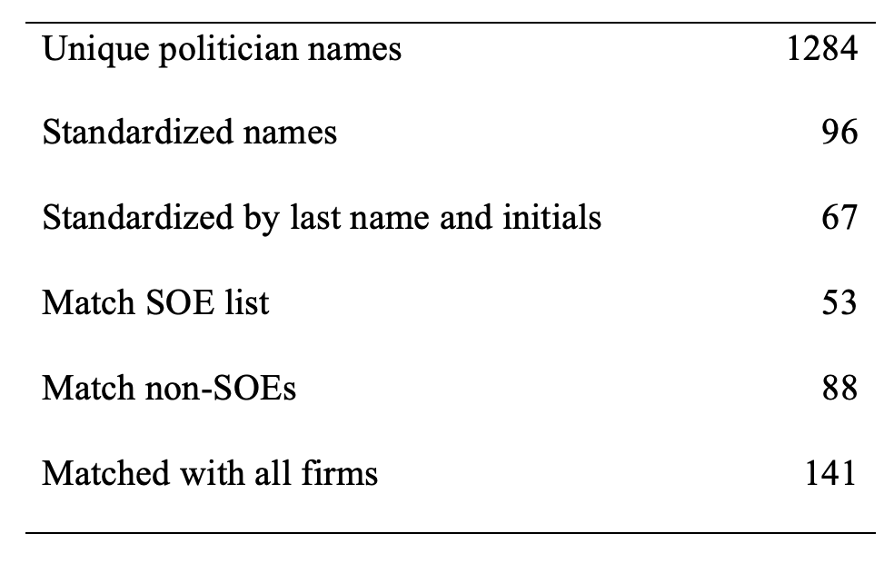
Methodology – data (iv)
Politician name matching process

Slide 13
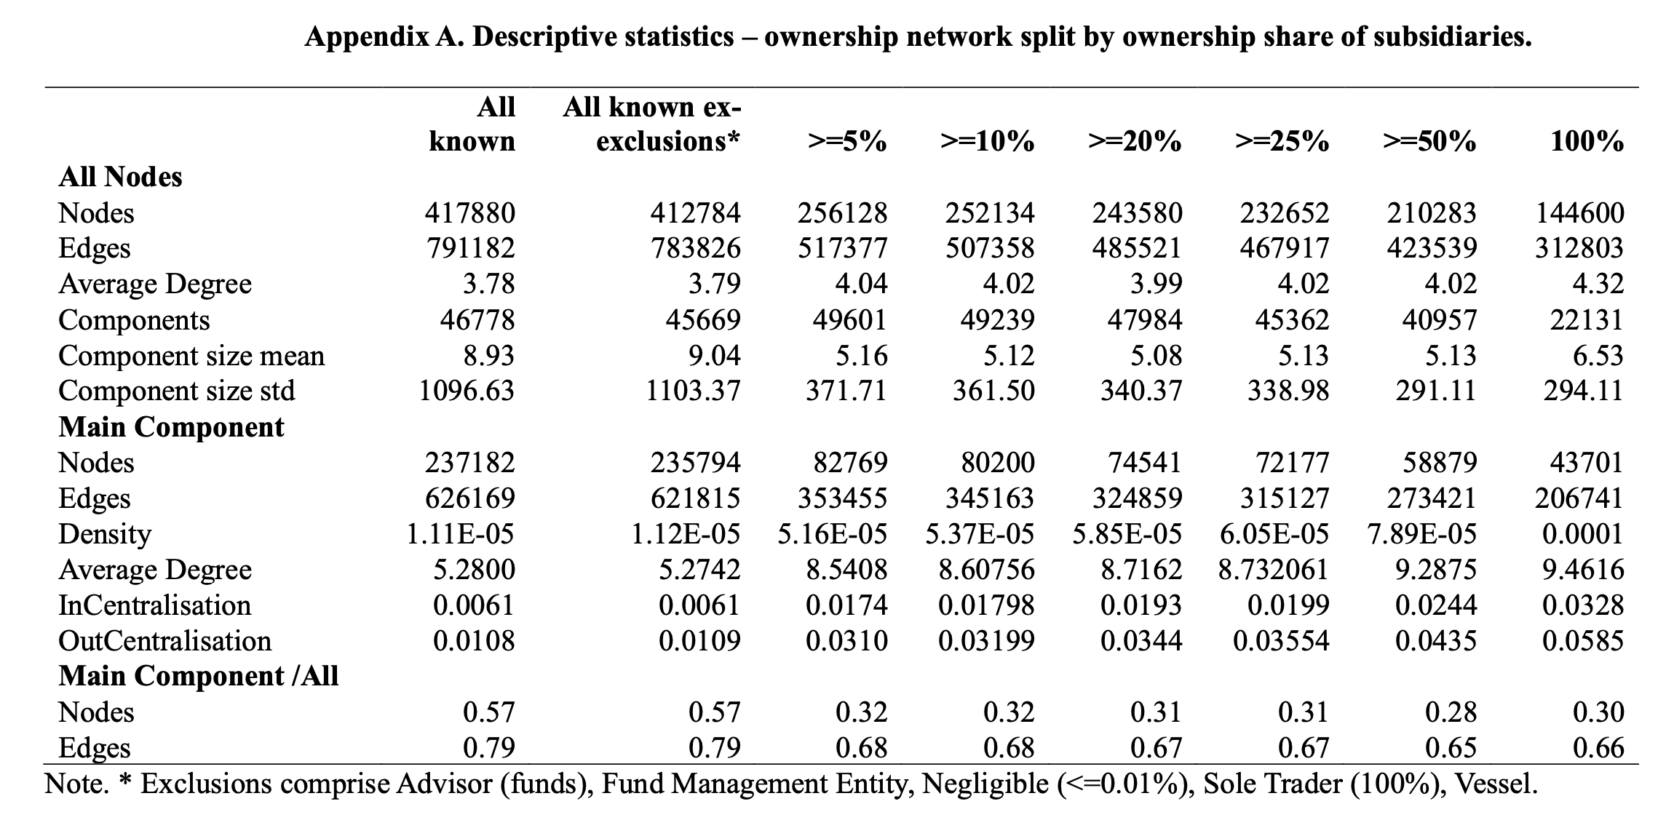
Methodology – variables (i)
Descriptive statistics – ownership network split by ownership share of subsidiaries

Slide 14
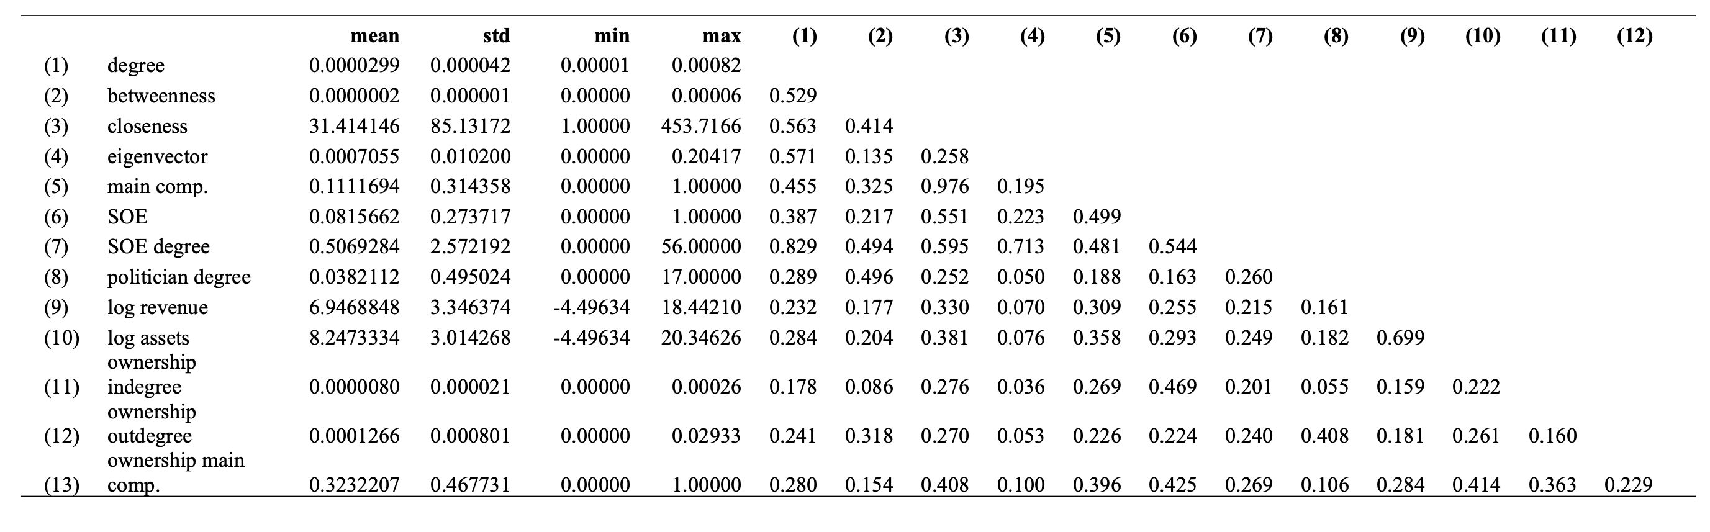
Methodology – variables (ii)
Descriptive statistics and correlation among independent variables

Slide 15
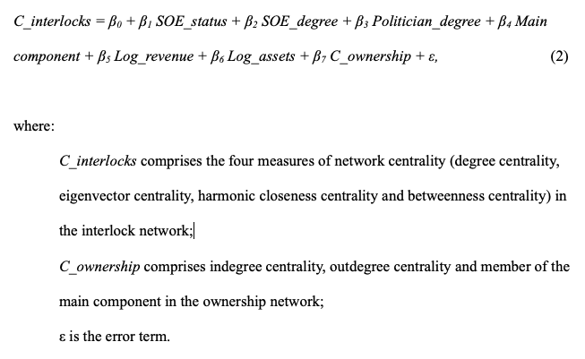
Methodology – data analysis
Cohesion measures of networks for scale and concentration
Visualizations of main component of each
Visualized Louvain clustering within the main component and SOEs
OLS regressions:

Slide 16
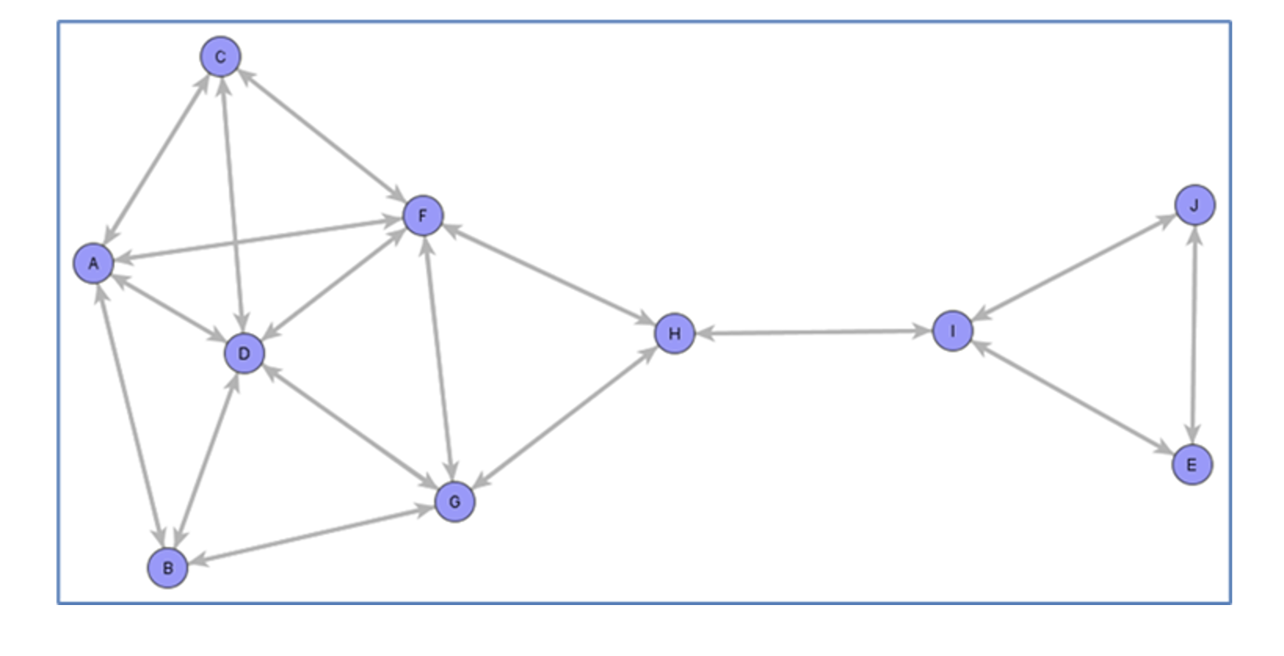
Illustration of different positions in the network

Slide 17
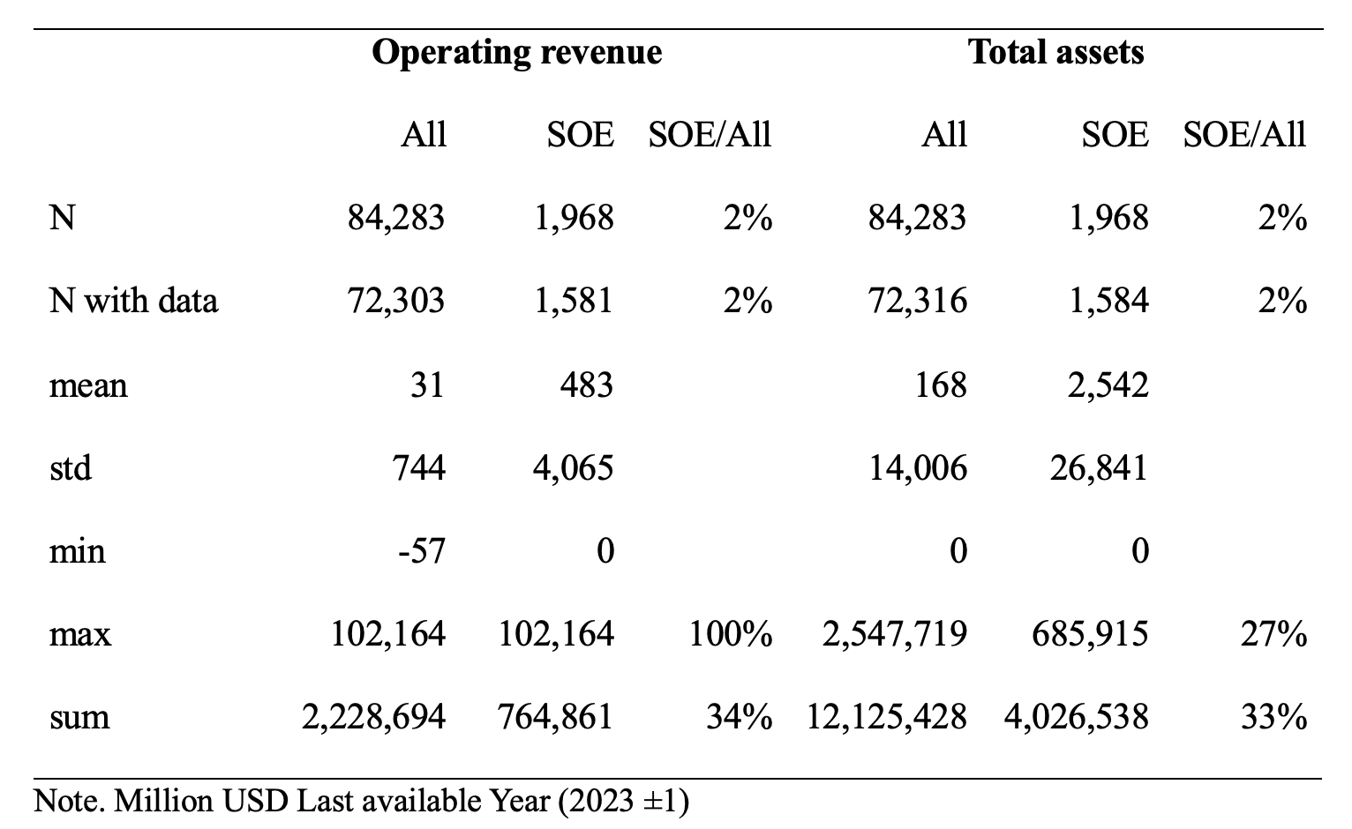
Findings
Financial statistics of Russian firms with subsidiaries
Among firms with subsidiaries, SOEs account for 2% of all owned subsidiaries in Russia but 33% of revenue and assets.
Mean SOE revenue and assets are 15x larger than firms in general with a smaller proportional standard deviation.
H1. Individual SOEs and their subsidiaries are likely to account for much more Russian economic activity than those commanded by private conglomerates. ✓

Slide 18
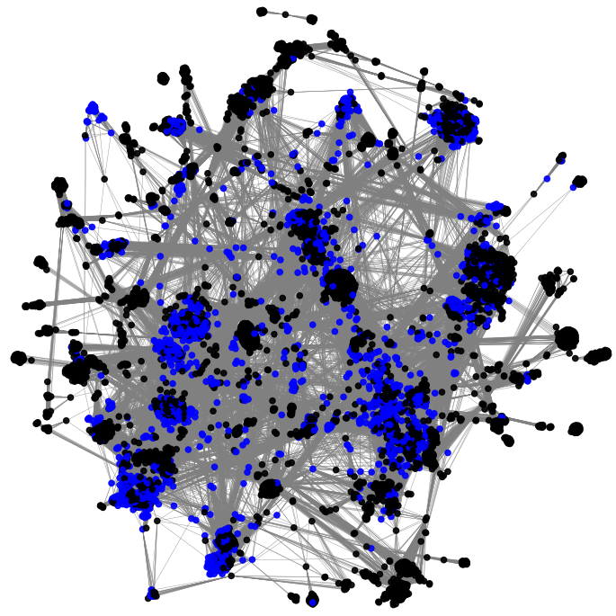
Findings
Russian corporate ownership network: largest component
Nodes within the largest component with a degree of 10 or more (аorceatlas2 layout)
Legend: Blue circles - SOEs; grey circles non-SOEs, lines ownership.
All SOEs (coloured blue) are located entirely within the main component, accounting for 13.5 percent of these 80,200 firms.
Financially, SOEs account for 78 percent of revenue and 80 percent of assets within the component, greatly concentrating their potential influence among these firms
H2. In the ownership network involving both SOE and private sector joint ventures, SOEs will command much more economic activity than private firms. ✓

Slide 19
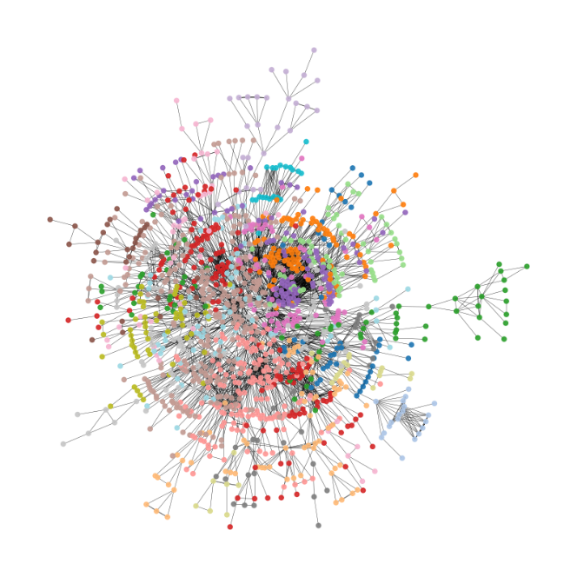
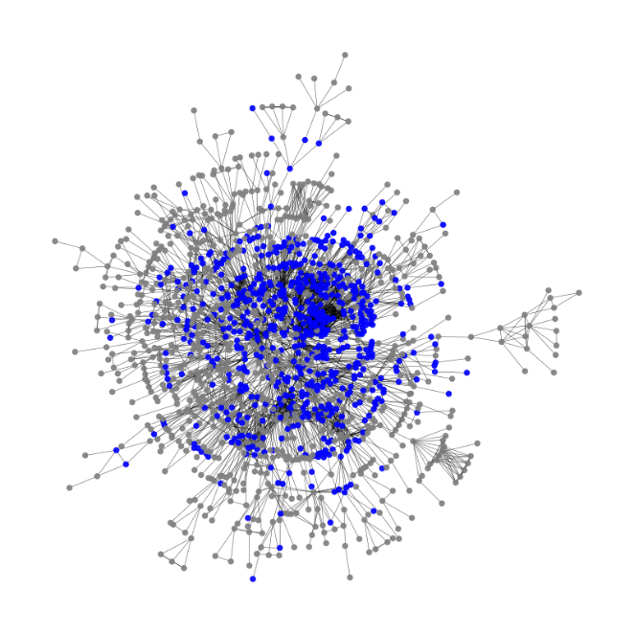
Russian board interlock network - largest component
Circles represent firms, lines represent shared directors.
In (A) each color represents a distinct Louvain cluster. Kamada Kawai layout.
In (B) blue circles represent SOEs, grey circles represent non-SOEs.
Comparing the positions of SOEs with Panel B, suggests that SOEs (A) are clustered in different interaction patterns.
(A) Louvain clusters
(B) SOEs
H2. In the ownership network involving both SOE and private sector joint ventures, SOEs will command much more economic activity than private firms. ?

Slide 20
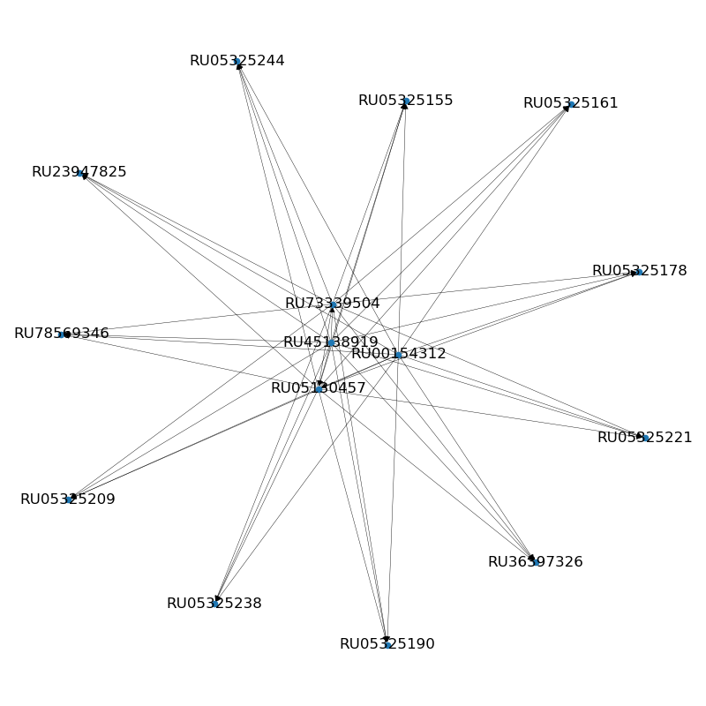
Immediate ownership holdings of Gazprom Gazoraspredeleniye Orenburg (RU05130457)

Slide 21
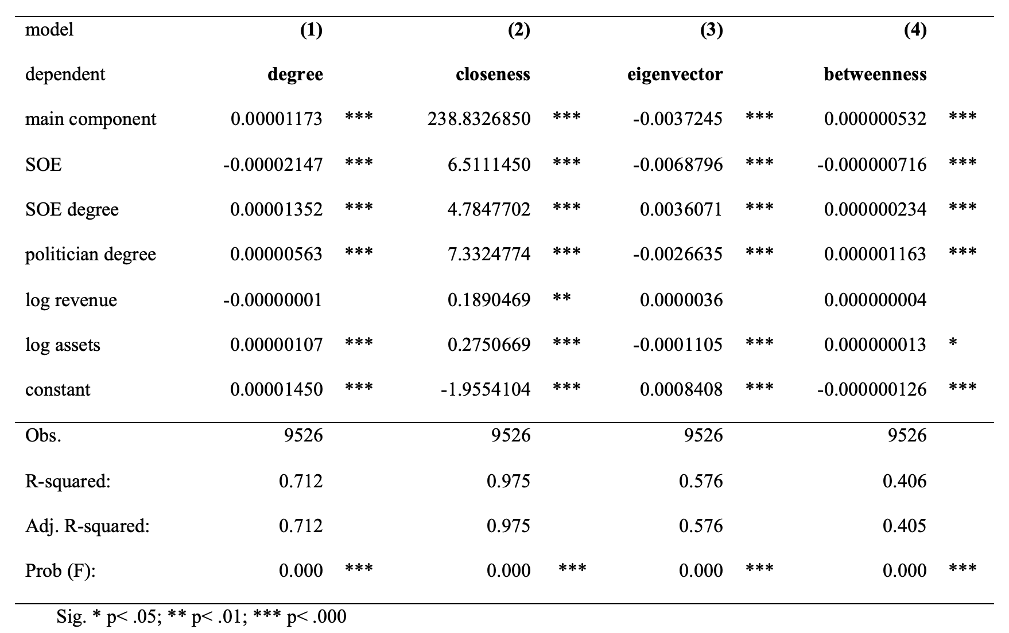
Russian director interlock position – OLS regression results, models 1-4
H5a ✗ H5b ✓
H4 ✓
H4 ✗
H5a ✗ H5b ✓ H7 ✗

Slide 22
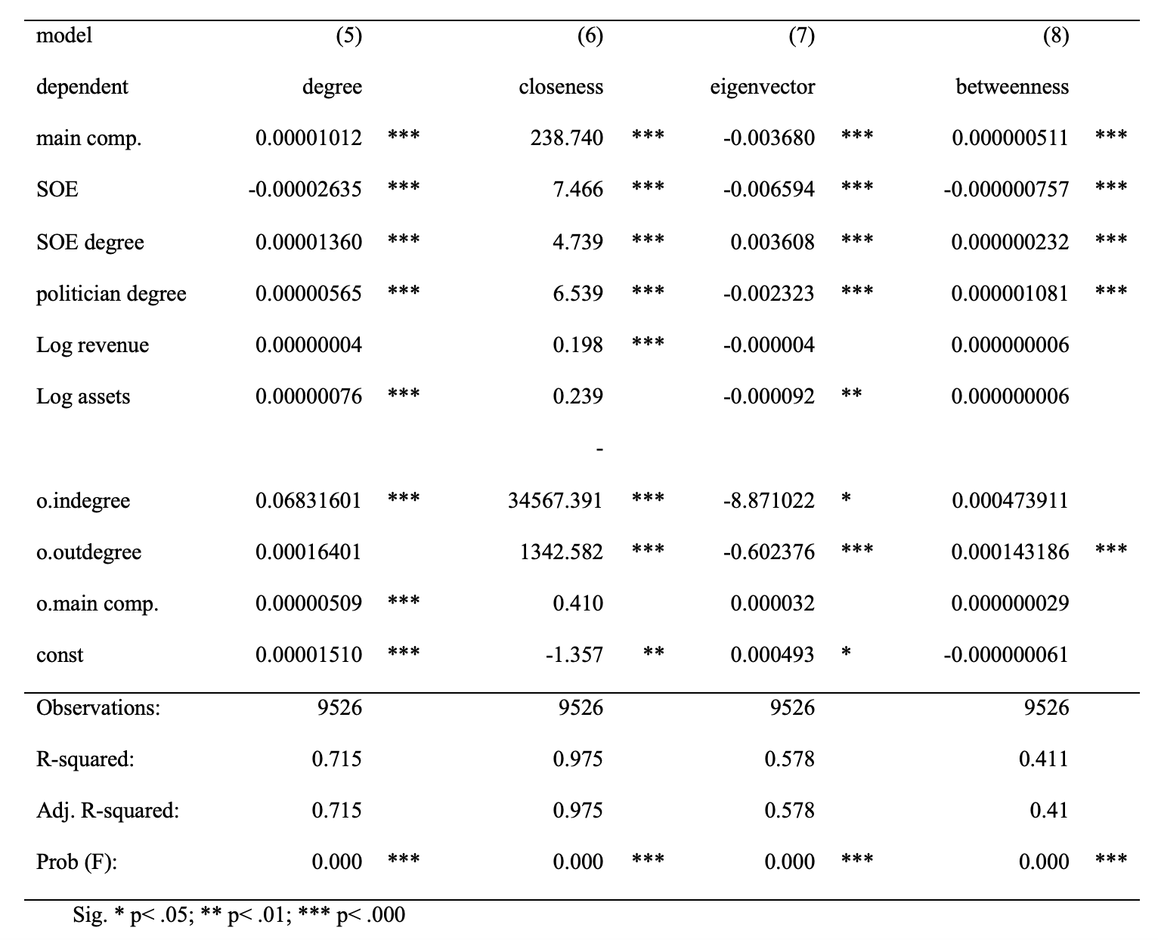
Russian director interlock position – OLS regression results, models 5-8
H5a ✗ H5b ✓
H4 ✓
H4 ✗
H5a ✗ H5b ✓ H7 ✗

Slide 23
In summary
H1 | Individual SOEs and their subsidiaries are likely to account for much more Russian economic activity than those commanded by private conglomerates | ✓
H2 | In the ownership network involving both SOE and private sector joint ventures, SOEs will command much more economic activity than private firms | ✓
H3 | The longer the chain of ownership through levels of subsidiaries, the more likely are vertical board interlocks between higher and lower-level subsidiaries | not tested
H4 | SOEs are likely to concentrate their directors in the Russian board interlock network at the centre of the network and primarily connect with highly-connected others | ✓
H5a | SOEs are likely to spread their directors to a wide range of private firms. | ✗
H5b | Private firms are likely to spread their directors to a wide range of private firms. | ✓
H6 | SOEs are likely to be more central than private firms within Russian board interlock network in clusters of firms with complementary resources | not tested
H7 | The most central SOEs in the board network will have more political directors | ✗

Slide 24
Conclusions
Russian state’s influence is disproportionately large relative to the number of SOEs.
Although SOEs comprise only 2% of firms with subsidiaries, they account for a third of the operating revenue and total assets and 80% of both in the main component of the ownership network, underscoring the outsized economic power that the state wields through direct ownership of key enterprises.
The Russian state extends its influence beyond direct ownership.
The presence of interlocking directorates, wherein directors are shared between SOEs and non-SOEs, creates additional channels of state control.
Particularly noteworthy is the role of former politicians who serve on the boards of these firms, further intertwining state interests with private-sector operations.
By identifying and analysing the "politician degree" in the director interlock network, this research uncovers how political connections facilitate the flow of influence both ways, from state to business and vice versa.
In Russia, the SOE degree strengthens formal control in state-owned firms but also extends additional control to non-SOEs.
This dual mechanism reveals how interlocking directorates not only reinforce the state’s direct control of its own enterprises but also create a secondary layer of influence over private entities, thereby blurring the boundaries between the public and private sectors.

Slide 25
Contributions
By using SNA to map these relationships, this research makes a methodological contribution, demonstrating how network-based approaches can reveal hidden layers of power and influence within corporate structures.
This study extends the concept of Network State Capitalism (Grätz, 2014) as the predominant form of economic organisation in Russia, by focusing on how state influence is embedded not only in ownership structures but also in corporate governance networks.
This extends the understanding of how formal corporate mechanisms of state control operate simultaneously with the private sector, offering a more comprehensive picture of state-business relations in Russia.

Slide 26
Thank you for your attention!
Sergey Sosnovskikh, PhD
s.sosnovskikh@mmu.ac.uk

