Slide 1
Reframing Assessment: Challenging Sector Policy Constraints Through Creative Practice
David Yarwood
Lecturer in Business Education | Manchester Metropolitan University

Slide 2




The Problem Space
Notes:
"From exam robots to intrapreneurs"
“I spent 18 years in secondary teaching. Assessment was terminal. Now I work with degree apprentices and see the creative competencies employers want. What happens in the middle is the tricky bit.”

Slide 3
Why Start with Policy?
Policies frame the assessment culture
Discourses are powerful, they shape what is possible
Notes:
“My DEE project is about developing creative, authentic practice—but we need to understand the barriers first.”

Slide 4
Research Overview
"Assessment policies are not neutral - they shape the conditions for or against innovation.”
Compliance & Standardisation
Managerialism in Assessment
Pressure from AI & Rankings
Neoliberal Influences
Notes:
Assessment policies in UK universities have become tightly bound up with managerial control, standardisation, and compliance. They claim to protect standards — but may unintentionally suppress innovation.
As a former secondary teacher and now a university lecturer, I’ve seen how institutional processes often override good pedagogy.
We know assessment drives learning. But what happens when policy prioritises efficiency, deadlines, and misconduct detection over creativity, agency, and process?
This study set out to explore that — by analysing policy documents from five universities using Fairclough’s Critical Discourse Analysis, I examined how language constructs power, risk, and compliance in assessment.”

Slide 5
What the Literature Tells Us
Assessment = Power Not just admin — assessment policies regulate student and academic behaviour (QAA, Fairclough, Raaper).
Barriers to Innovation Risk aversion, bureaucracy, and standardisation block creative assessment models (Deneen & Boud, 2013; Maclaren, 2012).
Managerialism & Performativity Emphasis on measurable outcomes embeds control, not flexibility (Evans, 2013; Raaper, 2017).
AI: A Double-Edged Sword Potential for feedback and personalisation, yet mostly framed through surveillance and misconduct prevention (Ardito, 2024; Smolansky et al., 2023).
Notes:
“This literature review sets the stage for the study. First, assessment in HE isn’t neutral — it’s a form of institutional power. Policies shape behaviour and reflect broader systems of control, often aligning more with bureaucratic stability than educational flexibility.
Second, despite widespread support for creative and student-centred assessment methods — from ungrading to phenomenon-based learning — universities are often risk-averse. Innovation gets blocked by policies designed to ensure efficiency and consistency.
Third, managerialism dominates. As Raaper and others point out, neoliberal values of excellence, accountability, and control are embedded in policy language.
Finally, AI brings a new layer. While it could support learning, institutions mostly frame it as a compliance tool — reinforcing, not disrupting, existing norms.
Taken together, these insights highlight the discursive and structural barriers assessment policies create, even when pedagogical innovation is a priority.”

Slide 6
Research Questions
To what extent do university assessment policies inhibit the implementation of innovative assessment methods?
Do formal policy texts explicitly restrict innovation, or do broader institutional discourses play a greater role in sustaining these constraints?
Notes:
“This research grew from my lived experience — trying to implement creative assessment methods and repeatedly running into walls. I started asking: is it really just the policy text? Or is it also how those policies are interpreted and embedded in wider institutional cultures?
These two questions form the basis of the research — examining both the text and the discourse surrounding it.”

Slide 7
Research Framework & Approach
Fairclough’s Critical Discourse Analysis (CDA)
Three lenses of analysis:
Textual – the language of assessment policy (modality, tone, vocabulary)
Discursive Practice – how policies are produced, circulated, and interpreted
Social Practice – links to broader ideologies like managerialism and risk aversion
Notes:
“I used Fairclough’s CDA to dig into how policy language both reflects and reinforces institutional values. This meant looking at the micro level — the words themselves — but also zooming out to understand how these policies function in practice and in wider systems of power.”

Slide 8
Sample & Methodology
Sample:
Policy documents from 5 diverse UK universities, selected for institutional variety:
Pre- and post-92 institutions
Research-intensive and teaching-focused
Distance and widening-participation providers
Method:
Inductive coding aligned to Fairclough’s 3D CDA
Thematic analysis following Braun & Clarke (2017)
Notes:
“This wasn’t about naming and shaming. Instead, I selected a range of universities to capture different policy styles and pressures. The dataset includes assessment regulations, guidance documents, and strategy papers.
Using NVivo helped me code themes across the documents — which eventually clustered into the four key patterns I’ll show you shortly.”

Slide 9
Researcher Lens
Practitioner + Researcher = Lived Insight
Barriers to innovative assessment
Cultural resistance to alternative models
Navigating policy as both constraint and opportunity
Disclaimer! This is not a critique!
Notes:
I approach this study from the dual perspective of practitioner and researcher. My background includes extensive experience trialling innovative assessments—such as portfolios and ungrading—particularly within apprenticeships and work-based learning. However, I’ve consistently come up against challenges rooted not just in implementation, but in the policy environment surrounding assessment.
These experiences prompted me to explore how assessment policy language itself might be shaping what we think is possible. I use Fairclough’s Critical Discourse Analysis to unpick how discourse around standardisation, efficiency, and risk management creates structural constraints.
I want to stress that this research is not a critique of any individual institution or colleague. All university names are anonymised. The focus is firmly on how policies across the sector, as texts, reflect broader discursive norms and power structures. The aim is to understand these constraints better—so we can start to rethink them.

Slide 10
Findings
Revealed through Critical Discourse Analysis:
Efficiency
Surveillance
Standardisation
Pastoral Power
Notes:
“From the documents, four consistent and powerful themes emerged. These aren’t just surface observations — they reflect deeper discursive patterns that shape how assessment is governed and practiced across different institutions. They tell a story of constraint — how innovation gets boxed in by institutional priorities.”

Slide 11
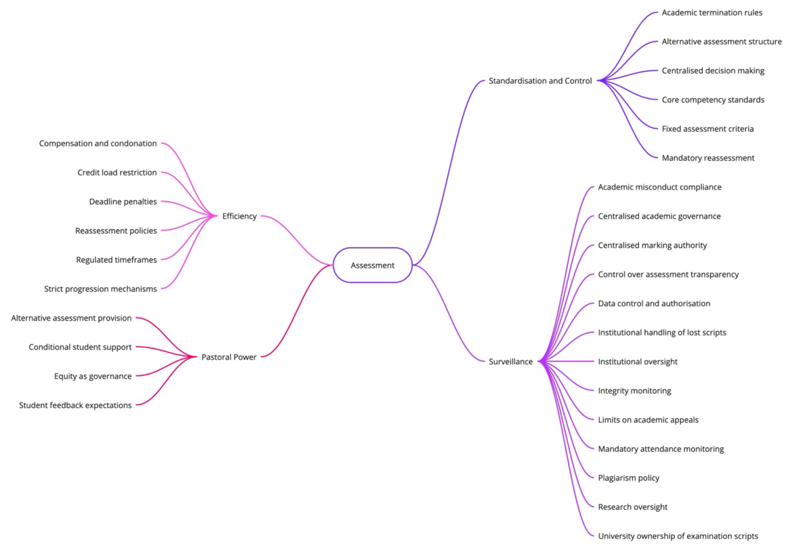
Findings

Slide 12
Theme 1: Efficieny
Key Messages
Policies emphasise deadlines, capped grades, limited reassessment
Students framed as compliant subjects
Staff positioned as administrators of policy
Institutional language embeds efficiency over flexibility
Policy Language Examples
"Late submissions will receive a maximum capped grade of 40%." – Institution A "Only one reassessment opportunity per failed module." – Institution D
Notes:
“This first theme — efficiency — runs deep across the institutions. Assessment policies use highly structured language to emphasise deadlines and administrative control, with clear penalties for deviation. For example, Institution A caps late submissions at 40%, while Institution D allows just one reassessment.
From a discourse perspective, this language transforms both students and staff. Students are cast not as curious learners, but as rule-followers. Academics are framed less as educators and more as enforcers of policy. And if you look at the text frequency analysis — words like ‘requirements’ and ‘submission’ dominate.
In terms of broader practice, this is part of a much wider discourse — one that values predictability and risk management. But in doing so, it limits scope for creativity, iteration, or failure-as-learning. Efficiency becomes a form of control, pushing assessment toward the administrative and away from the pedagogical.”

Slide 13
Theme 2 - Surveillance
Key Messages
Plagiarism detection and control over student work are central
Students framed as potential violators
Staff seen as regulators, not educators
Surveillance reinforces efficiency and standardisation
Policy Language Examples
"All student work will be subject to plagiarism detection software." – Institution C "Examination scripts remain the property of the university." – Institution E
Notes:
“The second theme is surveillance — not just in the traditional sense, but as a discursive tool of control. Policies consistently highlight technologies and procedures that position student work as needing monitoring. Institution C makes this explicit through its use of plagiarism detection software and integrity panels. Institution E even withholds exam scripts, reinforcing the university's ownership of student output.
The language here is highly regulatory. Words like ‘policy’, ‘regulations’, and ‘board’ dominate, creating a compliance-heavy tone. This discursive environment constructs students not as trusted learners, but as individuals under suspicion — potential rule-breakers. At the same time, it reframes the academic role: educators become enforcers.
From a CDA perspective, this reinforces the institutional logic of risk management and accountability. It aligns tightly with the themes of efficiency and standardisation — creating an ecosystem in which innovation is not only unsupported, but systematically constrained. Surveillance, then, is not just about plagiarism — it’s about maintaining institutional control through discourse.”

Slide 14
Theme 3 – Standardisation and Control
Key Messages
Policies promote uniform grading and central moderation
Emphasis on measurability over nuance
Staff framed as technicians, students as outputs
Standardisation interacts with surveillance and efficiency
Policy Language Examples
"All assessments must be marked out of 100..." – Institution B "Moderation processes ensure consistency..." – Institution A
Notes:
“The third theme is standardisation and control. Here, we see policies enforcing strict grading structures — for example, Institution B’s mandate that all assessments be marked out of 100 with fixed boundaries. Institution A echoes this with centralised moderation designed to ensure examiner conformity.
This isn’t just administrative convenience. The language — ‘marks’, ‘credits’, ‘classification’ — shows a deep institutional preference for what’s measurable, comparable, and controlled. But this is problematic, especially in disciplines like the humanities, where interpretive judgement matters. A fixed numerical structure can flatten academic nuance.
Discursively, these policies position students as standardised outputs, reducing learning to performance against rigid metrics. Lecturers are framed as implementers of these systems — more technician than teacher — applying rules rather than exercising pedagogical judgement.
From a CDA perspective, standardisation reinforces the themes of efficiency and surveillance. It enables control — making it easier to monitor, audit, and manage — but it also limits innovation and creativity. It creates a culture where risk is avoided, not embraced, and where autonomy is lost beneath procedural uniformity.”

Slide 15
Theme 4 – Pastoral Power
Key Messages
Student support is conditional, not unconditional
Policies emphasise formal approval and bureaucratic processes
Academics framed as gatekeepers, not mentors
Pastoral care intersects with efficiency, surveillance, and standardisation
Policy Language Examples
"Extensions... subject to formal evidence submission." – Institution D "All decisions final" – Institution C
Notes:
“Our final theme is Pastoral Power. At first glance, this seems like the ‘softer’ side of assessment — policies about extensions, special considerations, and student support. But a deeper analysis shows this support is tightly regulated.
For instance, Institution D allows extensions only with formal evidence, and Institution C requires a panel to review and finalise support decisions. There’s a clear emphasis on bureaucracy and oversight. Support becomes conditional — a concession rather than a pedagogical right.
Textually, we see frequent mentions of ‘requirements’, ‘students’, and ‘academic’ — reinforcing the idea that students are governed by procedures, not trusted as autonomous learners. Academics, in turn, are cast as procedural enforcers — not people empowered to make flexible or compassionate decisions based on context.
In CDA terms, this theme connects strongly with the other three. Pastoral care becomes another mechanism for efficiency, surveillance, and standardisation. Requests for flexibility are monitored, audited, and regulated.
At the social level, this contributes to a culture where care is conditional and tightly controlled — which ultimately limits the kind of student-centred innovation we want to see in assessment. It reinforces a compliance mindset rather than a culture of trust and genuine support.”

Slide 16
Interrelationship of Themes
Efficiency + Surveillance: Submission deadlines + plagiarism checks = compliance-focused culture
Standardisation + Efficiency: Uniform criteria = streamlined but rigid systems
Pastoral Power: Appears flexible, but is conditional and procedurally controlled
Combined Effect
A dominant institutional discourse that prioritises:
Managerial accountability
Predictability
Control over creativity, autonomy, and pedagogical innovation
Notes:
“These four themes don’t stand in isolation — they’re deeply interconnected and reinforce each other.
Take Efficiency and Surveillance: policies aimed at streamlining assessment — like tight deadlines and controlled reassessments — are supported by surveillance tools like plagiarism detection software. These mechanisms work together to embed a culture of compliance and monitoring.
Standardisation joins the mix by reinforcing uniform criteria and marking schemes. This makes things easier to manage, yes — but it also restricts innovation. There’s little room to flex or adapt.
Now Pastoral Power might seem like the counterpoint — offering flexibility through extensions and support. But on closer inspection, these are still tightly controlled. Policies require formal evidence and are subject to panel review. It’s support, but on institutional terms — still embedded in a culture of compliance.
All of this adds up to a dominant discourse — one where accountability, consistency, and control are privileged above all. It becomes very difficult for innovation or flexibility to take root in this environment, because the language of the policy — and the power structures it reflects — doesn’t allow for it.
This is exactly what Fairclough helps us to see: not just what policies say, but how the way they say it actually shapes what’s possible in practice.”

Slide 17
Discussion – What the Findings Mean
Assessment Policies as Discursive Mechanisms
Not neutral - they construct compliance
Fairclough’s CDA reveals how language enforces power structures
Interwoven Discourses
Efficiency + Surveillance = predictability > pedagogy
Standardisation marginalises disciplinary judgement
Pastoral Power appears supportive, but reinforces control
Constraints on Innovation
Policies frame innovation as risky or exceptional
AI currently framed as surveillance, not support
Discursive Change Needed
Shift policy language to support creativity, flexibility, and autonomy
Embed pedagogy into policy - not just procedure
Notes:
“In this section, I want to highlight what the findings actually mean in practice.
The first takeaway is that assessment policies aren’t just dry admin documents — they’re discursive tools that shape how we’re expected to teach and assess. Using Fairclough’s Critical Discourse Analysis, I’ve shown how the language itself prioritises institutional control over educational creativity.
The four themes — Efficiency, Surveillance, Standardisation, and Pastoral Power — don’t operate independently. They reinforce each other to create a compliance-focused environment. Deadlines and grade capping push efficiency; plagiarism software normalises surveillance; and standardisation erodes academic judgement in favour of uniformity.
Even when policies offer flexibility, like extensions or mitigating circumstances, it’s always conditional — subject to panels, evidence, and institutional gatekeeping. This is what Fairclough would call pastoral power — it looks supportive but reinforces the same control structures.
These constraints directly block pedagogical innovation. Ideas like phenomenon-based learning, competency-based assessment, or ungrading — all of which empower students — struggle to gain traction because the policy discourse doesn’t make space for them.
One striking example is AI. Institutions are rushing to regulate it as a threat to academic integrity, but there’s little discourse about its potential to support formative learning. That imbalance mirrors how innovation is treated more broadly — as risky, rather than an opportunity.
So what needs to change?
The answer lies in shifting the discourse itself. We need to reframe assessment policies not as control mechanisms, but as pedagogical tools — flexible, creative, and aligned to disciplinary expertise. That means rewriting the policy language, yes — but also embedding educators in the policy process itself.
In doing so, we don’t just change what the policies say — we change what kind of education becomes possible.”

Slide 18
Conclusions Key Insights
Assessment policies act as tools of governance
They constrain innovation through efficiency, surveillance, standardisation, and control
Discourses shape academic identities and practices, even without explicit mandates
Notes:
“As I wrap up, I want to draw attention to what this study ultimately tells us.
Assessment policies aren’t just guidelines — they are active mechanisms of institutional control. The discourses they embed—efficiency, surveillance, standardisation—form a web that restricts pedagogical freedom, shaping not only how we assess but how we think about assessment.
One key contribution of this research is highlighting how these discourses are so deeply embedded that even when the policies don’t explicitly prohibit innovation, they implicitly discourage it. The institutional culture they reinforce is one of caution, control, and risk-aversion.
So what can we do?

Slide 19
Recommendations
Reframe
Reframe AI as a formative tool, not surveillance
Decentralise
Decentralise governance - empower disciplinary autonomy
Pilot
Pilot alternatives: ungrading, portfolios, competency-based models
Engage
Engage staff in policy-making
Shift
Shift culture from punishment to trust & learning
Notes:
First, we need to reframe how AI is positioned in policy. Right now it’s locked into a surveillance role. Instead, policies should describe AI as a tool for formative feedback and adaptive learning.
Second, assessment governance needs decentralising. Academic faculties need more room to design assessment that aligns with their pedagogical approach, not a one-size-fits-all model.
Third, we need pilots. Trial innovative practices like ungrading, portfolios, or competency-based models in specific modules, then share what works.
Fourth, get staff involved in writing and revising policy. Academics bring classroom insight that policy teams often miss.
And finally, we need to shift the culture of assessment. That means less focus on punishment and detection, more on trust, learning, and reflection.
Looking forward, research should go beyond documents and look at how policies play out in practice. How do academics and students interpret, resist, or reshape them? And how do small innovations scale—or stall?
This research, in short, argues that real innovation in assessment requires more than good intentions. It requires changing the story institutions tell about what assessment is for—and who it should serve.”

Slide 20
Future Work
Preparing paper for peer-reviewed publication
Exploring pilot interventions
Adobe and video pitches
Google Design Sprint
Amplifying practitioner voice
DEE Project
Transition
Creativity - what about the knowledge?
https://yarwood.me/
Notes:
The next step for this work is to develop the analysis into a full academic paper for peer-reviewed publication. I’m currently preparing it for submission, focusing on how policy discourse constrains creativity and innovation in assessment across the sector.
Alongside this, I’m drawing these findings directly into my DEE project, which aims to support innovative, authentic assessment through a practical toolkit – now being developed under the name PrototypeED.
Rather than jumping straight to solutions, this research has helped me clarify the problem: the language of policy itself is a powerful force. So now, the toolkit will be designed to work with those constraints or challenge them where possible.
I’m also planning to pilot some of the ideas, including alternative policy language and small-scale assessment innovations, and gather feedback from educators on what’s feasible in real-world contexts.
Finally, a big part of this work is about amplifying the practitioner voice—especially those trying to do things differently in a landscape often defined by risk aversion and standardisation.

Slide 21
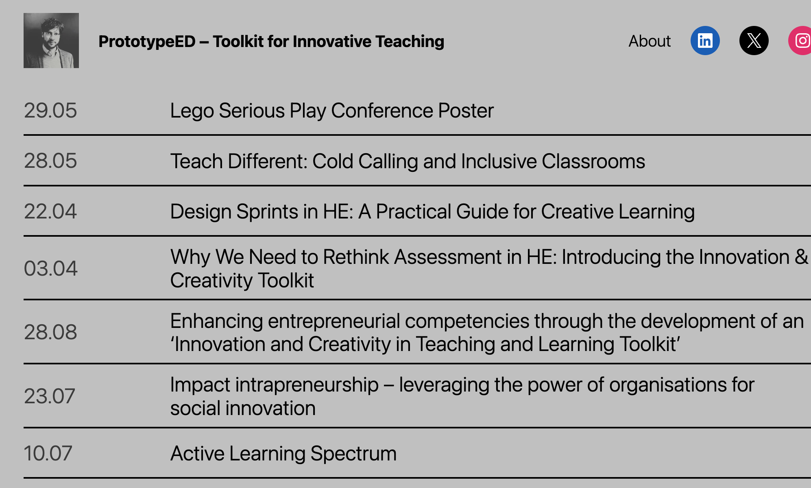
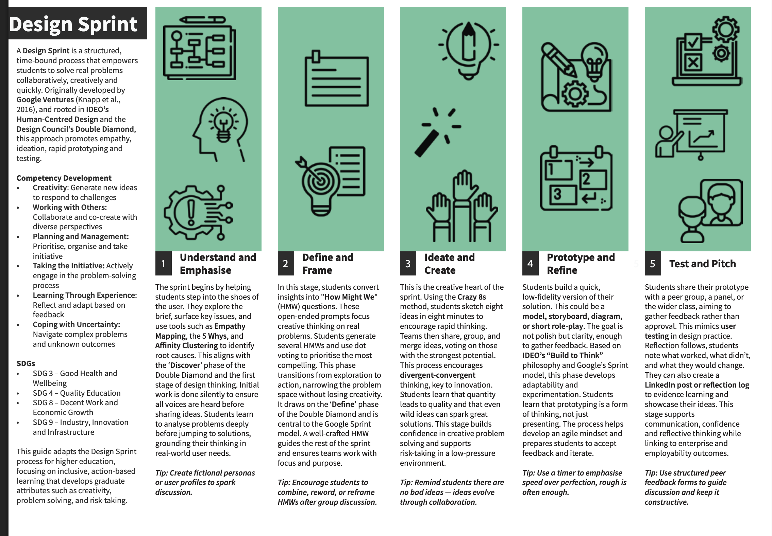
Adobe Playbook

Slide 22
List of References
Anjum, P. G., Choubey, P. J., Kushwaha, S. and Patkar, V. (2023) 'AI in Education: Evaluating the Efficacy and Fairness of Automated Grading Systems', International Journal of Innovative Research in Science,Engineering and Technology.
Ardito, C. (2024) 'Generative AI detection in higher education assessments', New Directions for Teaching and Learning.
Arthur, W. B. (1994) Increasing returns and path dependence in the economy. University of michigan Press.
Ashwin, P. (2020) Transforming University Education : A Manifesto. London, UNITED KINGDOM: Bloomsbury Publishing Plc.
Barbot, B., Besançon, M. and Lubart, T. (2011) 'Assessing Creativity in the Classroom', The Open Education Journal, 4, pp. 58-66.
Bearman, M., Dawson, P., Bennett, S., Hall, M., Molloy, E., Boud, D. and Joughin, G. (2017) 'How university teachers design assessments: a cross-disciplinary study', Higher Education, 74, pp. 49-64.
Bloxham, S. and Boyd, P. (2007) 'Developing Effective Assessment in Higher Education: A Practical Guide'.
Bok, H., Teunissen, P., Favier, R., Rietbroek, N., Theyse, L., Brommer, H., Haarhuis, J., Van Beukelen, P., Van Der Vleuten, C. and Jaarsma, D. (2013) 'Programmatic assessment of competency-based workplace learning: when theory meets practice', BMC Medical Education, 13, pp. 123-123.
Boud, D. and Falchikov, N. (2007) 'Developing assessment for informing judgement', Rethinking assessment in higher education: Routledge, pp. 191-207.
Brown, S. and Glasner, A. (1999) Assessment matters in higher education: choosing and using diverse approaches. McGraw-Hill Education (UK).
Clarke, V. and Braun, V. (2017) 'Thematic analysis', The journal of positive psychology, 12(3), pp. 297-298.
Czerniewicz, L., Mogliacci, R., Walji, S., Cliff, A., Swinnerton, B. and Morris, N. (2023) 'Academics teaching and learning at the nexus: unbundling, marketisation and digitisation in higher education', Teaching in Higher Education, 28(6), pp. 1295-1309.
Dannefer, E. and Henson, L. (2007) 'The portfolio approach to competency-based assessment at the Cleveland Clinic Lerner College of Medicine', Academic medicine : journal of the Association of American Medical Colleges, 82 5, pp. 493-502.
Deneen, C. and Boud, D. (2013) 'Patterns of resistance in managing assessment change', Assessment & Evaluation in Higher Education, 39.
Evans, C. (2013) 'Making sense of assessment feedback in higher education', Review of educational research, 83(1), pp. 70-120.
Fairclough, N. (2010) Critical discourse analysis : the critical study of language Oxon [England]: Routledge. Available at: https://www.taylorfrancis.com/books/e/9781315834368.
Foucault, M. and Faubion, J. D. (2002) Power. Penguin. Hughes, D., Lee, A., Tian, A., Newman, A. and Legood, A. (2018) 'Leadership, creativity,
and innovation: A critical review and practical recommendations', The Leadership Quarterly. Kohn, A. and Blum, S. D. (2020) Ungrading: Why rating students undermines learning (and
what to do instead). West Virginia University Press.
Lee, A., Legood, A., Hughes, D., Tian, A., Newman, A. and Knight, C. (2020) 'Leadership, creativity and innovation: a meta-analytic review', European Journal of Work and Organizational Psychology, 29, pp. 1-35.
Lonka, K. (2018) Phenomenal Learning from Finland. Edita. Maclaren, I. (2012) 'The Contradictions of Policy and Practice: Creativity in Higher
Education', London Review of Education, 10, pp. 159-172.
Montresor, S. and Vezzani, A. (2021) 'Financial constraints to investing in intangibles: Do innovative and non-innovative firms differ?', The Journal of Technology Transfer, 47, pp. 1- 32.
Moorhouse, B. L., Yeo, M. A. and Wan, Y. (2023) 'Generative AI tools and assessment: Guidelines of the world's top-ranking universities', Computers and Education Open, 5, pp. 100151.
QAA (2024) Assessment. Available at: https://www.qaa.ac.uk/the-quality-code/2018/advice- and-guidance-18/assessment# (Accessed: 17/11/24 2024).
Raaper, R. (2017) 'Tracing assessment policy discourses in neoliberalised higher education settings', Journal of Education Policy, 32(3), pp. 322-339.
Serdyukov, P. (2017) 'Innovation in education: what works, what doesn’t, and what to do about it?', Journal of research in innovative teaching & learning, 10(1), pp. 4-33.
Smolansky, A., Cram, A., Raduescu, C., Zeivots, S., Huber, E. and Kizilcec, R. (2023) 'Educator and Student Perspectives on the Impact of Generative AI on Assessments in Higher Education', Proceedings of the Tenth ACM Conference on Learning @ Scale.
Tidd, J. and Bessant, J. R. (2020) Managing Innovation: Integrating Technological, Market and Organizational Change. Wiley.
Torrance, H. (2017) 'Evidence, criteria, policy and politics: The debate about quality and utility in educational and social research'.
Torugsa, N. and Arundel, A. (2017) 'Rethinking the effect of risk aversion on the benefits of service innovations in public administration agencies', Research Policy, 46, pp. 900-910.

