Slide 1
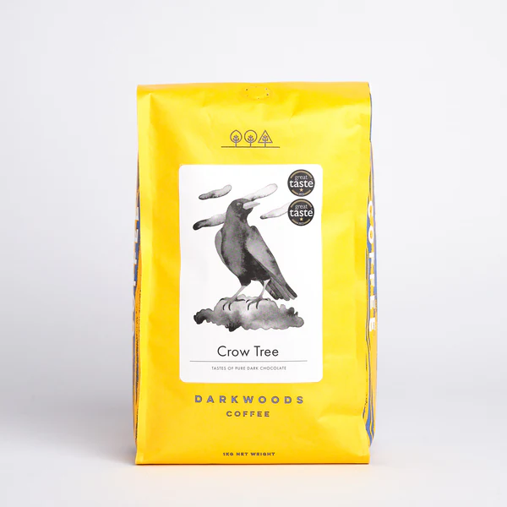
Brewing Impact Unexpected Business Lessons from Dark Woods Coffee
Dr John Lever
Reader, Sustainable and Resilient Communities

Slide 2
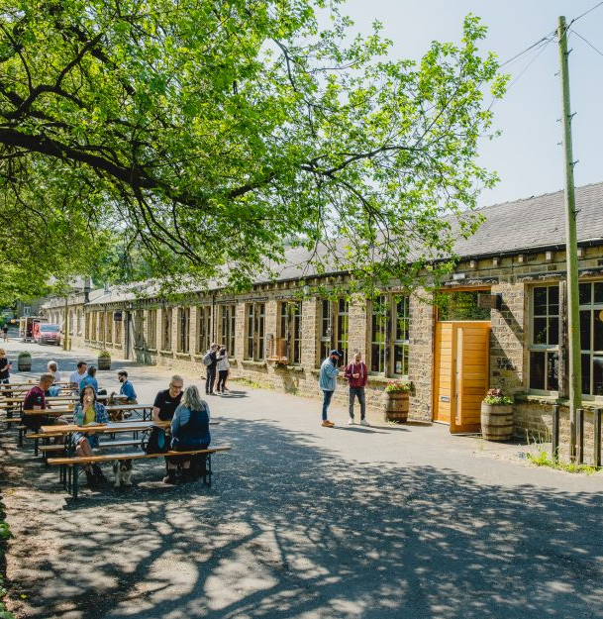
Set up a decade ago, Dark Woods is a speciality coffee roaster, Barista school, and pop-up café located in a refurbished Victorian textile mill in the West Yorkshire Pennines.

Slide 4
It is important… to know as much about the producers as we can. Who they are, how they operate, the standards they work to, the way they treat workers and their local environment. We will not knowingly buy from a producer who we think operates in a way which is harmful to their local community or environment.

Slide 5
Strengthening global coffee growing communities
Building strong relationships is at the heart of everything Dark Woods do!

Slide 6
One of the reasons that we do so well with a lot of the awards is because we get access to stuff that other people just don't get access to. And the reason we get that is because we've worked really hard on building strong relationships and friendships actually with… a lot of producers, which means… they send us stuff that they don’t send anybody else. And then we end up winning awards with it because it's so good.

Slide 7
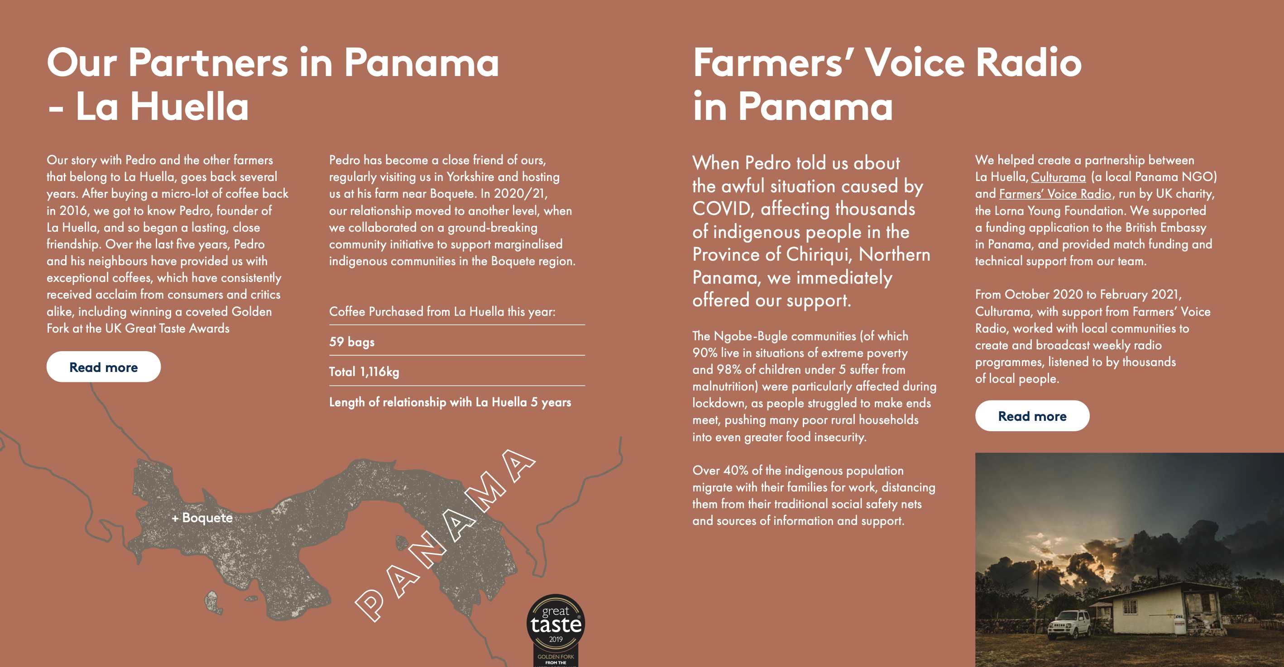
Relationship building is key to everything Dark Woods do!

Slide 9
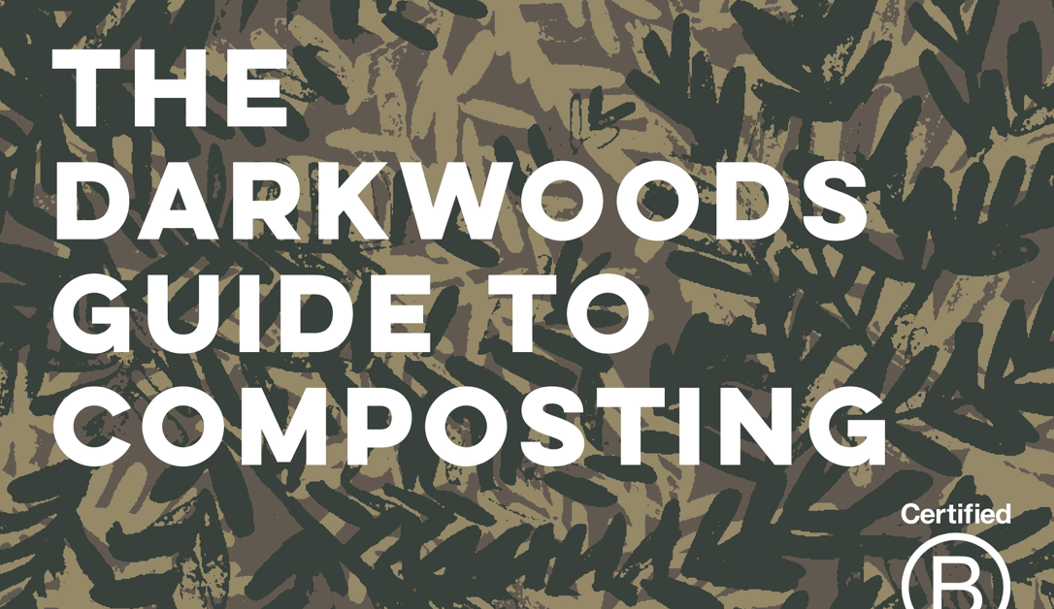
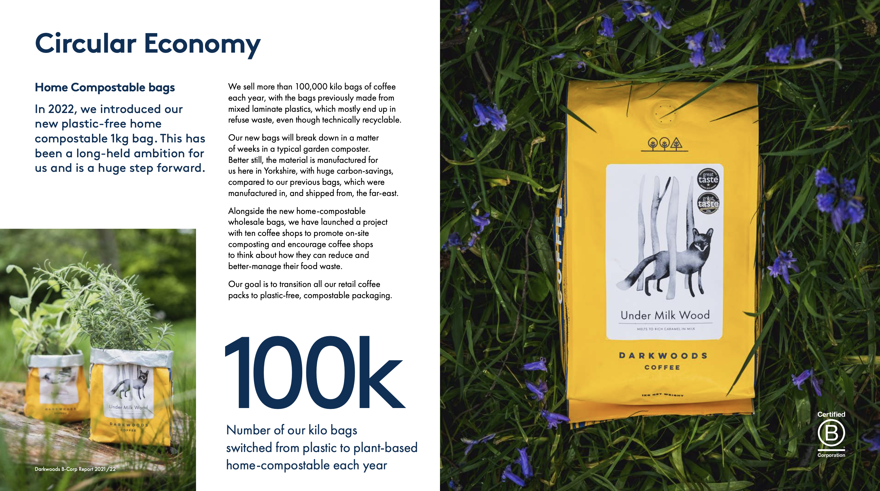
Strengthening local communities & supply chains

Slide 10
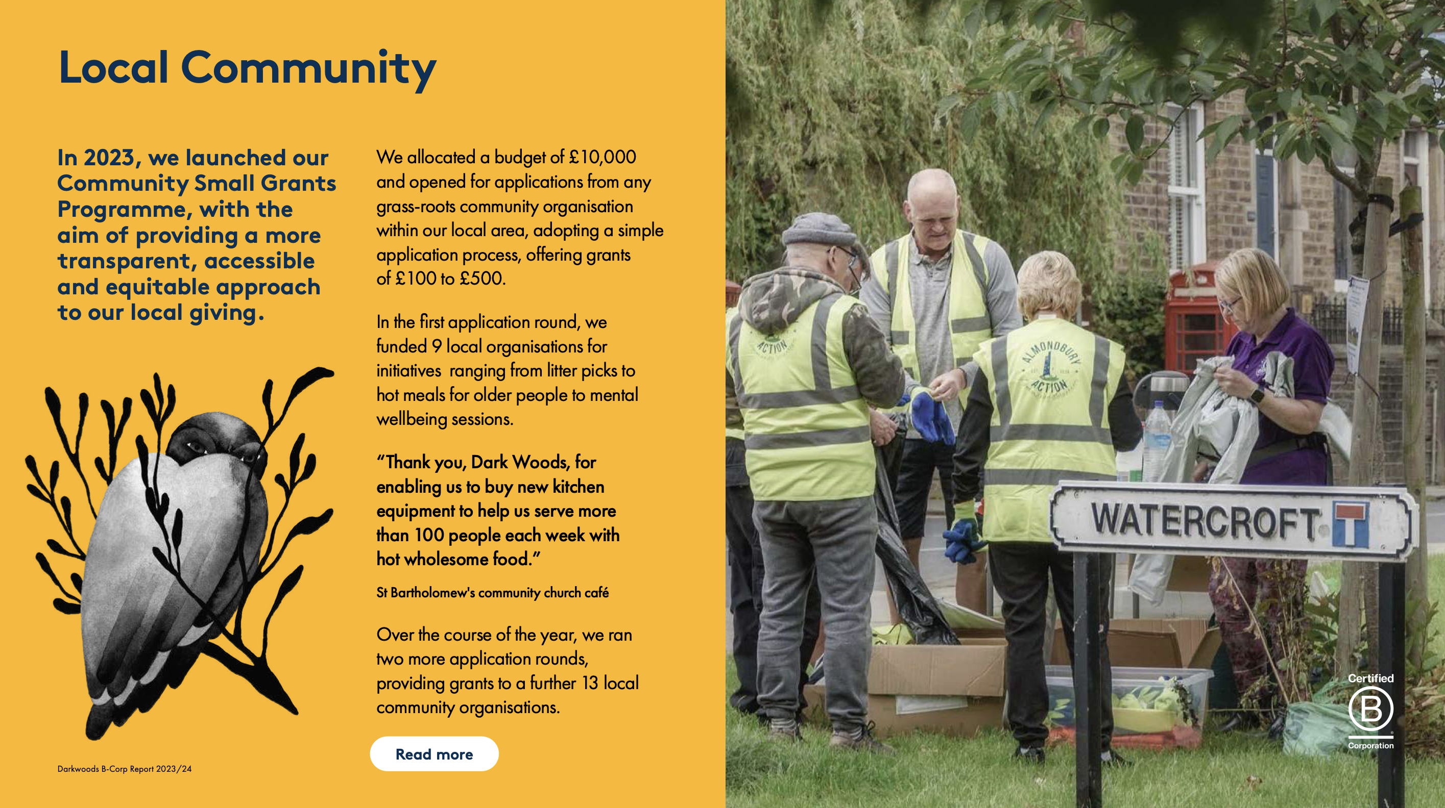
Community Small Grants Programme
Recent successful applications
litter picking
dementia clubs
cookers for food banks
compasses for scout groups
mental well-being sessions
Dark Woods are now setting up a foundation to bring all their community initiatives under one roof

Slide 11
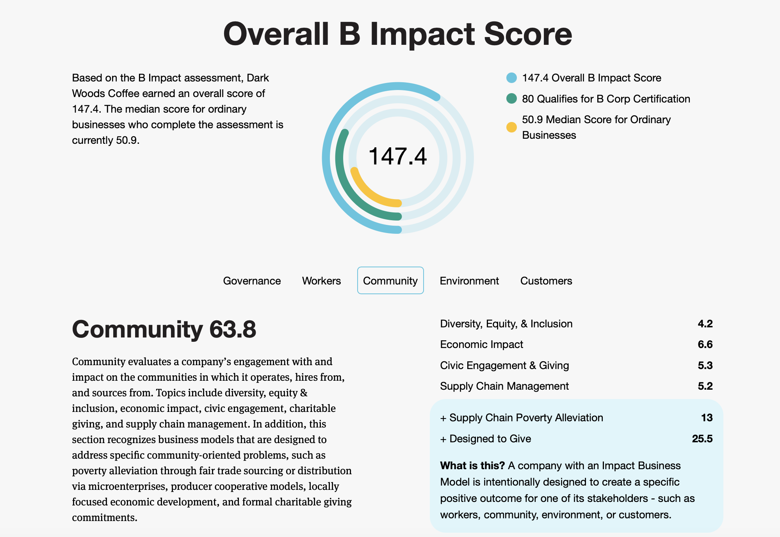
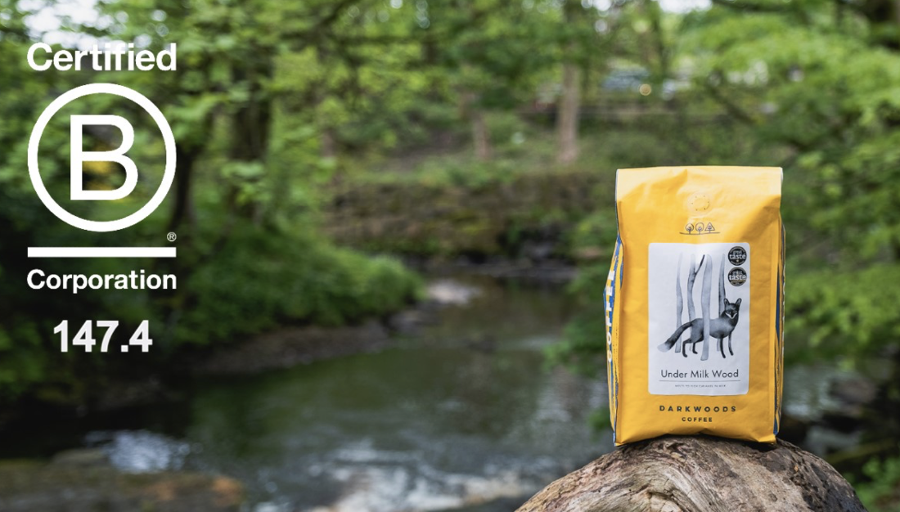
In 2020, Dark Woods were initially certified as a B Corp with a score of 99.6, making them one of the first certified B Corp coffee roasters in the UK. In 2021, they achieved an unverified score of 127.4. In 2024, Dark Woods became one of the highest scoring coffee B Corps in the world with a score of 147.4 As you can see, community constitutes the largest part of their score.

Slide 12
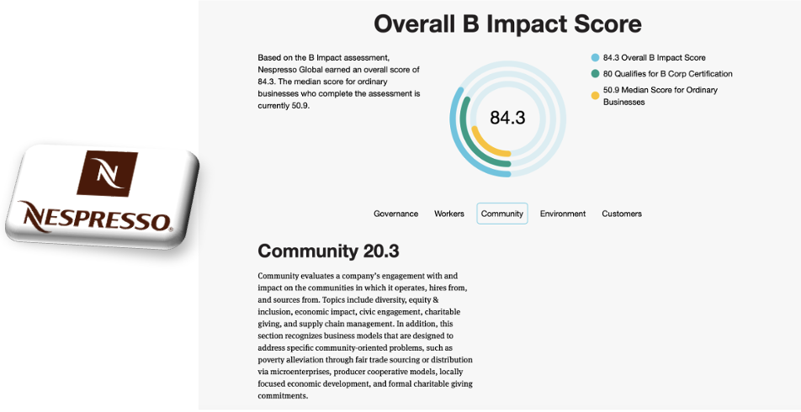
In 2020, Dark Woods were initially certified as a B Corp with a score of 99.6, making them one of the first certified B Corp coffee roasters in the UK. In 2021, they achieved an unverified score of 127.4. In 2024, Dark Woods became one of the highest scoring coffee B Corps in the world with a score of 147.4 As you can see, community constitutes the largest part of their score.

Slide 14
As researchers, we were interested in what motivated an already hugely successful coffee roaster to become a certified B Corp?

Slide 15
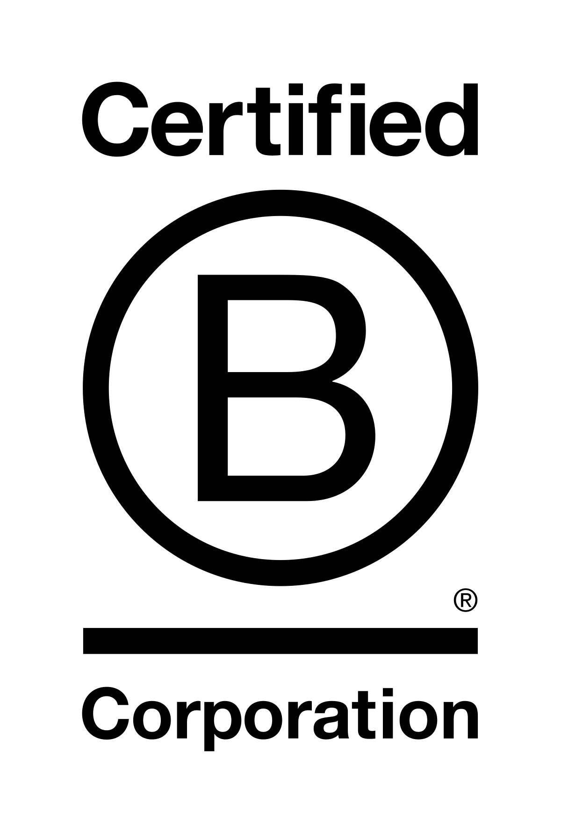
I have no doubt that, if we focussed solely on maximising profit, we would be much wealthier than we are – we would be using cheap beans, cheap packaging and pay low wages. We would simply shout about green messaging like many others do, but focus on making as much money as we can. We didn’t do that, and we still don’t do that.

Slide 16
We have the kind of Dark Woods way of doing things, but we haven't really articulated in a couple of sentences what that means. But we look at everything we do and just say that isn't how we do things or that is how we do things. I couldn't tell you what that means. But it isn't just about the way we buy coffee. It’s about the packaging. It's about the way we pay, it’s about all kinds of things…

Slide 17
