Slide 1



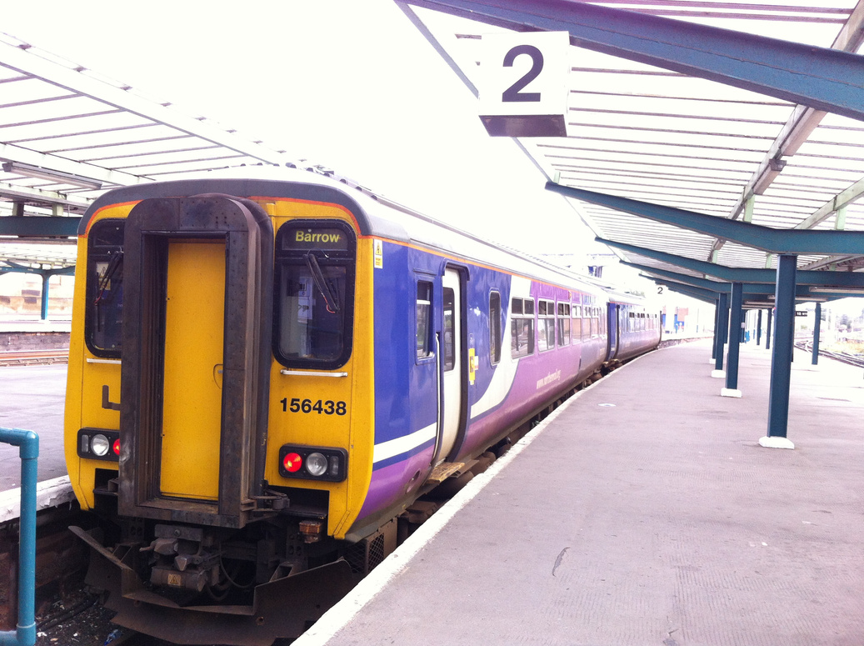



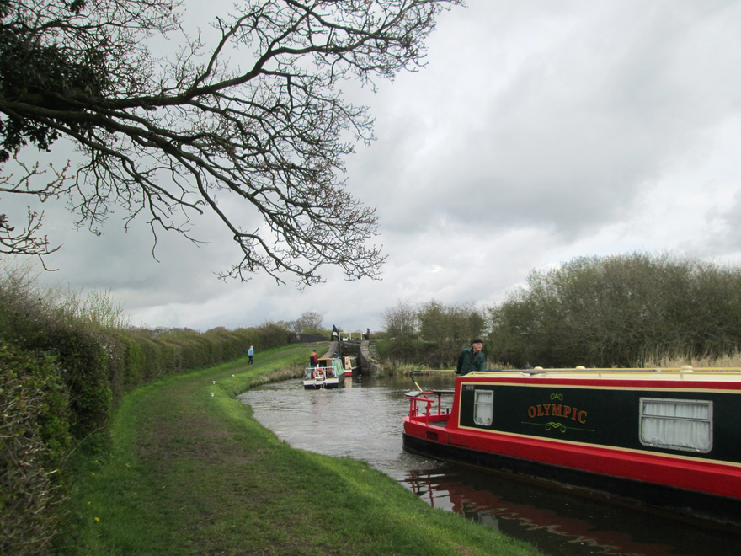


Conceptualising
Tourist
Skills
Ilze Mertena
Maarja Kaaristo
Manchester Metropolitan University

Slide 2


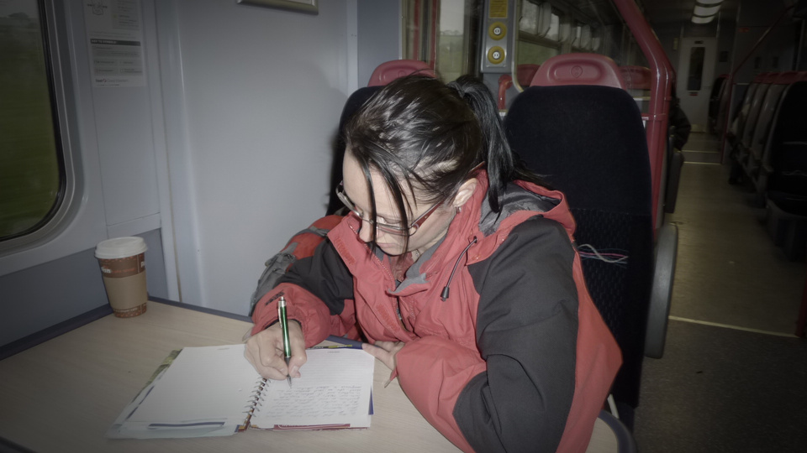
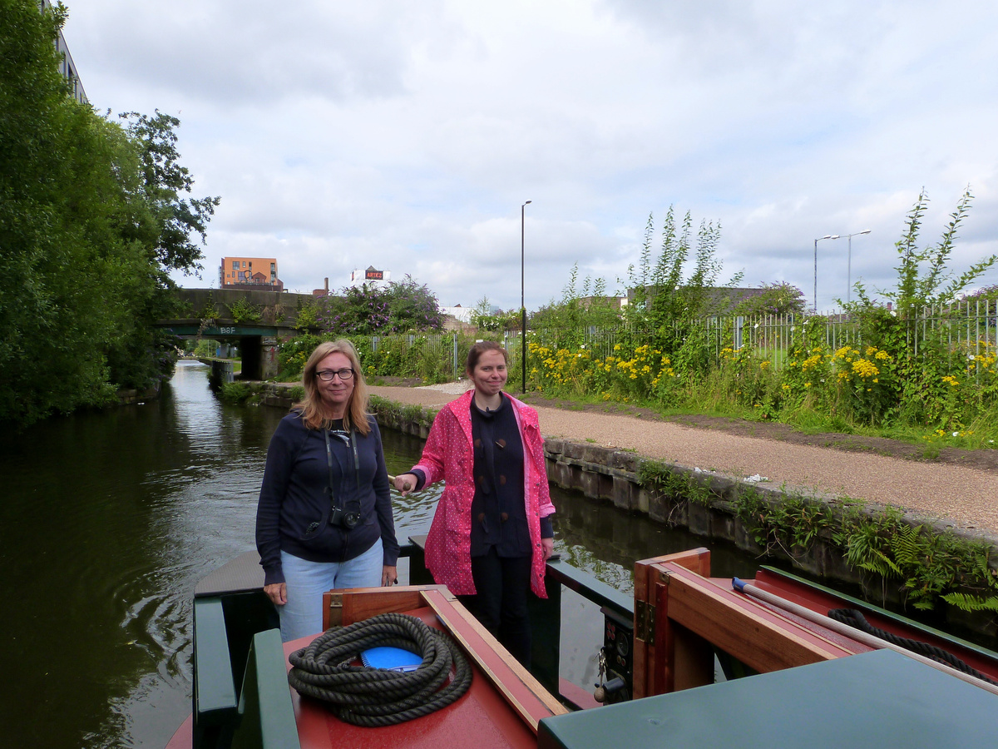
Background
&
Methodology
Researching transport tourism in the UK: train travel and canal boating
1
Mobile ethnographic methods:
2
2.1
12 journeys on regular trains; 15 boate trips
2.2
Interviews & participant observations
Data collection on trains
Data collection on boats
3
Skills as a recurring theme

Slide 3
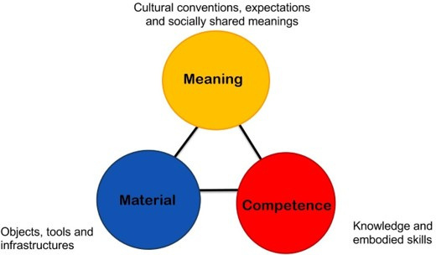
Social Practice Theory
Foregrounds:
  Social practices (e.g., cycling, boating, sightseeing), not individual practitioners
  What people do over what they think, value, et.
  The role of the body and socio-material interactions
  Any practice consists of three groups of elements
(Source: Shove, Pantzar, Watson, 2012)

Slide 4


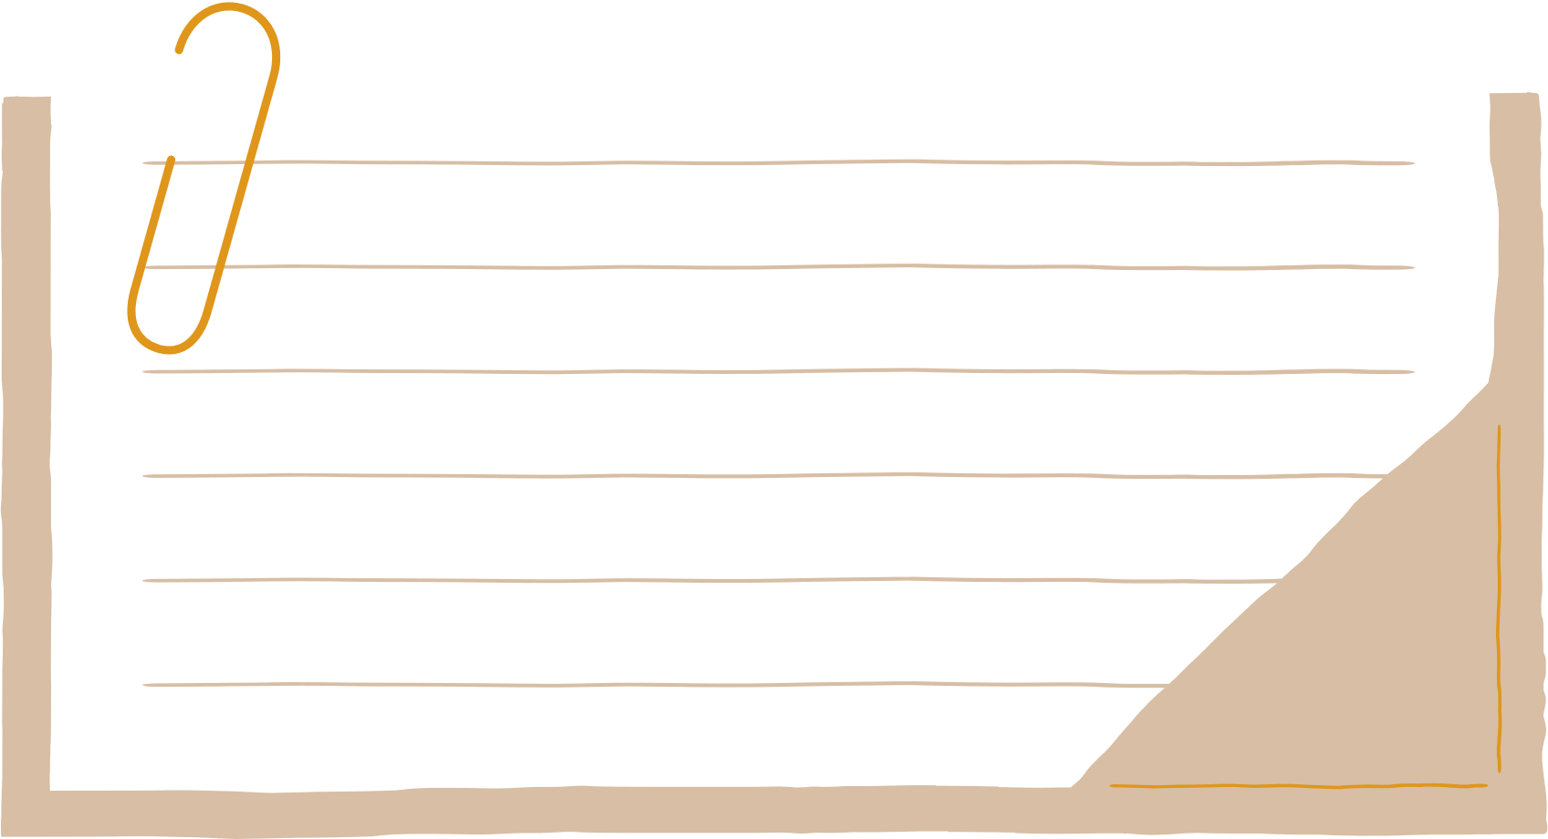

Properties of Skills:
Skills are not things-in-themselves
(Ingold, 1996)

Slide 5
Properties of Skills:
Even the simplest of skills are learned
often in a community of practice
(Lave and Wenger, 1991)

Slide 6

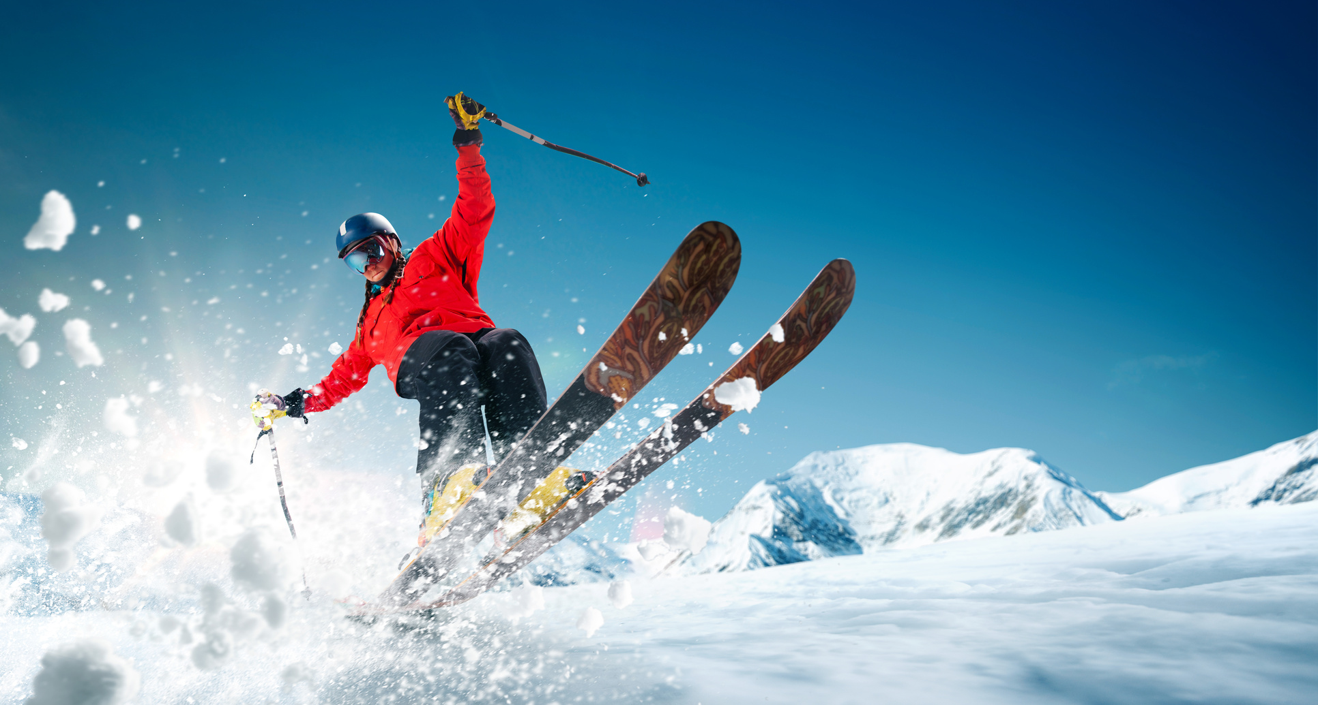

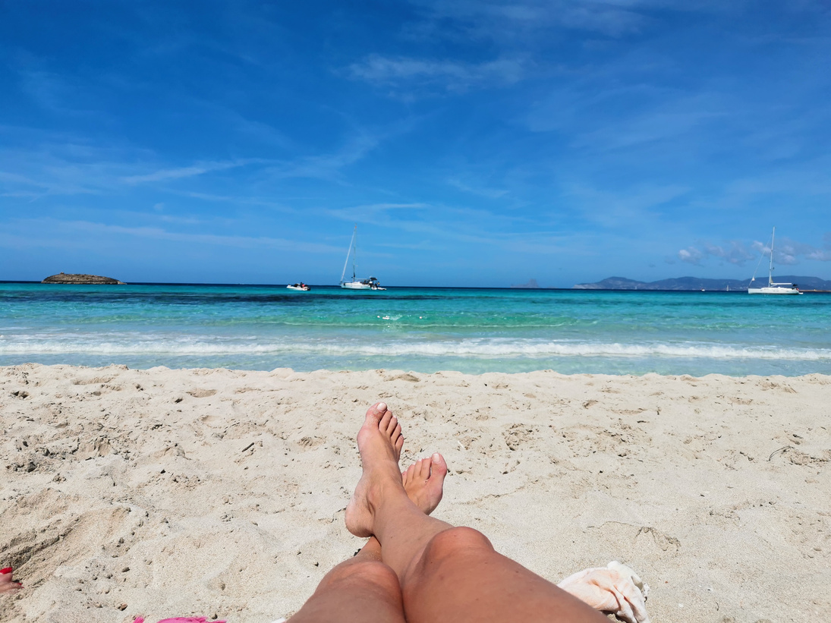

Existing Research in Tourism & Leisure
  Examines specialist skills (Shipway & Jones, 2007)
  Foregrounds knowledge (Tsaur, Yen and Chen, 2010; Cutler and Carmichael, 2010)
  Categories skills; lists of skills (Pearce and Foster, 2007)
Low-skill, high-skill activities (Richards, 1996)
Unskilled practices (Scitovsky, 1992)
Focus on Specialist skills

Slide 7
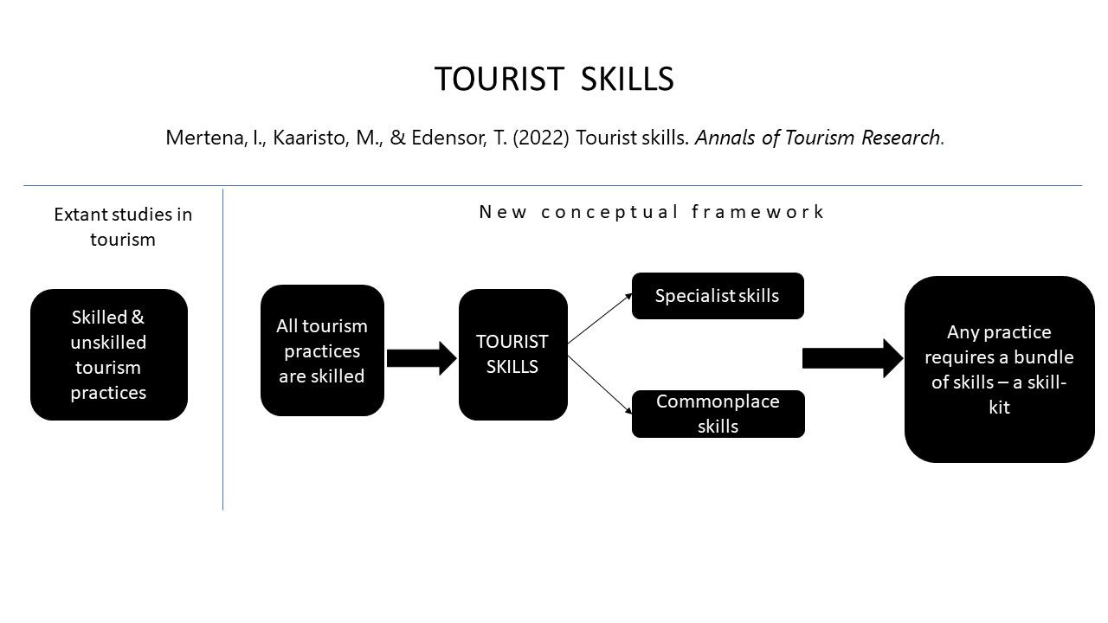

Slide 8
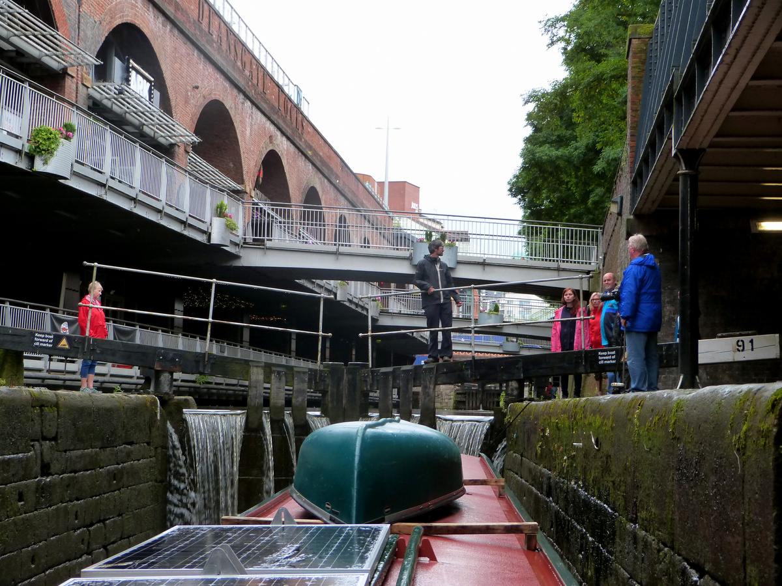
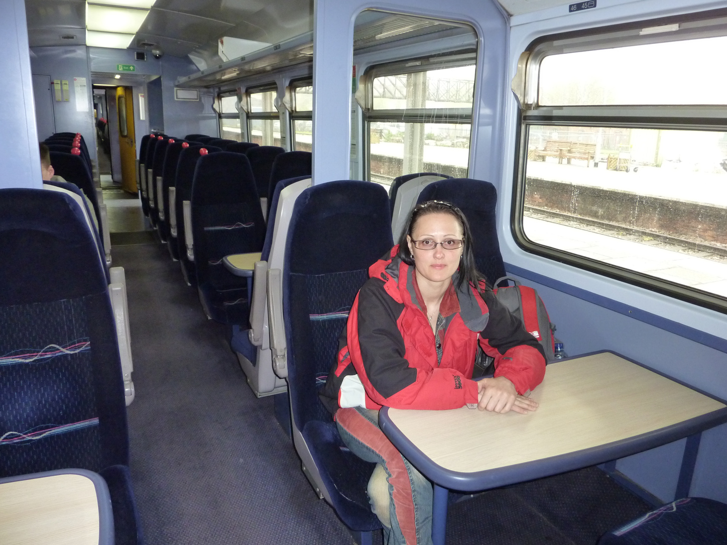
Tourist Skills (Mertena, Kaaristo & Edensor, 2022)
Skill-kit
Commonplace and Specialist skills
Commonplace Skills

Slide 9
Conceptualising Tourist Skills
Novice
Mastery
Expert
Infrequently used
Frequency of Usage
Frequently used
Unformalisable
Extent of Recognition
Formalisable
Unreflexively learned
Reflexively learned
Reflexivity

Slide 10
Conceptualising Tourist Skills
Skill-kit
Commonplace Skills
Specialist Skills
Novice
Mastery
Expert
Infrequently used
Frequency of Usage
Frequently used
Unformalisable
Extent of Recognition
Formalisable
Unreflexively learned
Reflexively learned
Reflexivity

Slide 11
01
Research skills in different contexts
Explore the four dimensions of skill
02
Future Research
03
The role of skills in decision making, motivation and the tourist experience
04
Explore if non-participation in tourism is linked to a lack of certain skills

Slide 12

Thank you for your attention!
Ilze Mertena i.mertena@mmu.ac.uk @DziedatajaIlze
Maarja Kaaristo m.kaaristo@mmu.ac.uk @MaarjaKaaristo

Slide 13
References:
Cutler, S. Q. & Carmichael, B. A. (2010). The Dimensions of the Tourist Experience. In Morgan, M., Lugosi, & Ritchie, J. R. B. (Eds.) Aspects of tourism. The tourism and leisure experience: consumer and managerial perspectives (pp. 3–26). Bristol: Channel View Publications.
Ingold, T. (1996). Situating action V: The history and evolution of bodily skills. Ecological psychology, 8(2), 171–182.
Mertena, I., Kaaristo, M. & Edensor, T. (2022). Tourist Skills. Annals of Tourism Research, 94, 103387.
Pearce, P. L., & Foster, F. (2007). A “university of travel”: Backpacker learning. Tourism Management, 28(5), 1285-1298.
Richards, G. (1996). Skilled consumption and UK ski holidays. Tourism Management, 17(1), 25–34.
Shipway, R., & Jones, I. (2007). Running away from home: Understanding visitor experiences and behaviour at sport tourism events. International Journal of Tourism Research, 9(5), 373-383.
Shove, E., Pantzar, M., & Watson, M. (2012). The dynamics of social practice: Everyday life and how it changes. London: Sage.
Scitovsky, T. 1992 [1976]. The Joyless Economy. Oxford: Oxford University Press.
Tsaur, S. H., Yen, C. H., & Chen, C. L. (2010). Independent tourist knowledge and skills. Annals of Tourism Research, 37(4), 1035–1054.

