Slide 1
TITITLE
ISC2024 – Liverpool, UK – 6-10 Oct 2024
A Holistic Approach to the Analysis of Novel Psychoactive Substances
Dr Oliver Sutcliffe
Reader and Director of MANDRAKE
Manchester Metropolitan University (email. o.sutcliffe@mmu.ac.uk)
@sutcliffeob
@MANDRAKE_LAB
MANDRAKE_LAB

Slide 2
TITITLE
Manchester – Our Journey Begins….
THIS IS NOT A MANCHESTER-CENTRIC ISSUE

Slide 3
TITITLE
MANDRAKE – A Journey through Time and “Spice”
2012
2015
2016
2024
2017
2018
2021
2022
2023
Appointed to Manchester Metropolitan University
Established street supply of “Spice” and other NPS
Greater Manchester Drugs Early Warning System
Herman-Goldstein Award (2024)
Coronial
Emergency Departments
Operation Vulcan
Synthetic Cannabinoids
“Street” Benzodiazepines
Nitazenes
254
GMP begin to experience issues with NPS in City Centre.
MANDRAKE established
GMP
Forensic Pathway
MANDRAKE
Expansion
“The MANDRAKE model”
1239

Slide 4
TITITLE
MANDRAKE – Our Focus – The Deathly Hallows
PUBLIC
Rapid, robust and cost-effective
Public Alerts
HARM REDUCTION
ANALYSIS
POLICY
MAKERS
SCIENTISTS
INTELLIGENCE
Professional Networks

Slide 5
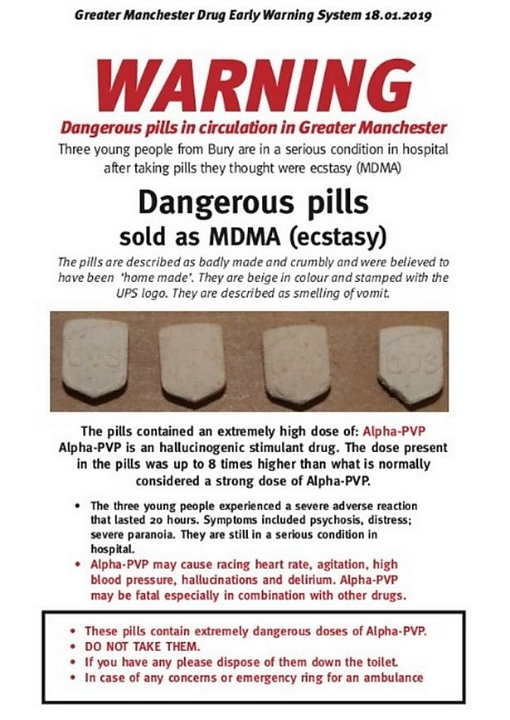
TITITLE
Case Study – The Bury Incident – 17 Jan 2019
22:00
03:45
07:30
18:00
09:00
14:00
14:30
16:30
17:30
INTELLIGENCE
Confirmatory Tests and Quantification to GM DEWS & NMGH
Call from NMGH
GMP seize suspect pills
MANDRAKE informed
Samples arrive securely
Public Alert Issued
18 Jan
ANALYSIS
2.5h Turnaround
17 Jan
Major Incident declared
Gold Command Meeting
Presumptive Tests (IR, NMR) confirm α-PVP
GM DEWS
Meeting
HARM REDUCTION

Slide 6
TITITLE
Harm Reduction thro’ Excellence in Science
INNOVATION
Targeted
Factual
Informative
Novel Technologies
Novel Methodologies
Multimodal Approach
“Real World” Scenarios
HARM REDUCTION
ANALYSIS
A
I
C
COLLABORATION
APPLICATION
INTELLIGENCE

Slide 7
TITITLE
Regioisomeric Discrimination of NPS
Thirty-three diphenidine derivatives.
UHPLC-MS/MS
Linear gradient (10 min)
Three MRM transitions for each analyte coupled with retention times, allowed for unambiguous identity and confirmation [2]
methoxphenidines
NMDAR affinity
2-MXP (K_{i} = 36.0 nM)
3-MXP (K_{i} = 19.3 nM)
4-MXP (K_{i} = 461.0 nM)
ACD/LC Simulator, v2016.1.1
SFC-UV
Linear gradient (<10 min)
Orthogonal Elution
(3-MXP < 4-MXP < 2-MXP) [3]
Conditions: SP: ACE-C₁₈-AR (50 x 4.6 mm, 3 μm); Flow rate: 0.3 mL/min, MP: MeCN/10 mM NH₄OAc (pH 6.8) [1]
[1] Boateng et al., J. Pharm. Biomed. Anal., 2018, 153, 238; [2] Field et al., J. Pharm. Biomed. Anal., 2022, 216, 114798; [3] Cochrane et al., J. Pharm. Biomed. Anal., 2022, 216, 114797; [4] Euerby et al., ISC2024, 2024, “Fentanyls” Board 187 (7 Oct 2024)

Slide 8
TITITLE
Enantiomeric Discrimination of NPS
4-MXP
Enantiomer A
Enantiomer B
3-MXP
Lux Cellulose-2
(−)-(R)-2-MXP before (+)-(S)-2-MXP
Lux i-Amylose-3
(+)-(S)-2-MXP before (−)-(R)-2-MXP
Street samples are racemic.
Thirty-two diphenidine derivatives.
Resolution: ortho- < meta- < para-
Speculative assignment of enantiomers.
Preparation of enantiopure standards is ongoing.
2-MXP
3-MXP
4-MXP
2-MXP
10
15
20
25
30
R = H (diphenidine)
R = OMe (methoxphenidines)
2-MXP (sample)
(R)
(S)
NMDAR affinity
(+)-(S)-diphenidine (K_{i} = 130 nM)
(−)-(R)-diphenidine (K_{i} = 5.25 nM)
10
15
20
25
30
Time [min]
Conditions: SP: Lux Cellulose-2 (150 x 4.6 mm, 5 μm); Flow rate: 1.0 mL/min, MP: 95:5:0.1:0.1 %v/v/v/v MeCN:IPA:FA:DEA [1]
[1] Euerby et al., J. Pharm. Biomed. Anal., 2024 (accepted, 26 Sept 2024)

Slide 9
TITITLE
Holistic Approach to the Analysis of Drugs
Chromatography
Qualitative
Spectroscopy
“Challenging Materials”
Synthesis
Quantitative*
Isomers
Presumptive Tests
Mass Spectrometry
Quantitative*
New or “Prophetic” Standards
Existing Standards

Slide 10
TITITLE
Skeletalisomeric Discrimination of NPS
NMR (500 MHz) Analysis:
DMSO-d₆
Unknown Cathinone
“Seized tablets”
Caffeine
GC-EI-MS analysis indicates N-ethylpentylone
NMR does not match literature for N-ethylpentylone
Conditions: SP: Shim-pack Velox Biphenyl (100 x 2.1 mm, 2.7 μm); Temp. 40 ºC, Flow rate: 0.3 mL/min, MP: MeOH/2 mM NH₄HCO₂/0.002% HCOOH

Slide 11
TITITLE
Skeletalisomeric Discrimination of NPS
HRMS-QTOF Analysis [2]:
Synthesis [1]:
Synthesised putylone reference standard has t_{R} = 5.05 min
The standard was used to quantify the seized tablets
Putylone (130.6–135.5 mg/tablet)
Caffeine (40.2–43.4 mg/tablet).
Applied to other examples of novel cathinones
[1] Dixon et al., Forensic Chemistry, 2023, 35, 100523; [2] Barnes et al., ISC2024, 2024, O.8 Forensics (7 Oct 2024)

Slide 12
TITITLE
Manchester – Our Journey Continues….
THIS IS A MANCHESTER-LED SOLUTION

Slide 13
TITITLE
Acknowledgements
Shimadzu UK Limited
Dr Christopher Titman
Dr Alan Barnes (MSO)
Dr Emily Armitage (MSO)
Dr Raymond Wong
Mr Benjamin Barrett
Manchester Metropolitan University
Dr Ryan Mewis
Dr Matthew Hulme
Dr Nicolas Gilbert
Mr David Dixon
Ms Molly Millea
Ms Emily Dawber
Mr Michael Sallenger
Funding
Greater Manchester Combined Authority (GMCA)
Manchester City Council
Canadian Government
Greater Manchester Police
Greater Manchester Police
PC Andrew Costello
PC Jamie Ellison
Strathclyde University
Professor Melvin Euerby*
Dr Darren Edwards
Dr Jennifer Field*
Mr Graeme Cochrane
Dr Bernard Boateng
*Affiliated to Shimadzu UK Limited
Thank you for your attention

