Slide 1

Reverse / reciprocal mentoring collaborative session
Source: https://ssir.org/articles/entry/how_reverse_mentoring_can_lead_to_more_equitable_workplaces

Slide 2
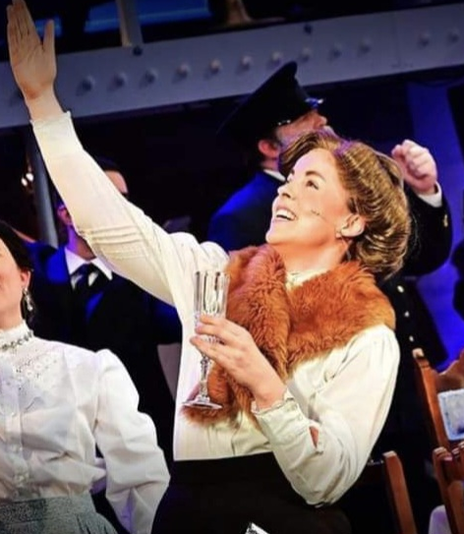
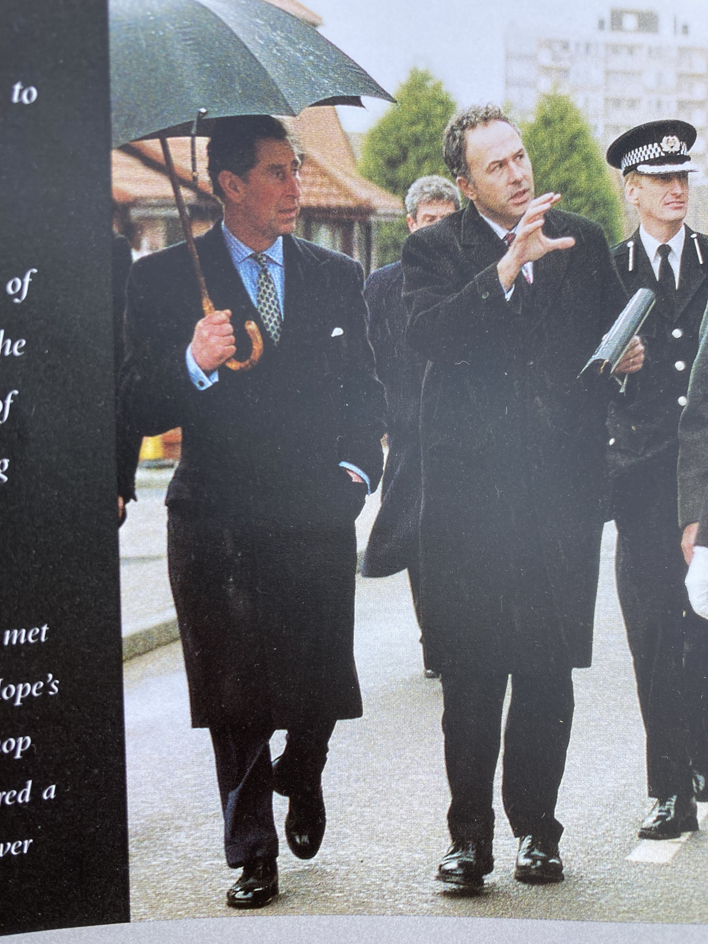
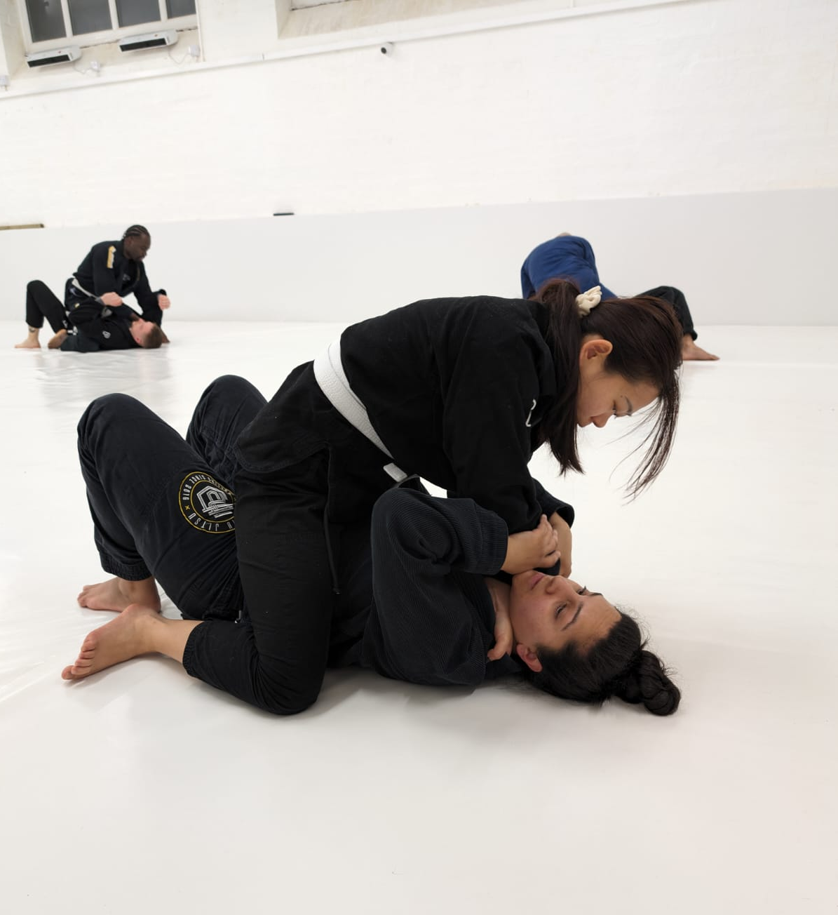
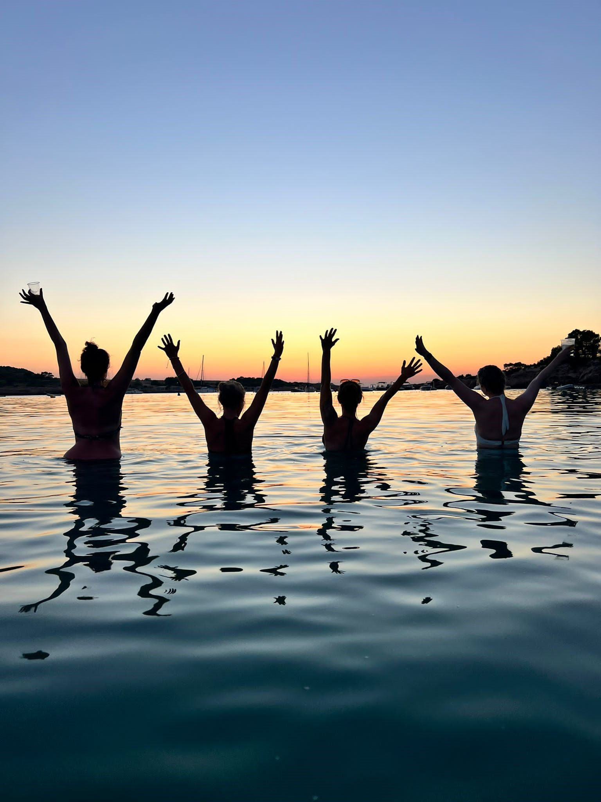
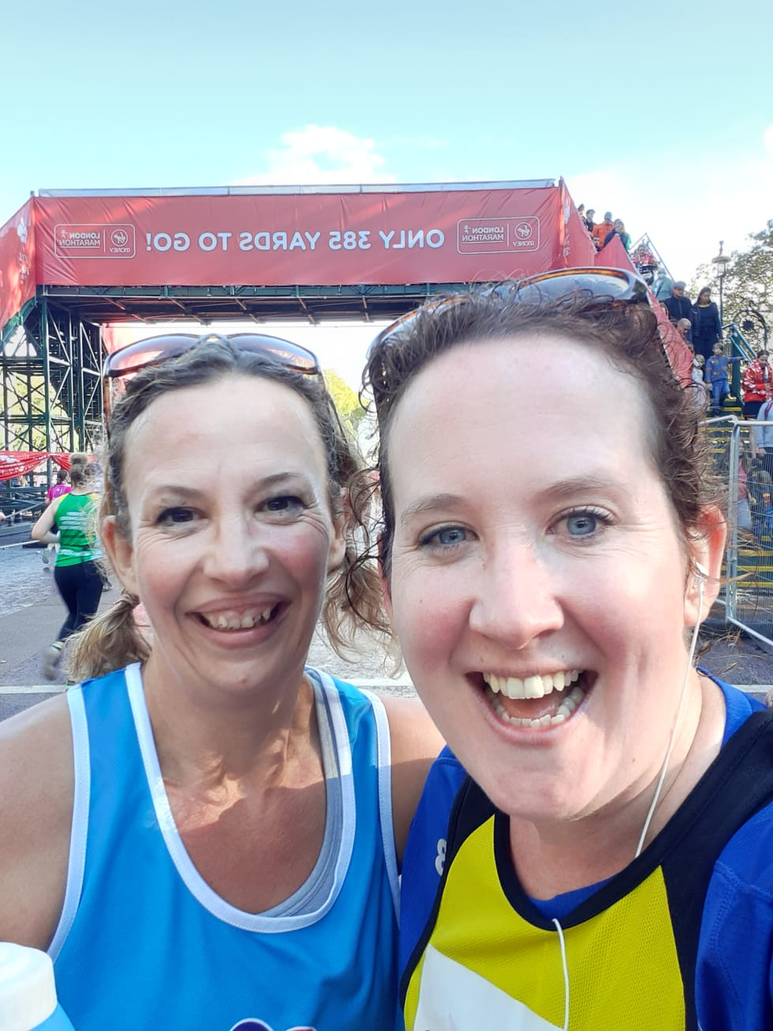
Pedagogic research and community co-design (Rachael O’Connor)
Early & Later Career Academics (Zi Yang & Simon Lee)
In Our Classrooms (Vicky Martin & Catherine Shephard)

Slide 3

What is it?
Reverse mentoring promotes reciprocal conversations across perceived divides. It positions people who typically face deficit narratives around their identity as experts (mentors), mentoring those with scope to improve their knowledge by learning from mentors’ lived experiences (mentees). These conversations can contribute towards wider change within a community or organisation through follow-up actions i.e. they act as a catalyst or vehicle. Conversations can focus on any topic that is a priority in the relevant context and provides mentors and mentees with insight into experiences different to their own.

Slide 4
A researcher’s perspective
More than just conversations - impact on institutional policies
  Academic personal tutoring
  Student voices initiatives
  Workplace EDI development
Partnership and community building
  Sustained relationships - friendships
Co-design and collaborative methodologies
  Legal profession roundtables
  Under-represented student research team

Slide 5
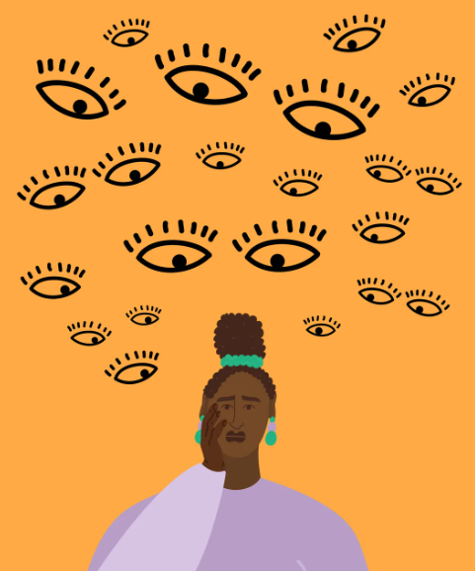
Some cautionary notes …
Don’t force people into reverse mentoring
Pay/reward/workload
Empowering mentors – beware the deficit narrative
Meeting guidance which builds in individuality
Create community – group get togethers
Emotional labour - supporting participants
Purpose – RM is the vehicle, not the answer
Acting on findings and reporting on actions
Extending relationships beyond the project
Source: https://www.refinery29.com/en-gb/how-to-overcome-imposter-syndrome#slide-1

Slide 6

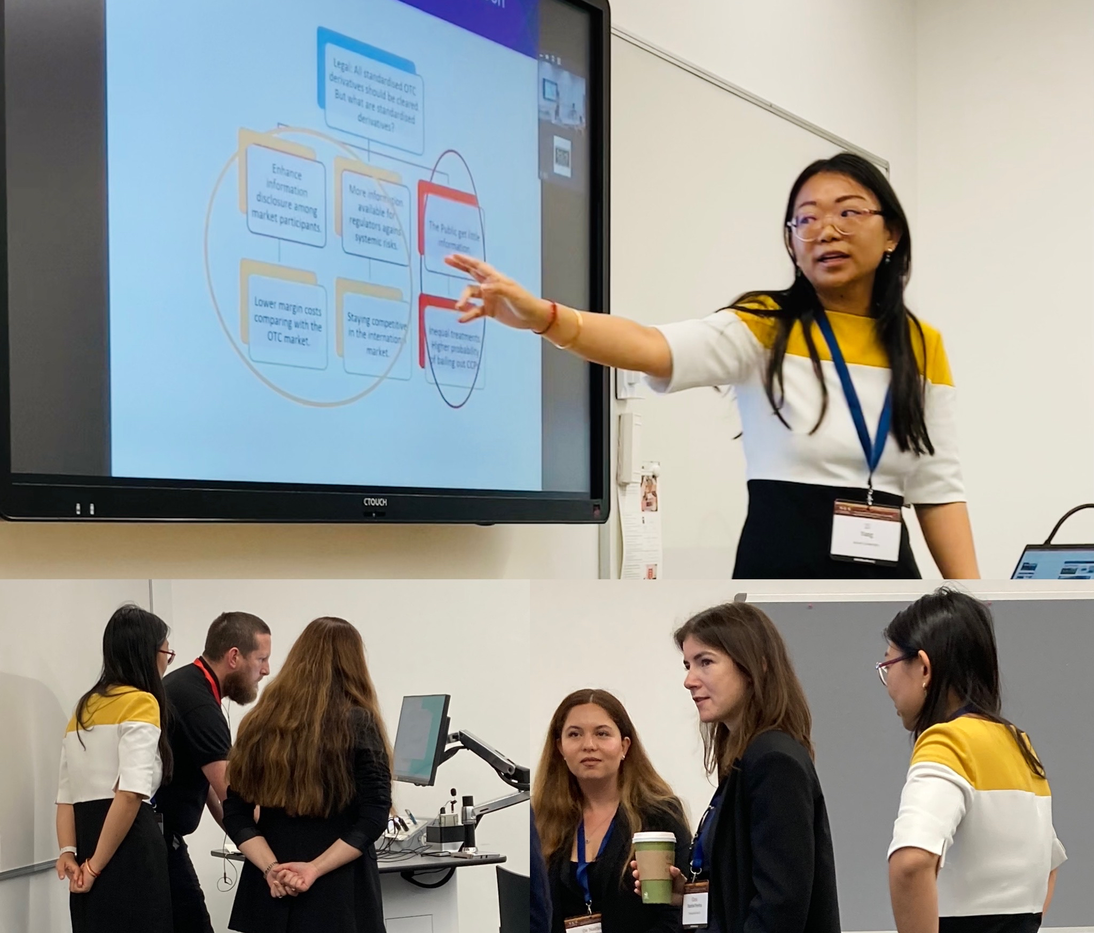

Who are we? Can you spot which one is the early & which is the later career academic?

Slide 7
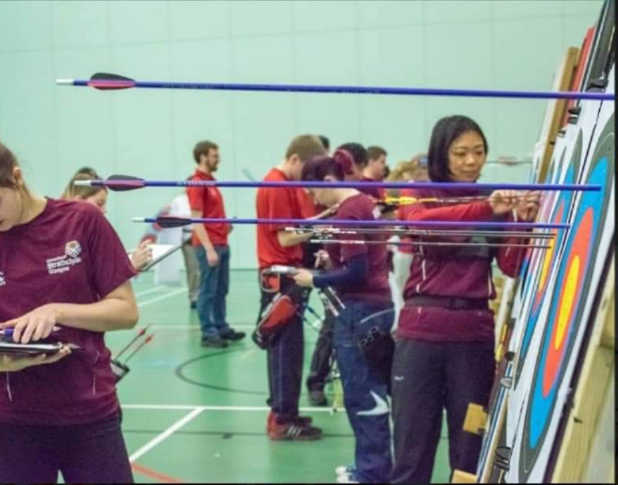
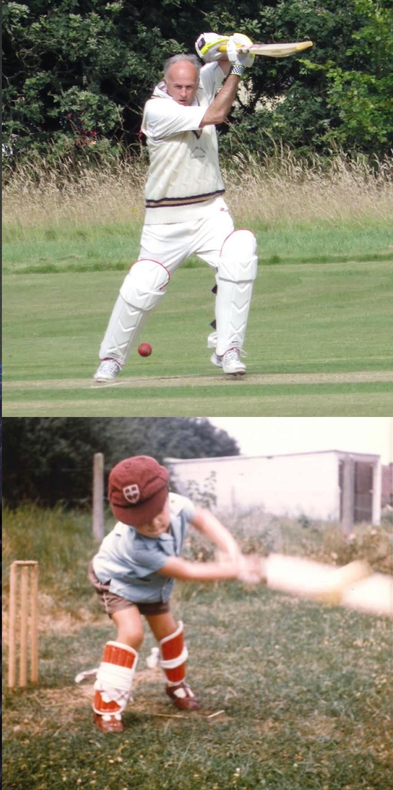
Has coaching made us any better?

Slide 8

Why, What, How?
What?
Experiential Active Learning…for Connection
Why?
Practice-informed Pedagogies
‘New Normal’ / Wicked Problems
How? Take risks…
Problem-based learning
Digital Technologies
Meta learning (learning about learning)
Authenticity¹, Sharing, Humour, Trust
¹ Football and Dead Bodies

Slide 9
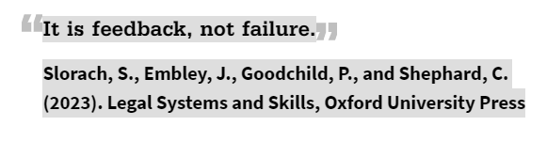
So What?
Start to shape expectations and boundaries, inform realities, provide cultural capital
Fear → Curiosity
Failing is not the end
Reflection…What is learning? Being taught? Sense-making? Building knowledge with others?
  Progress not perfection
Cyclical process updates our own practice
Modelling skills helps with skills teaching
Shared perspective and values
Communication, care and compassion = inclusive community
Co–creation encourages engagement

Slide 10
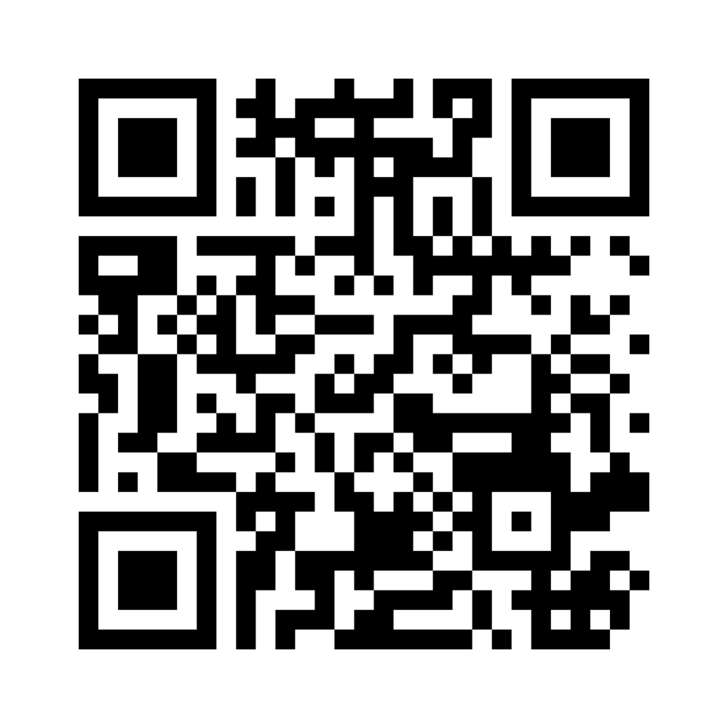
Words of wisdom that stick
Share mentoring guidance that has stayed with you
From the top down ↓
& From the ground up ↑

Slide 11
Give it a go!
Online attendees: breakout room of 2
In-person attendees: pairs on tables
Reciprocally share and discuss for c.10 minutes:
a time when you have felt included or excluded in legal education and/or in the legal profession

Slide 12

How did it make you feel?
This Photo by Unknown Author is licensed under CC BY-NC

Slide 13

Let’s eat!
12:45-13:30
Grab some food outside and head to the makers’ space for crafting
This Photo by Unknown Author is licensed under CC BY-SA

