Slide 1
Collaboration, safe spaces and breaking down barriers to belonging: using active learning, technology and compassion in the classroom
Catherine Shephard & Vicky Martin
Manchester Law School
12 June 2024

Slide 2
What is belonging and why does it matter?
“Belonging is integral to the realisation of inclusion. To belong is to be valued (Smerdon, 2002), to connect with us and to have a sense of fitting in (Osterman, 2000). Educators value developing a culture of belonging to foster a safe environment for risk taking and engagement in learning (MacArthur, 2009; Vygotsky 1981)….Belonging can be understood as a dynamic construct that is shaped by our interaction with people, places and things.”
(Guerin and McMenamin 2018)

Slide 3
Belonging versus fitting in
“Fitting in is about assessing a situation and becoming who you need to be to be accepted. Belonging, on the other hand, doesn't require us to change who we are; it requires us to be who we are.”
(Brown 2017)

Slide 4
What are the issues?
Post COVID the landscape has changed (Shephard, Burns et al. 2023)
There has been low attendance and low engagement from a significant number of students
Students are not engaging with personal tutoring provision or in the classrooms, although there are many areas of really good practice
This is not unique to the school or the university; it is endemic across the sector
Although we are providing support, many students are not accessing this- so the big question is why

Slide 5
What do students currently think?
So far 155 students have completed the survey
4 students have had one to one interviews
Although focused on personal tutoring , some key themes have emerged
Key issues include:
Feeling of loneliness and isolation
Don’t feel they belong here or deserve to be here
Fear of judgement – by staff and peers
Do not want to expose themselves to possible failure
(Martin 2024)

Slide 6
How do we do help with these issues in the classroom and our interactions with students?
Take risks…
Problem-based learning
Digital Technologies
Meta learning (learning about learning)
Authenticity, Sharing, Humour, Trust

Slide 7
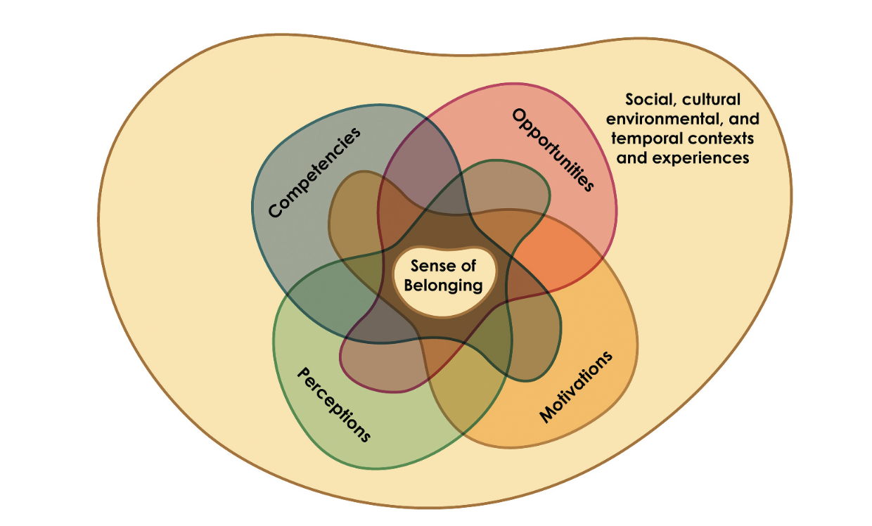
So What?
Start to shape expectations and boundaries, inform realities, provide cultural capital
Fear → Curiosity
Using technology to encourage less fearful interaction
Reflection…What is learning? Being taught? Sense-making? Building knowledge with others?
Progress not perfection
Cyclical process updates our own practice
Modelling skills helps with skills teaching
Shared perspective and values
Communication, care and compassion = inclusive community
Co–creation encourages engagement
(Allen, Kern et al. 2021)

Slide 8
Interaction
(Hoffman 2002)

Slide 9
Scaffolding, self-efficacy, metacognition, validation
(Vygotsky and Cole 1978, Bandura 1977, Flavell 1979, Pintrich and Garcia 1994, Rendon 1994)

Slide 10
Collaborative working and peer review
(Susskind, 2023, Winstone and Boud 2022, Nicol 2013 )

Slide 11
References
Allen, K.-A., M. L. Kern, C. S. Rozek, D. M. McInerney and G. M. Slavich (2021). "Belonging: a review of conceptual issues, an integrative framework, and directions for future research." Australian Journal of Psychology 73(1): 87-102.
Bandura, A. (1977). "Self-efficacy: toward a unifying theory of behavioral change." Psychological review 84(2): 191.
Brown, B. (2017). Braving the wilderness: The quest for true belonging and the courage to stand alone, Random House.
Flavell, J. H. (1979). "Metacognition and cognitive monitoring: A new area of cognitive–developmental inquiry." American Psychologist 34(10): 906-911.
Guerin, A. and T. McMenamin (2018). Belonging: Rethinking inclusive practices to Support well-being and Identity, Brill.
Hoffman, M., Richmond, J., Morrow, J., & Salomone, K. (2002). Investigating “Sense of Belonging” in First-Year College Students. Journal of College Student Retention: Research, Theory & Practice, 4(3), 227-256. https://doi.org/10.2190/DRYC-CXQ9-JQ8V-HT4V
Käfer, J., Kuger, S., Klieme, E. et al. The significance of dealing with mistakes for student achievement and motivation: results of doubly latent multilevel analyses. Eur J Psychol Educ 34, 731–753 (2019). https://doi.org/10.1007/s10212-018-0408-7

Slide 12
References (contd.)
Martin, V, 'Being a Personal Tutor in a Diverse HE Sector' in Bleasdale, L, How to Offer Effective Wellbeing Support to Law Students, Edward Elgar 2024.
Pintrich, P. R. and T. Garcia (1994). "Self-regulated learning in college students: Knowledge, strategies, and motivation." Student motivation, cognition, and learning: Essays in honor of Wilbert J. McKeachie: 113-133.
Rendon, L. I. (1994). "Validating culturally diverse students: Toward a new model of learning and student development." Innovative higher education 19: 33-51.
Shephard, C., N. Burns, V. Martin, M. Regan and P. Wilson (2023). 'We’re not in Kansas anymore': identifying our ‘New Normal’ in Legal Education. Annual Conference of the Scocio-Legal Studies Association 2023, Ulster University, 5 April 2023.
Slorach, S., Embley, J., Shephard, C., Goodchild, P. (2023) Legal Systems and Skills 5th Ed.. Oxford University Press.
Susskind, R., 2023. Tomorrow's lawyers: An introduction to your future. Oxford University Press.
Vygotsky, L. S. and M. Cole (1978). Mind in society: Development of higher psychological processes, Harvard University Press.
Winstone, N. E. and D. Boud (2022). "The need to disentangle assessment and feedback in higher education." Studies in higher education 47(3): 656-667.

