Slide 1
Comparative analysis of the skills among IT specialists in Russia and USA
Sergey Sosnovskikh, PhD
Manchester Metropolitan University (UK)
s.sosnovskikh@mmu.ac.uk
BASEES (April 2024)

Slide 2
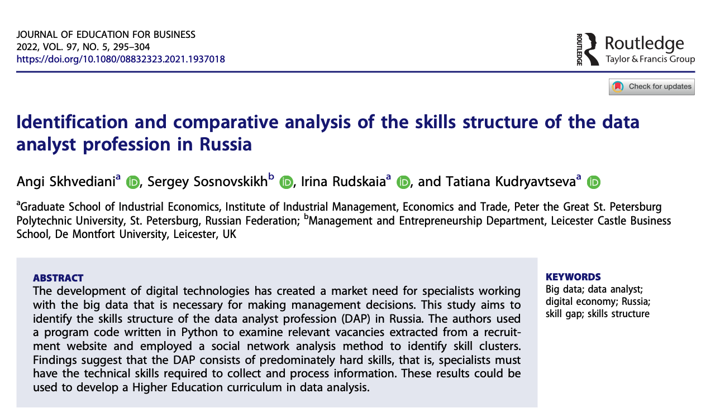
Research background
Part of the continuous project studying the skills structure of the data analyst profession in Russia.
Skhvediani, A., Sosnovskikh, S., Rudskaia, I., & Kudryavtseva, T. (2022). Identification and comparative analysis of the skills structure of the data analyst profession in Russia. Journal of Education for Business, 97(5), 295–304. https://doi.org/10.1080/08832323.2021.1937018

Slide 3
Introduction
Businesses have acknowledged the strategic benefits and potential value derivable from integrating big data capabilities into their structural framework (Wang et al., 2015).
Viewing data as a quintessential business asset, these entities have concentrated on procuring the tools and developing the competencies essential for big data analytics (BDA) (Abbasi et al., 2016; Halwani et al., 2022).
BDA intersects with many disciplines: information science, engineering, computer science, mathematics, social sciences, systems science, psychology, management, business, and economics (Jin et al., 2015).
This field leverages methodologies from diverse areas, including probability theory, machine learning, statistical learning, computer programming, data engineering, pattern recognition, data visualisation, data warehousing, and high-performance computing (Jin et al., 2015).
Additionally, it encompasses a broad spectrum of contemporary technological hardware, software applications, and services.

Slide 4
Research context and aim
This issue is particularly pronounced in Russia, where there is a notable demand for IT managers (Anisimova et al., 2023; Matraeva et al., 2020), yet there exists a marked lack of clarity in delineating the distinctions between data analysts (DAs) and business analysts (BAs).
This study aims to bridge the existing knowledge gap by systematically collecting and analysing job descriptions for two professions situated at the intersection of big data and data science.
This investigation is contextualised within the COVID period and subsequent start of the military conflict between Russia and Ukraine in February 2022—a period marked by a heightened demand for highly-skilled professionals in digital analysis in Russia (Basu, 2023; Grizovski, 2022; Skhvediani et al., 2022).
Our research aims to examine the dynamics and evolving skillset structures associated with these two roles.
The selection of these professions for our study is predicated on their frequent co-mentioning within industry job descriptions, as well as the observation by several scholars that these roles often cluster together in discussions regarding job preparedness offered by existing curricula (Halwani et al., 2022; Persaud, 2020; Verma et al., 2019).

Slide 5
BDA paradigm
In the realm of computing professions, data science is commonly conceptualised as an interdisciplinary amalgamation encompassing statistics, business intelligence, sociology, computer science, and communication (Sajid et al., 2021).
Data science is characterised as a discipline dedicated to discovering, extracting, and analysing data for informed decision-making and predictive analysis.
A more exhaustive inventory of tools and competencies expected of data scientists might encompass a wide array of elements, including knowledge of data management and storage tools like SQL, contemporary computing and manipulation tools capable of merging, aggregating, and iteratively processing data, proficiency in data visualisation and the principles of visual perception, understanding of confidence intervals through bootstrap methods, simulation, regression, variable selection, data mining/machine learning, classification, cross-validation, text mining, mapping, regular expressions, network science, MapReduce, among other subjects (Hardin et al., 2015).

Slide 6
Differentiating DAs from data scientists presents a challenge. The academic groundwork for DAs begins with obtaining a degree in statistics, mathematics, computer science, management science, biological sciences, economics, information management, or business information systems (Abbott, 2014).
The designation of a BAs professional traditionally refers to an individual who primarily examines existing business processes and the formulation of technological solutions (Vidgen et al., 2017).
From an IT perspective, BA is delineated as an ensemble of solutions employed to construct analytical models and simulations for creating scenarios, comprehending realities, and projecting future states. At its core, business analytics represents a synthesis of business acumen and data science disciplines (Russom, 2013).
Professionals in business analytics are tasked with generating novel business insights and formulating recommendations predicated on data analysis. They are expected to possess a background in IT and statistical knowledge, augmented by relevant business experience.

Slide 7
Theoretical Framework
A competency framework is conventionally regarded as an analytical instrument that delineates the requisite skills, knowledge, personal attributes, and behaviours essential for the efficacious execution of a role within an organisation (Le Deist & Winterton, 2005; Lucia & Lepsinger, 1999).
Moreover, Le Deist & Winterton (2005) observe that competency models have been extensively utilised to synchronise individual capabilities with an organisation's core competencies (Rothwell & Lindholm, 1999).
Competency transcends mere knowledge and skills to encompass attitudes, behaviours, work habits, abilities, and personal characteristics (Gangani et al., 2006; Le Deist & Winterton, 2005; Russ-Eft, 1995), and is manifested not in isolation but within contexts pivotal to professional practice (Hager & Gonczi, 1996; Russ-Eft, 1995).
The adoption of a competency approach is motivated by its potential to signal labour market demands, assist individuals in navigating career mobility (Le Deist & Winterton, 2005), enhance the capacity of educational providers to more effectively bridge education and training with labour market requirements (Hager & Gonczi, 1996), and demonstrate the convergence between formal education and experiential learning in the cultivation of professional competence (Cheetham & Chivers, 1996).

Slide 8
Methodology

Slide 9
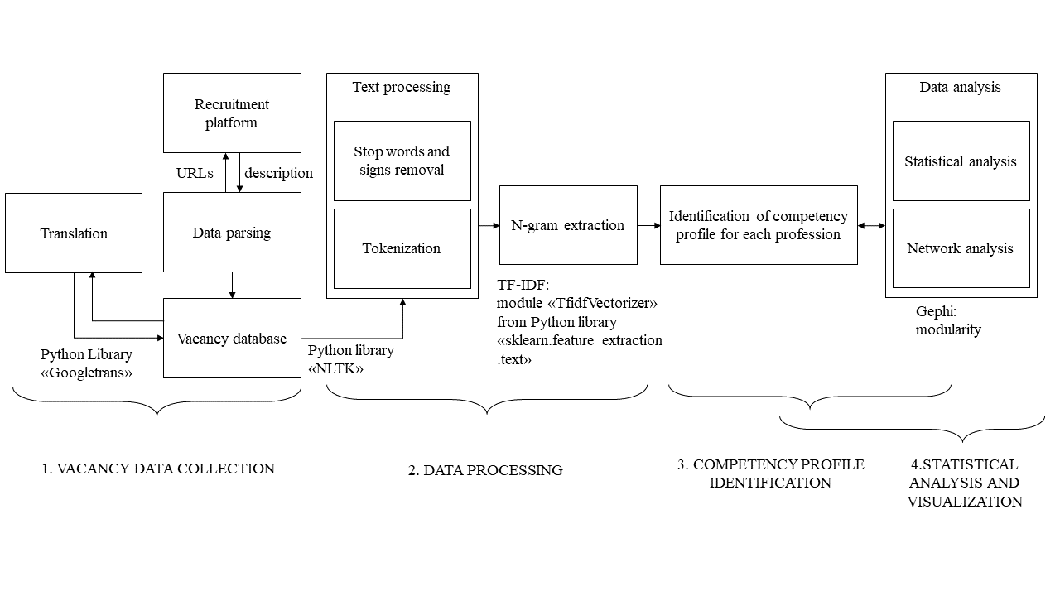
Algorithm and tools for identification, statistical and graph analysis of key competencies presented in vacancies from the online job postings.

Slide 10
In the first stage, we collected data using web scraping of vacancies on the HeadHunter website and parsing the collected data.
The data collection (web scraping and data parsing) was performed in Python in July 2020 and July 2023. Our sample size comprises 2357 vacancies.
First, the URLs of all vacancies for each position were collected. Next, each URL was parsed for positions: job title, job description, salary, address, and work experience.
In the second stage, we processed the data. We tokenised text descriptions of vacancies; we removed stop words and signs from them using the Nltk library, which helped eliminate words of little significance.
To extract unigrams, bigrams and trigrams from job descriptions, we used the TF-IDF (Term Frequency-Inverse Document Frequency) method, implemented using the TfidfVectorizer module of the Scikit-Learn library.
For each n-gram, we calculated how many job descriptions they appeared in and arranged the ranking of n-grams for each group. The TF-IDF method allowed the conversion of text into numeric vectors:

Slide 11
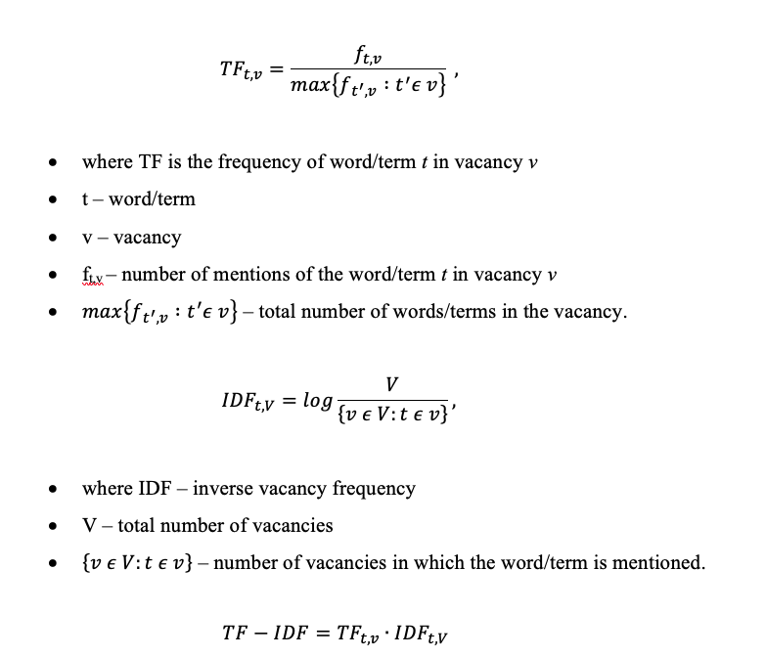

Slide 12
In the third stage, based on the selected n-grams, we graphically determined the structure of competencies. In this case, categorisation occurred using graph construction.
In the fourth stage, we carried out a statistical analysis of data on vacancies and their visualisation. We analysed the most mentioned competencies in the competency structure and assessed their relationship.
To assess the connection, we constructed the graph using Gephi software, where the selected competencies were represented as nodes and the connections between them (joint appearance in the same vacancy) as edges. To divide competencies into groups/clusters, we used a measure of network structure - modularity.
This graph allowed us to identify relationships between competencies and define clusters with similar competencies.

Slide 13
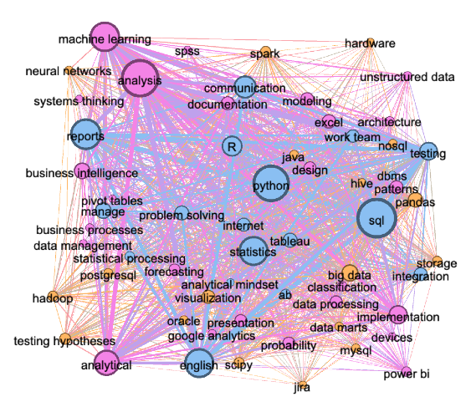
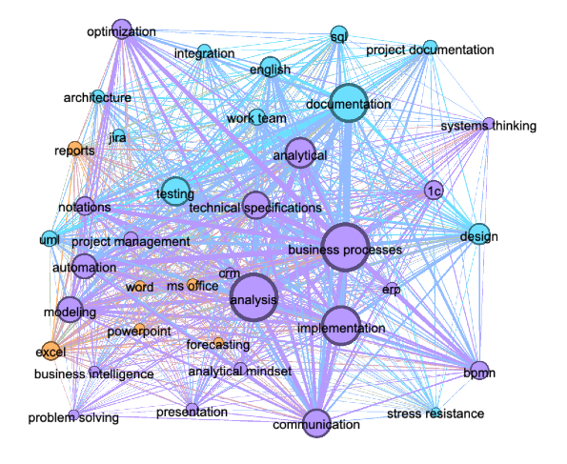
Results 2020
Data Analyst
Business Analyst

Slide 14
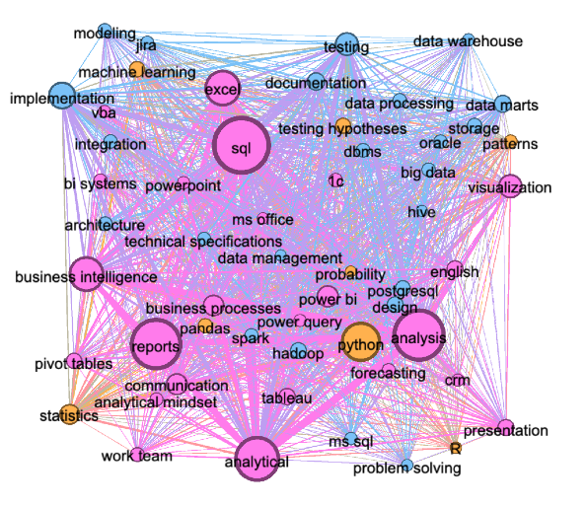
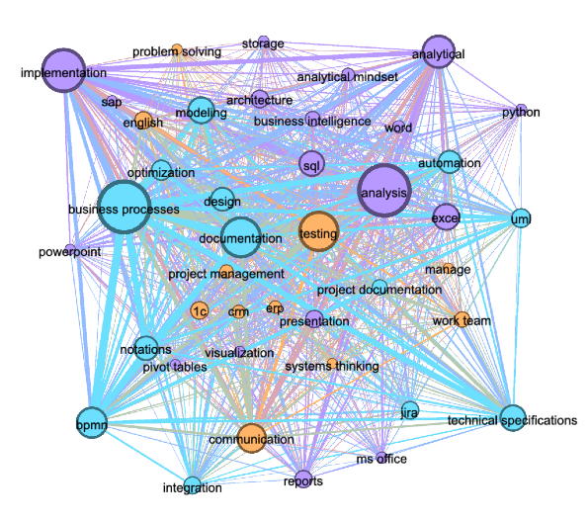
Results 2023
Data Analyst
Business Analyst

Slide 15
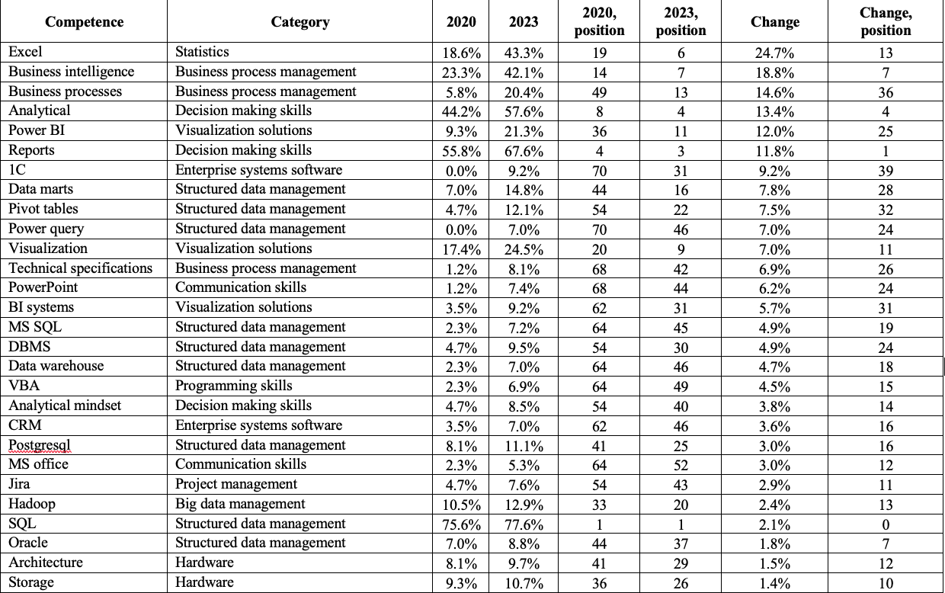
Comparison of the DA competences between 2020 and 2023

Slide 16
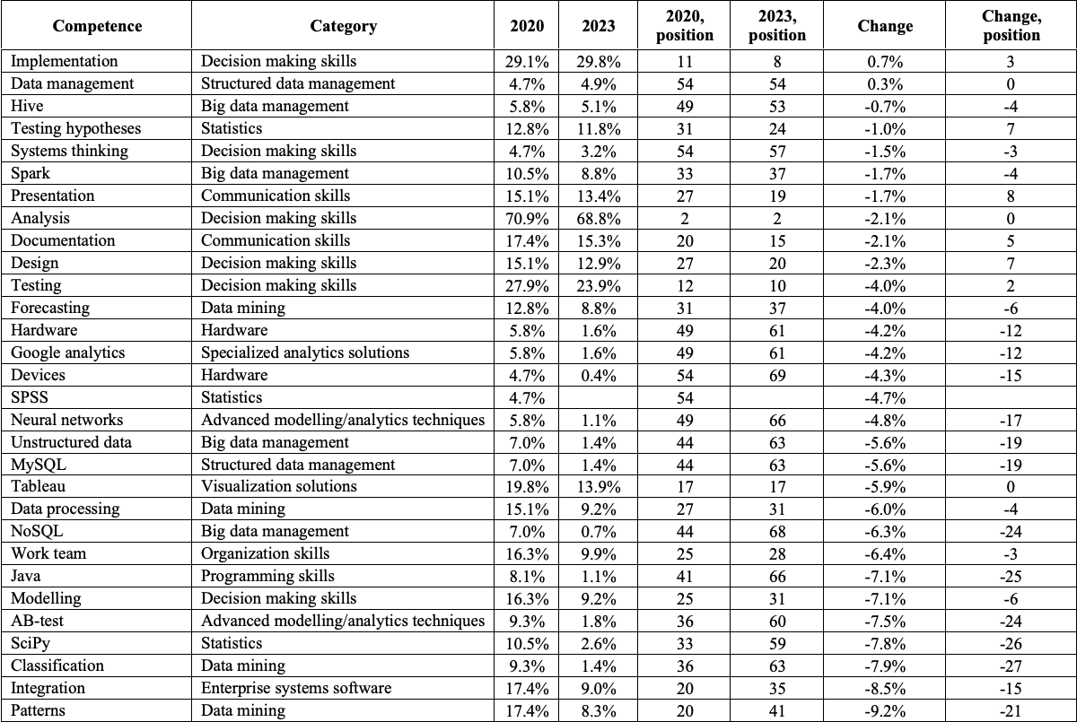

Slide 18
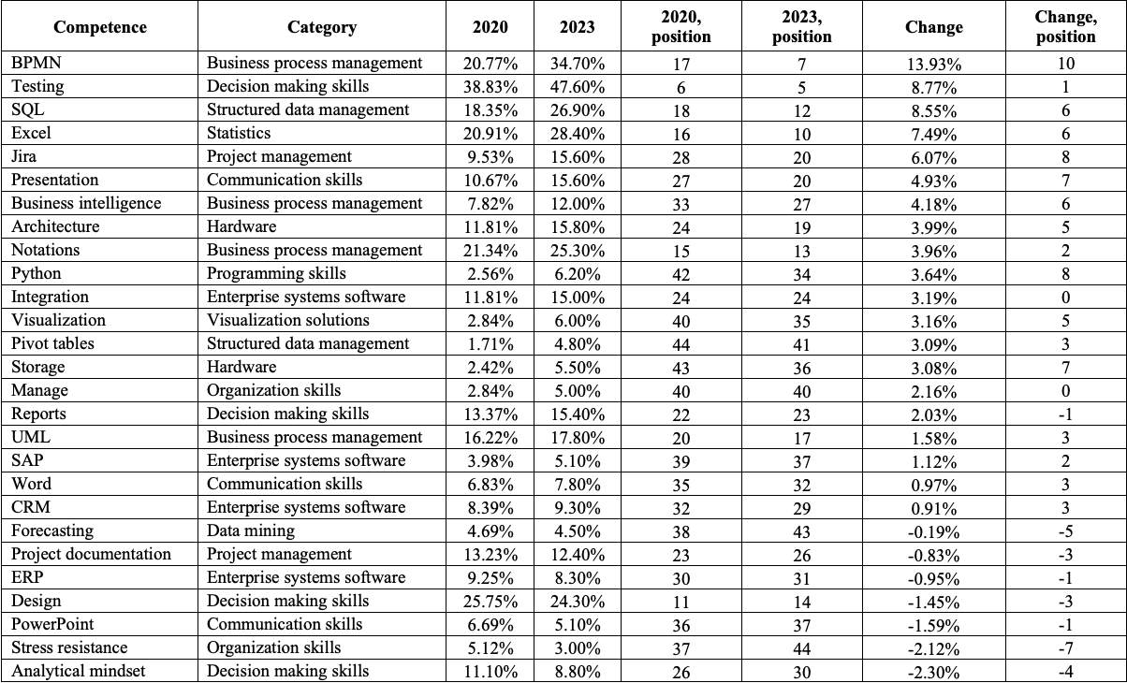
Comparison of the BA competences between 2020 and 2023

Slide 19
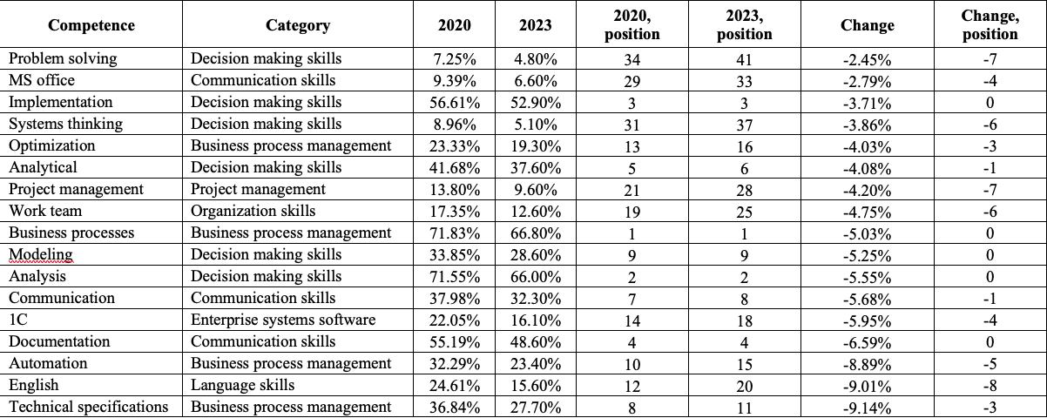

Slide 20
Conclusions
This study meticulously delineates the distinct differences between these two professions.
This suggests a shift towards recognising the importance of diverse skill sets within the data science field in Russia.
The observed transformation in the skills framework and requisite competencies presents a fascinating dynamic in studies years: DAs are increasingly expected to exhibit soft skills, including management, communication, and teamwork capabilities, whereas BAs are more frequently required to possess hard skills, such as proficiency in data analysis, analytics, and specific language skills (coding).
Comparing our results to similar research about the skills structures in the USA (Halwani et al., 2022; Fareri et al., 2020; Sousa & Rocha, 2019; Verma et al., 2019), we see that in both countries, most frequently mentioned skill categories coincide: statistical packages, structured data management, and decision making. However, they occupy different places in the ranked list.
In the US, the emphasis is given to soft skills represented by the decision making and organisation categories, while in Russia they are ranked lower, respectively.
On the other hand, programming skills are quite important in Russia, while in the USA, they are not included in the top most frequently cited skills in relevant vacancies.

Slide 21
Thank you for your attention!
Sergey Sosnovskikh, PhD
Manchester Metropolitan University (UK)
s.sosnovskikh@mmu.ac.uk

