Slide 1

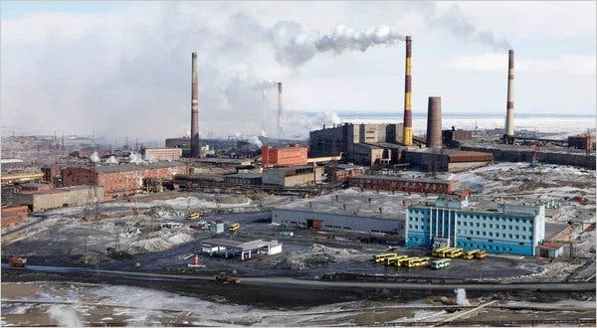
Environmental Investments and State Funding as Mechanisms of Corruption: The Case of Russia
Sergey Sosnovskikh, PhD
Manchester Metropolitan University (UK)
s.sosnovskikh@mmu.ac.uk
BASEES (April 2024)

Slide 2
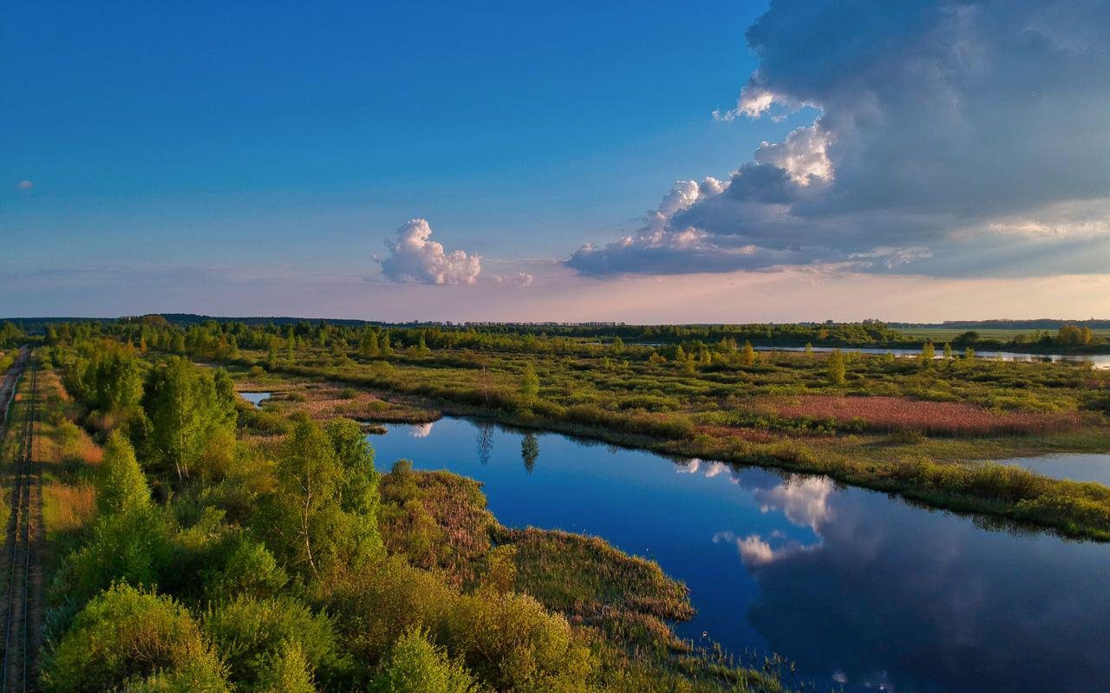
Research context
Russia has always paid little attention to environmental problems
USSR has made some ‘recycling’ programs in the 70s
However, the economy has been over reliant on polluting industries such oil, gas, heavy metallurgy, mining, nuclear industry and recycling, etc. (Peterson, 2019)
In 1956, the XX Congress of the Communist Party of the Soviet Union (CPSU) passed a resolution to develop productive forces and increase the population’s well-being: resolving environmental issues and the violation of the ecological balance in the country’s industrially developed and developing regions by modernising production (Pryde & Mcauley, 1991).
The collapse of the USSR exacerbated transboundary and interregional environmental problems. During 1991–1995, there was a decline in industrial production.
In 1996, under the influence of the main declarations of the 1992 United Nations Conference on Environment and Development Forum “Earth Summit”, the “Concept of the Russian Federation’s transition to sustainable development” was developed and approved as a national environmental policy (Crotty, 2003).

Slide 3
In 1996, President Yeltsin downgraded the Ministry of the Environment to the State Committee for Environmental Protection (Госкомэкология). In 2000, it was liquidated by President Putin.
One of the arguments was that mitigating environmental barriers to economic development would lead to faster economic growth and increased investment in the real sector of the economy.
This was an urgent move after the financial crisis in 1998 (Crotty, 2003).
Later, the Environmental Doctrine of the Russian Federation (2002) and the Fundamentals of State Policy in the Field of Environmental Development of the Russian Federation (2012) were implemented.
Russia participated in the implementation of the United Nations Framework Convention on Climate Change (hereinafter - the Convention), the Kyoto Protocol of December 11, 1997, and the Paris Agreement of December 12, 2015.
Large enterprises in Russia employ a few environmental management specialists. Small and most medium-sized enterprises (SMEs) do not have such specialists (Middleton, 2015).
In 2019, the green theme was actively discussed at government and expert meetings, and new issuers of green bonds appeared.
For the first time in Russia, an expert platform on sustainable development and green finance was created: the Centre of Competencies and Green Expertise.
After 2022, many environmental projects are still operating but with some specifics…

Slide 4
Theorizing corruption
Corruption refers to the abuse of entrusted power for private gain.
It can manifest in various forms, including bribery, embezzlement, nepotism, and fraud.
Corruption undermines legal and ethical standards, erodes public trust in institutions, distorts markets, and hampers economic development and democracy. (Wu et al., 2023)
It affects all levels of society, from local to global, and can have profound social, economic, and political consequences.
Institution-based view suggests that the strength, efficiency, and integrity of institutions play a crucial role in either curbing or facilitating corruption.
It underscores the importance of legal frameworks, regulatory bodies, and governance mechanisms in shaping the incentives for corrupt behavior.
By focusing on reforming and strengthening institutions, strategies can be developed to reduce opportunities for corruption, enhance accountability, and promote transparency, thereby creating an environment where ethical conduct is encouraged, and corruption is less likely to thrive. (Jepperson & Meyer, 2021)

Slide 5
Formal institutions | Informal institutions
Codified laws and regulations designed to prevent and punish corruption or keep corruption Strengthening these through robust legal systems and transparent regulatory mechanisms can deter corrupt activities. However, there are policies that help to evade or corruption, or make it legal (i.e., donations) (Jepperson & Meyer, 2021) | Societal norms, cultures, and unwritten rules that influence corruption. Tackling corruption effectively requires improving informal aspects, such as changing cultural attitudes towards corruption, to foster an environment where integrity and ethical behaviour are valued and reinforced Reinforcing corruption due to lack of trust in the governing bodies Insufficient formal institutions
Institutional asymmetry - disparities between and within formal and informal institutions: effectiveness, enforcement, or ethical standards across different institutional frameworks. (Ostapenko & Williams, 2016)
Harmonizing laws, regulations, and societal norms can fail due to:
Government officials resist to change
Population resist to change

Slide 6

Another focus…
Market liberalists suggest that markets are capable of regulating themselves, through innovation, customers’ expectations, competition and innovation. Further regulations can be achieved through market-based policies such as carbon credits, green bonds and other financial mechanisms
Green socialists support institution-based view and advocate for state intervention and non-market policies such as taxes, green infrastructural projects, subsidiaries, and total bans.
Schoenmaker & Schramade (2018)
The focus of this research is public procurement and state investments in green projects as mechanisms of corruption.

Slide 7
Methodology
Corruption in public procurement
50 semi-structured interviews
Sample: 18 construction companies, 5 banks, 4 state authorities in Moscow, Leningrad, Sverdlovsk, regions, Tatarstan Republic.
Time period: 2019, 2021, 2023
Environmental policies and state funding
12 interviews with state authorities
Location: Moscow, Leningrad, Sverdlovsk, Chelabinsk, Tyumen, Tatarstan, Lipetsk, Nizhny Novgorod, Kemerovo regions, Tatarstan Republic, Krasnoyarsk krai, Bashkortostan Republic, and Perm krai.
Rosstat («Росстат») database and Consultant Plus
Time period: 2020, 2022
Current activities
Staying in touch with participants for further data collection
It’s getting challenging and almost impossible to communicate with state authorities

Slide 8
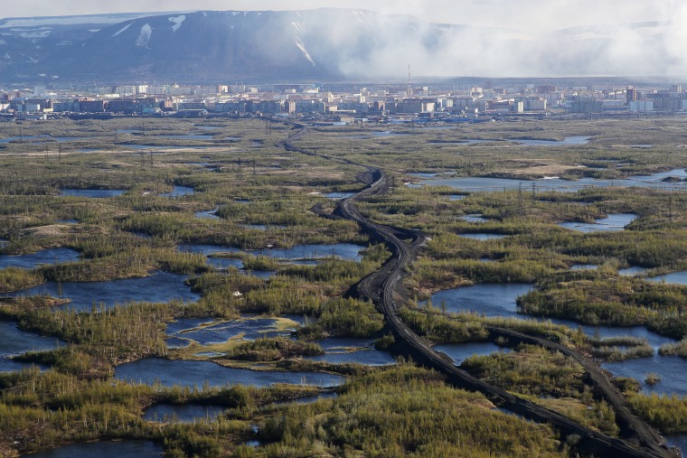
Findings
Most of environmental projects have been suspended, as has Russia’s participation in important agreements and councils on environmental issues after 2022.
Western countries have stopped cooperation with Russia in the field of environmental protection: project financing has been suspended, Russia’s presence in advisory bodies is in question…
… As well as Russia’s activities in such associations as the Arctic Council, the Council of Europe, the Baltic Sea Council, the Barents/Euro-Arctic region, where countries cooperated on a wide range of environmental issues: joint environmental expeditions, water resource monitoring, implementation of environmental technologies, green energy, environmentally friendly waste management and many other important areas.
Russia remains the fourth largest CO2 emitter in 2022. However, China (1), USA (2), India (3).
Western universities no longer share environmental assessments with Russian ones.
Local governments focus only on the level of local economic development and selectively ignore indicators of social well-being such as environmental quality.

Slide 9
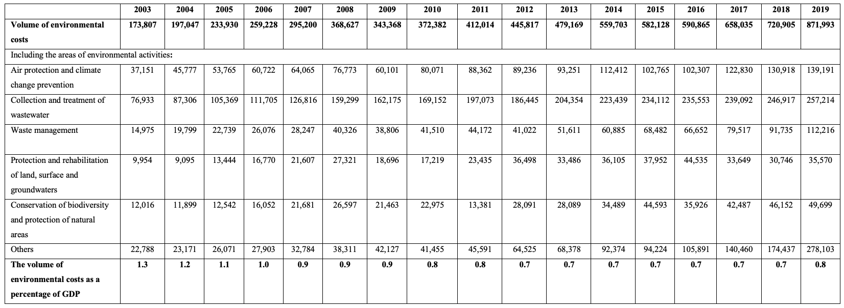
Environmental protection costs in Russia 2003-2019 (in actual prices, million rubles)
The amount of government spending on environmental protection is insufficient.
From 2003 to 2019, the share of environmental expenditures as a percentage of GDP decreased from 1.3% to 0.8%
According to the interview findings, it is estimated that environmental spending should be at least 2003 levels (i.e., 1.3% of GDP) in order to steer Russia towards sustainable development.

Slide 10

Transition to green technologies
It is estimated that the implementation of the best available technologies requires the funding of 4–8 trillion rubles (up to $86 billion)
The estimated potential of Russia in terms of investments, taking into account climatic factors in selected industries, is approximately US$313 billion for the period from 2016 to 2030.
Additional funding from the public and private sectors will be required to support the transition to green infrastructure.
Currently, the transition to a green economy in Russia is regulated by the national project “Ecology”, which was introduced in 2019 and running until 2024.
It proposes to ensure the effective management of production and consumption waste, including:
  the elimination of all unauthorised landfills identified in 2018 within the city boundaries
  a dramatic reduction in the level of air pollution in large industrial centres
  a reduction of at least 20% of the total volume of emissions of pollutants into the air in the most polluted cities,
  improve the quality of drinking water
  ecologically improve the water bodies
  conserve biological diversity.

Slide 11
Structure of the national project “Ecology”

Slide 12
Infrastructural projects (2023)
Federal project “Clean Country”:
77 of the most dangerous objects with accumulated environmental damage were eliminated;
19 Municipal solid waste landfills were reclaimed in the Moscow region;
66 landfills have been eliminated (however, new ones are appearing in both cases)
Federal project “Integrated municipal solid waste management system”:
238 infrastructure facilities in the field of MSW management were put into operation with a total capacity of 19.493 million tons/year for processing, 5.743 million tons/year for recycling and 4.152 million tons/year for disposal (disposal).
Federal project “Infrastructure for waste management of I-II hazard classes”:
4 production and technical complexes for processing, recycling and neutralization of waste of hazard classes I and II are being created on the basis of property complexes of chemical weapons destruction facilities in the Saratov, Kurgan, Kirov regions and the Udmurt Republic;
2 production and technical complexes are being created “from scratch” in the Irkutsk and Tomsk regions.

Slide 13
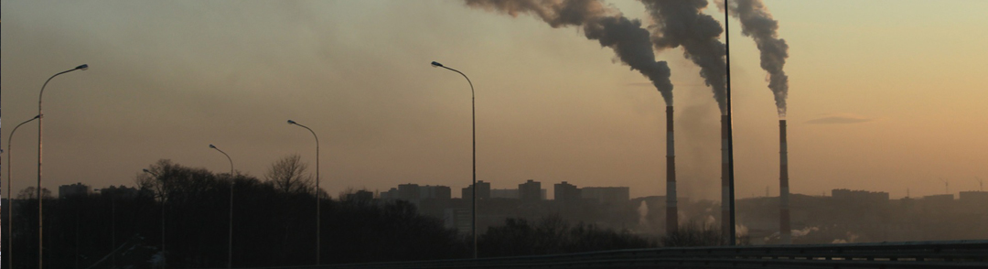
Russian government conducts these projects through public procurement projects
This is arranged in cooperation with state-owned or state-affiliated organizations or with private companies but with individuals affiliated with organizations
This also occurs due to nepotism, kickbacks (откат), tax evasion (обналичка), and money-laundering.
The national strategy for financing sustainable development is currently not formed as a single document. It is characterised by an unclear structure, incomplete coverage, and an unsystematic approach.
There are no specific and approved indicators on the federal level to measure the effectiveness of environmental policies and project implementation: hence, it’s difficult to regulate it further and form other national mechanisms
Various ‘national programs’ are implemented with no purpose or to gain profits from construction procedures

Slide 14
Cashing-out scheme within public procurement tender in Russia

Slide 15
Conclusions
Market liberal vs. social green views
Russia is known as an authoritarian regime or ’Interventionist Entrepreneurial State’ (Wright et al., 2021)
State intervention and involvement are significant and seen as a necessity
Environmental projects are expected to be and are being financed, supported and regulated by the government at all levels
Institution-based view
We can observe an institutional asymmetry
  The economy is reliant on polluting industries
  One part of the society is ready for the ecological agenda, another part is not (majority)
  Some businesses participate in the ecological programs with direct positive impact, others imitate that participation and involvement (majority)
For the government, it is a challenge to balance the interests of different stakeholders also considering internal issues (corruption and opportunist behavior among state officials)
The government uses environmental infrastructural projects as mechanisms for self-enrichment and maintaining power

Slide 16
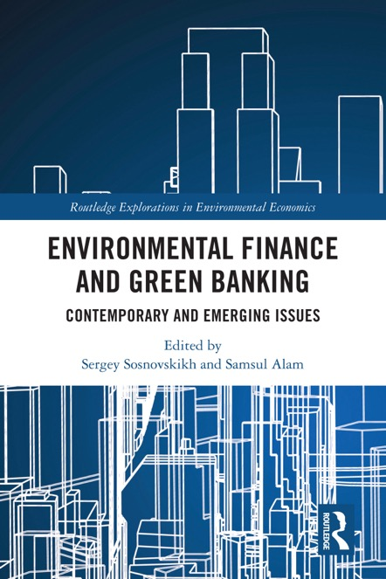
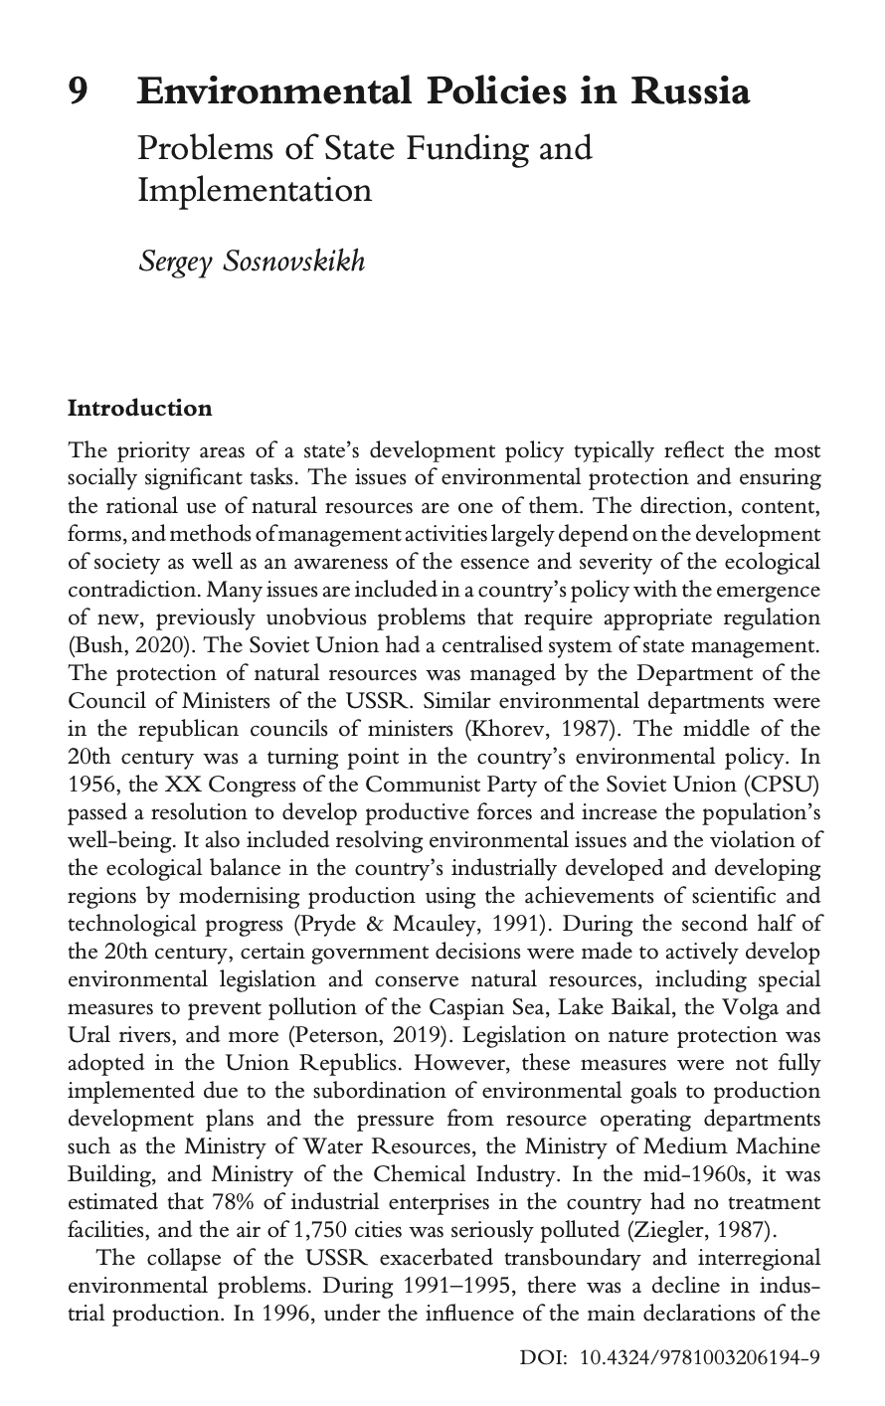
Sosnovskikh, S., & Samsul, A. (Eds.). (2023). Environmental Finance and Green Banking: Contemporary and Emerging Issues. Routledge. https://doi.org/10.4324/9781003206194

Slide 17
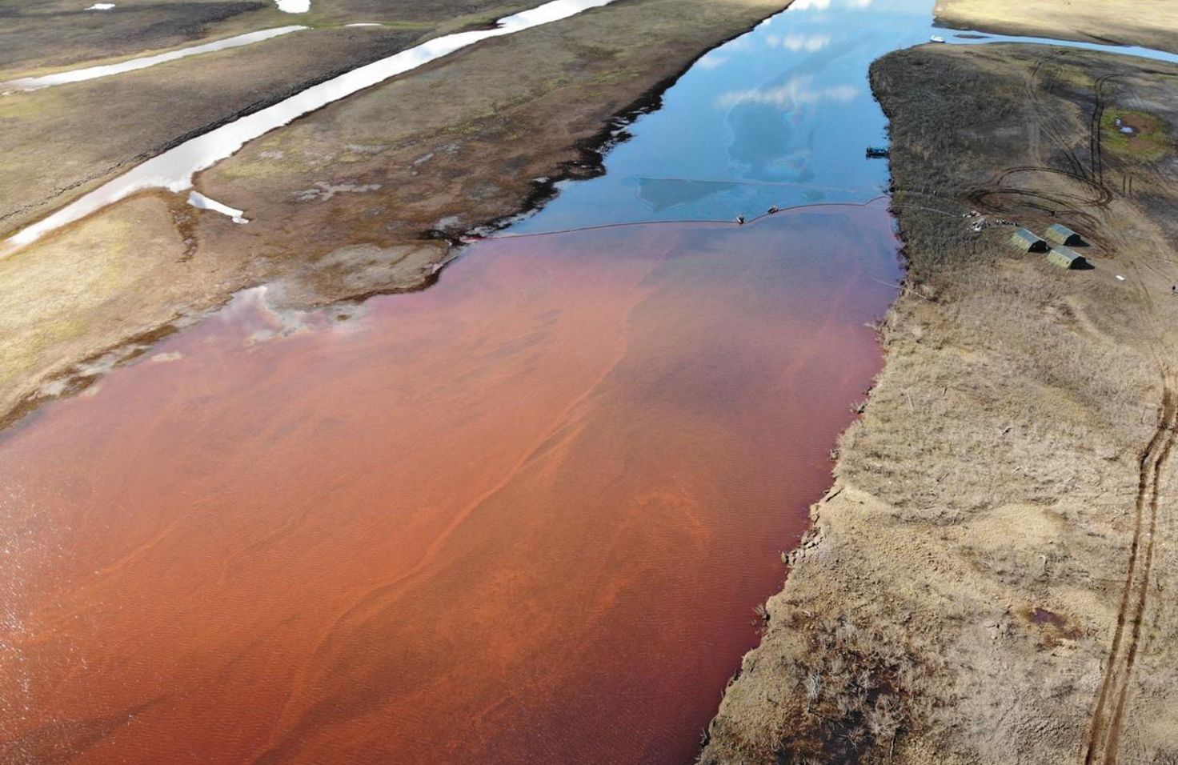
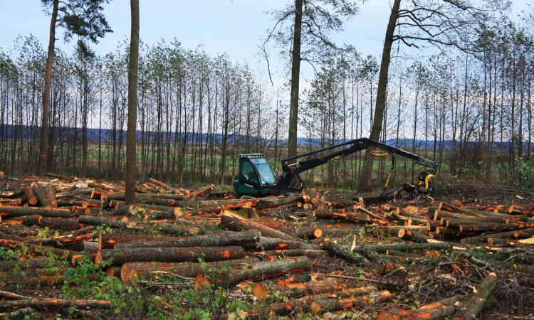
Thank you for your attention!
Sergey Sosnovskikh, PhD
Manchester Metropolitan University (UK)
s.sosnovskikh@mmu.ac.uk

