Slide 1
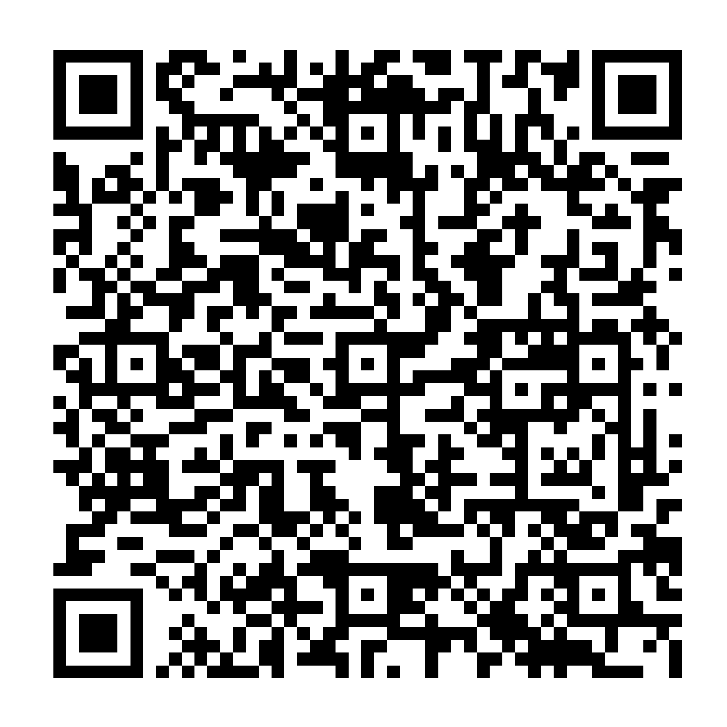
Anonymous marking online with large cohorts: a collaborative reflection
Catherine Shephard Reader in Practice-Informed Legal Education, Manchester Law School
Leanne Fitton Senior Digital Education Specialist
14 June 2023
Scan this QR code to access our presentation and resources →

Slide 2
Learning outcomes
Understand our evaluation of our experience
Apply the ideas we created for our process to be inclusive, accessible and effective
Evaluate the process from your own perspective
Feel motivated to create your own ideas for your inclusive, accessible and effective processes

Slide 3
September 2022
Unit leader
Multiple markers
Large cohort

Slide 4
September 2022
Unit leader
Moderation
Anonymous marking
Multiple markers
Extensions
Large cohort

Slide 5
Setting Sail
Unit leader
Simultaneous process changes:
Moderation
Extensions
Anonymous marking
Moderation
Anonymous marking
Multiple markers
Large cohort
Extensions

Slide 6
Mapping the journey
Unit leader
Setting up the submission point
Marking criteria, step marks, assessment brief
Allocating markers
Extensions, script identification, queries, practicalities
Multiple markers
Large cohort

Slide 7
Beacons
Unit leader
Consistency:
Answer Guidance
Feedback Guidance
Academic Integrity Guidance
Rubric
→ Markers' pack
Multiple markers
Large cohort

Slide 8
Turbulent Seas
Unit leader
Changing settings can reallocate markers
Deactivation button
Extensions, late submissions and marking deadlines
Academic integrity and Turnitin
Multiple markers
Large cohort

Slide 9
Nearly there!
Unit leader
Moderation
Dip
Calibration
Grid
Out of unit
Multiple markers
Large cohort

Slide 10
Arrival
Unit leader
Releasing marks and feedback
Moodle announcement
Linking to FAQ sheet on moodle
Anonymous feedback
Welcoming
Fair, transparent process (Borkin, 2021)
Multiple markers
Large cohort

Slide 11
The Engine Room
Our custom-made coursework tool is:
Sector-leading
Flexible
submission points are set up centrally
can manage personalised deadlines and feedback
Complex
functions that might seem straightforward...might not be
Currently:
Identities need to be revealed to release feedback
Work submitted after the original deadline cannot be marked anonymously after the original feedback date

Slide 12
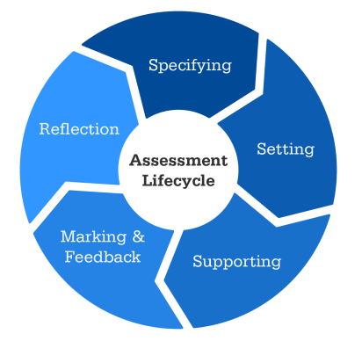
Notes from the sailing log
Consider opportunities to encourage students to engage with feedback
Share your experience
Be transparent – “anonymous wherever possible”
Engage students & marking team with the process
Coursework/ online exam distinction
Ask for advice
Consider audio feedback or 'welcoming' top and tail for engagement
Anticipate queries with FAQ sheet
Make it all easy to find
Anticipate issues
Facilitate consistency:
use a rubric
feedback guidance
Consider academic integrity approach
Adapted from Forsyth et al. (2015)

Slide 13
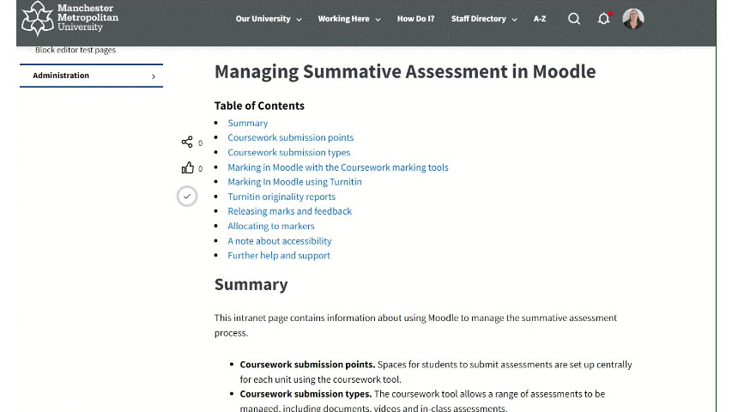
Your adventure!
Guidance for allocating assessors, rubrics, releasing marks and feedback (and more) has been updated.
Managing Summative Assessment in Moodle intranet page

Slide 14
'Tomorrow's lawyers will be the people who are designing and developing the systems that will solve legal problems'
(Susskind, 2023)
Catherine Shephard Reader in Practice-Informed Legal Education, Manchester Law School
Leanne Fitton Senior Digital Education Specialist
Scan this QR code to access our presentation and resources →
Thank you. Questions?

Slide 15
References
Borkin, H. (2021) ‘Unconscious bias literature review: bias in the curriculum’. Advance HE. Available at: https://www.advance-he.ac.uk/knowledge-hub/unconscious-bias-literature-review-bias-curriculum (Accessed: 3 Mar 2023)
Forsyth, R., Cullen, R., Ringan, N. & Stubbs, M. (2015). Supporting the development of assessment literacy of staff through institutional process change. London Review of Education. 13. 34-41. 10.18546/LRE.13.3.05.
Susskind, R., 2023. Tomorrow's lawyers: An introduction to your future. Oxford University Press.

