Slide 1
Macro and micro sustainability in innovation in the legal services sector and the management of paralegals
Catherine Shephard

Slide 2
Faculty of Business and Law
The Law Society of England and Wales. (2016) Economic Value of the Legal Services Sector. [Online] [Accessed on 3 November 2016] file:///C:/Users/55108540/Downloads/legal-sector-economic-value-final-march-2016%20(1).pdf
based on analysis by:
Cambridge Econometrics
Oxford Economics
Law Society’s Research Unit
Tuesday, June 6, 2023
2

Slide 3
Faculty of Business and Law
For every 1% growth in the UKLSS:
8,000 new jobs created
£379 million added to economy
Each £1 of extra turnover in the UKLSS:
stimulates £1.39 in the rest of the economy.
Every 100 extra jobs in the UKLSS:
supports a further 67 jobs.
c370,000 people employed in UKLSS:
63 % solicitors/ employed by solicitor firms.
Tuesday, June 6, 2023
3

Slide 4
Faculty of Business and Law
Growth in UKLSS has averaged 3.3 % pa last decade:
(UK economic growth rate of 1.2%)
UKLSS grew by 8 % 2014-15.
Net exports of UKLSS - £3.6 billion
av 5.6% growth pa over the last 10 years
export value is £4.8bn (net £3.6bn)
Total value of UKLSS to the economy is £25.7bn
English and Welsh law is the choice of law internationally
England and Wales is the jurisdiction of choice.
Tuesday, June 6, 2023
4

Slide 5
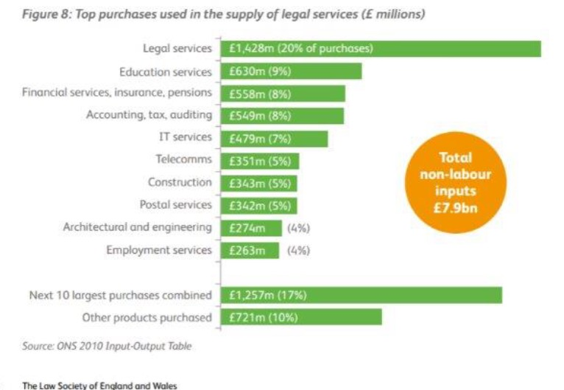
Faculty of Business and Law Postgraduate Certificate in Legal Practice Management
Tuesday, June 6, 2023
5

Slide 6
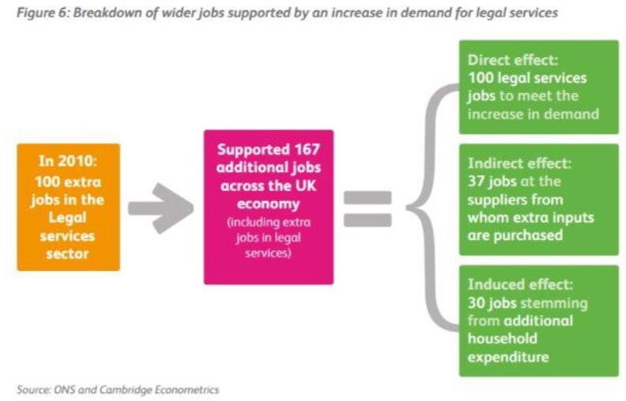
Faculty of Business and Law
Tuesday, June 6, 2023
6

Slide 7
Faculty of Business and Law
Motivation
Current debate on management in the legal services
sector
LETR – framework to support provision in time of unprecedented change
SRA Competence Statement
CILEx inquiry into meaning of paraprofessional
Research question
Can experience of change management in the public sector inform this debate?
Macro and micro sustainability
Tuesday, June 6, 2023
7

Slide 8
Faculty of Business and Law
Literature review
FE
[Policing]
NHS
Academic research in this area?
Tuesday, June 6, 2023
8

Slide 9
Faculty of Business and Law
Methodology
Conceptual paper, ideas piece
Theoretical analysis, at macro level
Intellectual exercise to reveal and articulate a shared management agenda across public and private sectors
Seeks to produce framework for management at micro level of rapid structural change in legal services sector (LSS) which will have impact and inform the current debate
Tuesday, June 6, 2023
9

Slide 10
Faculty of Business and Law
Shephard, C. and Todd, I. A. (2016) 'Strategies for managing change and the use of paraprofessionals: a cross-sector study for the benefit of post-LETR providers of legal services. Part 1: Further Education, the NHS and the Shared Management Agenda.' Northern Ireland Law Quarterly, 67(1)(1) p. 99.
Shephard, C. (2016) 'Strategies for managing change and the use of paraprofessionals: a cross-sector study for the benefit of post-LETR providers of legal services. Part 2: The Legal Services Sector and the Shared Management Agenda ' Northern Ireland Law Quarterly, 67(2) p. 141.
Tuesday, June 6, 2023
10

Slide 11
Faculty of Business and Law
Discussion
Analyses recent strategies employed in public sector to manage and implement change
Extrapolates the strategies into 3 generic categories:
Refracts current changes in LS sector through this lens
Seeks to identify a cross sector shared management agenda
Provide the service as before and meet every imperative for efficiency by requiring highly qualified staff to work harder (‘Strategy One’).
Substitute paraprofessionals for professionals (‘Strategy Two’).
Substitute capital for labour (‘Strategy Three’).
11

Slide 12
Faculty of Business and Law
Provide the service as before and meet every imperative for efficiency by requiring highly qualified staff to work harder (‘Strategy One’).
Professionals should be allowed to deal with high-order, ‘A’ team, challenging work
Default strategy
Unfeasible, primarily due to cost
Tuesday, June 6, 2023
12

Slide 13
Faculty of Business and Law
Substitute paraprofessionals for professionals (‘Strategy Two’).
Proven solution
Professionals resist idea
Better service delivery?
Need to be able to define paraprofessional and how differs from professional
SRA/ CILEx
Acceptance of risk?
Hierarchy
Customer does not mind how service ‘badged’ provided is good
How to credit paraprofessional experience
Career structure
13

Slide 14
Faculty of Business and Law
Substitute capital for labour (‘Strategy Three’).
Proven solution, provided proper implementation
Efficiencies in moving back office function to cheaper location
Tuesday, June 6, 2023
14

Slide 15
Faculty of Business and Law
Conclusion
There is a cross sector shared management agenda:
Allow for system improvement
Appropriate supervision, flexibility of approach & allocation of responsibility
Actively manage paraprofessionals
Risk, accountability, reward, support
Identify how best to use professionals
Prepare, resource, identify ‘A team’ work
Allow professionals to ‘own’ IT systems
Delivery, evaluation, refinement
Support staff through profound change
Opportunities, threats, career progression
15

Slide 16
Faculty of Business and Law
Limitations
Lack of body of academic research and debate
Conceptual piece:
Legal academics – open to theoretical, idea pieces – but this about ‘practice’ not ‘law’
Management academics – social science basis – like data
Written for practitioners
Law firm culture: not traditionally open to ‘management’ education or academic research
Where is home?
Tuesday, June 6, 2023
16

Slide 17
Faculty of Business and Law
Further research
Empirical support for the argument
Scope for further analysis of areas which resonate most with managers in legal services sector
Tuesday, June 6, 2023
17

Slide 18
Faculty of Business and Law Postgraduate Certificate in Legal Practice Management
Questions?
Distinction between professionals and paraprofessionals
Home for the paper
Catherine Shephard | Senior Lecturer | Law
MA (Cantab.), BA Law (Cantab.), PGDip. Legal Practice, PGCE (HE), Solicitor (non-practising)
c.shephard@mmu.ac.uk
@missshephard
Tuesday, June 6, 2023
18

