Slide 1
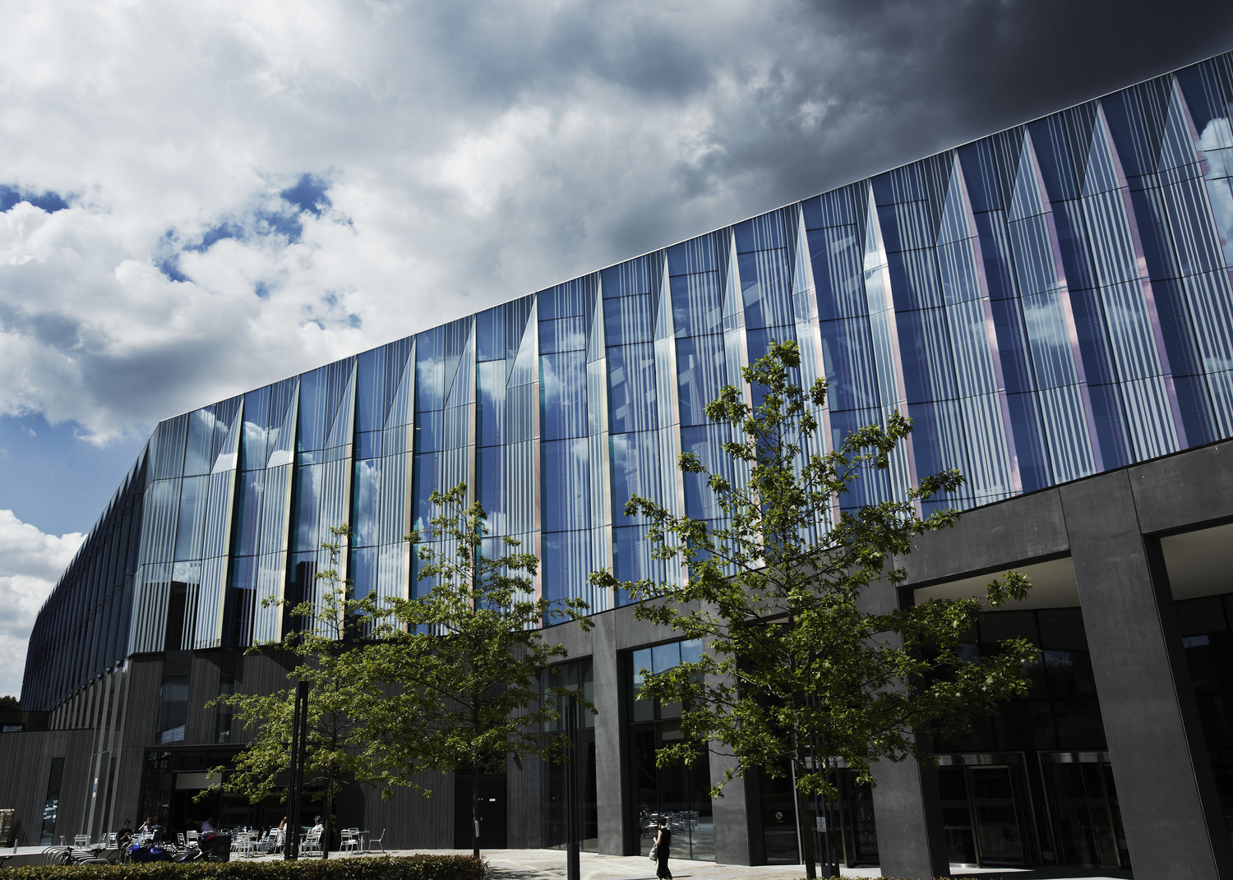
Strategies for managing change and the use of paraprofessionals; a comparative study for the benefit of post-LETR providers of legal services
Catherine Shephard

Slide 2

Faculty of Business and Law Postgraduate Certificate in Legal Practice Management
Introduction
Catherine Shephard | Senior Lecturer | Law
MA (Cantab.), BA Law (Cantab.), PGDip. Legal Practice,
PGCE (HE), Solicitor (non-practising)
c.shephard@mmu.ac.uk
@missshephard
Programme Director, Postgraduate Certificate in Legal Practice Management
Law Society’s Management Course Stage 1
Tuesday, June 6, 2023
2

Slide 3
Faculty of Business and Law Postgraduate Certificate in Legal Practice Management
Motivation
Current debate on management in the legal services
sector
LETR – framework to support provision in time of unprecedented change
SRA Competence Statement
CILEx inquiry into meaning of paraprofessional
Research question
Can experience of change management in the public sector inform this debate?
Tuesday, June 6, 2023
3

Slide 4
Faculty of Business and Law Postgraduate Certificate in Legal Practice Management
Literature review
FE
Policing
Healthcare
[Accountancy]
Academic research in this area?
Tuesday, June 6, 2023
4

Slide 5
Faculty of Business and Law Postgraduate Certificate in Legal Practice Management
Methodology
Conceptual paper, ideas piece
Theoretical analysis, at macro level
Intellectual exercise to reveal and articulate a shared management agenda across public and private sectors
Seeks to produce framework for management of rapid structural change in legal services sector which will have impact and inform the current debate
Tuesday, June 6, 2023
5

Slide 6
Faculty of Business and Law Postgraduate Certificate in Legal Practice Management
Discussion
Analyses recent strategies employed in public sector to manage and implement change
Extrapolates the strategies into 3 generic categories:
Refracts current changes in LS sector through this lens
Seeks to identify a cross sector shared management agenda
Provide the service as before and meet every imperative for efficiency by requiring highly qualified staff to work harder (‘Strategy One’).
Substitute paraprofessionals for professionals (‘Strategy Two’).
Substitute capital for labour (‘Strategy Three’).
6

Slide 7
Faculty of Business and Law Postgraduate Certificate in Legal Practice Management
Provide the service as before and meet every imperative for efficiency by requiring highly qualified staff to work harder (‘Strategy One’).
Professionals should be allowed to deal with high-order, ‘A’ team, challenging work
Default strategy
Unfeasible, primarily due to cost
Tuesday, June 6, 2023
7

Slide 8
Faculty of Business and Law Postgraduate Certificate in Legal Practice Management
Substitute paraprofessionals for professionals (‘Strategy Two’).
Proven solution
Professionals resist idea
Better service delivery?
Need to be able to define paraprofessional and how differs from professional
  SRA/ CILEx
  Acceptance of risk?
  Hierarchy
Customer does not mind how service ‘badged’ provided is good
How to credit paraprofessional experience
Career structure
8

Slide 9
Faculty of Business and Law Postgraduate Certificate in Legal Practice Management
Substitute capital for labour (‘Strategy Three’).
Proven solution, provided proper implementation
Efficiencies in moving back office function to cheaper location
Tuesday, June 6, 2023
9

Slide 10
Faculty of Business and Law Postgraduate Certificate in Legal Practice Management
Conclusion
There is a cross sector shared management agenda:
Allow for system improvement
Appropriate supervision, flexibility of approach & allocation of responsibility
Actively manage paraprofessionals
Risk, accountability, reward, support
Identify how best to use professionals
Prepare, resource, identify ‘A team’ work
Allow professionals to ‘own’ IT systems
Delivery, evaluation, refinement
Support staff through profound change
Opportunities, threats, career progression
10

Slide 11
Faculty of Business and Law Postgraduate Certificate in Legal Practice Management
Limitations
Lack of body of academic research and debate
Conceptual piece:
  Legal academics – open to theoretical, idea pieces – but this about ‘practice’ not ‘law’
  Management academics – social science basis – like data
Written for practitioners
  Law firm culture: not traditionally open to ‘management’ education or academic research
Where is home?
Tuesday, June 6, 2023
11

Slide 12
Faculty of Business and Law Postgraduate Certificate in Legal Practice Management
Further research
Empirical support for the argument
Scope for further analysis of areas which resonate most with managers in legal services sector
Tuesday, June 6, 2023
12

Slide 13
Faculty of Business and Law Postgraduate Certificate in Legal Practice Management
Questions?
Distinction between professionals and paraprofessionals
Home for the paper
Catherine Shephard | Senior Lecturer | Law
MA (Cantab.), BA Law (Cantab.), PGDip. Legal Practice, PGCE (HE), Solicitor (non-practising)
c.shephard@mmu.ac.uk
@missshephard
Tuesday, June 6, 2023
13

