Slide 1



Reflections on Decent Work and Career Guidance
CDI Scotland Conference – 10 March 2023
Dr Fiona Christie – Senior lecturer
Notes:
Introduction of me.
This talk will explore the implications of the UN Sustainable Development Goal ‘Decent Work and Economic Growth’ for careers practitioners. It will address how Decent Work is defined and explore barriers and opportunities to Decent Work. It will also suggest ways careers practitioners can use the concept in both policy and practice. In presenting this talk, Fiona will draw upon her recent research with precarious workers, and also experiences in career development-related practice.

Slide 2
Today
Defining Decent Work
Opportunities for Decent Work
Barriers to Decent Work
Implications for Career Guidance

Slide 3
Defining Decent Work

Slide 4

The Sustainable Development Goals (SDGs)
Source: United Nations, 2015
Notes:
DW Part of international values depicted as goals.
Decent Work partnered with Economic Growth (I won’t go into the latter today). But want to acknowledge that lots of debates about merits of growth and having sustainable growth so creating work opportunities that are good for the environment.

Slide 5
Global aspirations for Decent Work (ILO since 1999)
Promoting employment by creating a sustainable institutional and economic environment
Developing and enhancing measure of social protection – social security and labour protection – which are sustainable and adapted to national circumstances.
Promoting social dialogue and tripartism (i.e., close connections between government, worker organisations and employers).
Respecting, promoting and realising the fundamental principles and rights at work

Slide 6

The ILO’s Decent Work agenda
Dignity
Equality
Fair income
Safe working conditions
Voice
Access to work
Rights at work
Social protection
Social dialogue
ILO. (2019), Work for a better future. The Global Commission on Work. ILO. Geneva
Notes:
ILO (2019). Work for brighter future. Geneva.

Slide 7

Some ongoing debates (Brill, 2021)
Not radical enough. Trade union rights watered down in ‘social dialogue’. Compromised by tripartite nature (governments, employers, trade unions).
Inadequate attention on the individual and meaning of work issues.
Difference in nature of work across Global South and Global North. Issues of globalisation.
Feminist scholars welcome its breadth - space on the ILO’s agenda for the protection of informal forms of employment where women workers are often over-represented
Notes:
Some of the debates about Decent Work that continue.

Slide 8
Opportunities for Decent Work
Notes:
Strong argument that Decent Work contributes to productivity and economic growth. ILO use language of Sustainable Economic Growth. Wider debates about growth and the relationship to the environment and climate change.

Slide 9



‘Good Work’ in the UK
Notes:
There has been quite a lot of activity in the UK about Good work. This does connect to international discussions about Decent Work as UN SDG.
The ILO have done work internationally in defining Decent Work, ILO (2019). Work for brighter future. Geneva.
RSA (originally commissioned by Theresa may’s government) and Carnegie UK Trust have developed measures about this. This has fed into the CIPD’s Good Work index.
What is happening in your region about Good Work?

Slide 10
Carnegie Trust & RSA (2018) Measures of ‘Good Work’ – integration into CIPD Good Work index
Terms of employment
Pay and benefits
Health, safety and psychosocial wellbeing
Job design and nature of work
Social support and cohesion
Voice and Representation
Work-life balance
Notes:
Carnegie UK Trust & RSA (2018). Measuring Good Work: The final report of the Measuring Job Quality Working Group. Carnegie UK Trust website,, Carnegie UK Trust, RSA Future Work Centre,.
Terms of employment – job security, Minimum guaranteed hours, underemployment
Pay and benefits – pay (actual) satisfaction with pay, entitlements, non-wage benefits
Health, safety and psychosocial wellbeing – health and safety, physical injury, mental health
Job design and nature of work – training, usefulness of training, use of skills, control, opportunities for progression, sense of purpose, authonomy and discretion
Social support and cohesion – peer support, line manager relationship, personal development, resolving problems
Voce and representation – trade union membership, employee information, employee involvement
Work-life balance – over-employment, overtime (paid and unpaid), flexibility (formal and informal), suitability of hours, advance notice of shift patterns and work location, anxiety and work-life balance
These aspects have been integrated into the CIPD Good Work Index. As UK Government moves around good work are slow, the CIPD has been an important body in driving employer practices

Slide 11
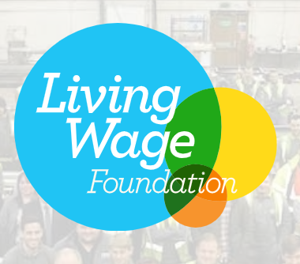
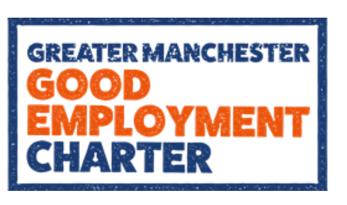
The Good Work Movement
Paying a Living Wage – the Living Wage Foundation
Secure hours – the Living Hours Campaign
Regional Good Work Agenda – Greater Manchester Employment Charter, others planned in Liverpool and West Yorkshire; Scottish Fair Work Convention; Welsh Fair Work Commission
Strengthening management (especially in SMEs) – GM Good Employment Learning Lab; CIPD People Skills project; West Midlands Productivity from Below.
Notes:
Jones and Kumar (2022) Idleness useful chapter on this
Relationship between good work and productivity suggested in projects listed in final bullet point

Slide 12
Barriers to Decent Work

Slide 13
Labour market trends
Concerns about delay in employment legislation following departure from EU. Though some positive legal cases, e.g., status of Uber drivers
In-work poverty
Insecure work, e.g., zero hours contracts, self-employment, gig work through platforms.
Involuntary economic inactivity
Jones and Kumar (2022), Resolution Foundation (2022)
Notes:
In-work poverty associated with low pay and part-time hours (8.3 million people in UK) 2019/20 - Jones and Kumar – figures
ONS estimate 1 million people working on zero hours contracts – 2021
Resolution Foundation – Low Pay Britain report
Low-paid self-employed workforce – 1.6 million
Gig workers – 350,000
Labour Force Survey – estimates 3.4% of working age people – inactive but would like to work – sick or disabled, family responsibilities, other reasons (jones and kumar) – circa 3 million

Slide 14
Implications for Career Guidance practice

Slide 15
What can career guidance do?
Career guidance for social justice movement offers a framework of theoretical ideas for practice. (Hooley et al, 2021)
  build critical consciousness;
  name oppression;
  question what is normal;
  encourage people to work together;
  and work at a range of levels.
Notes:
https://careerguidancesocialjustice.wordpress.com/2021/12/17/five-signposts-to-a-socially-justapproach-to-career-guidance
Career guidance includes wide range of activities. Individual advice, provision of information, employer engagement activity. How it functions depends on the sector you work in, ie., community, higher education, schools
Careers practitioners unique role acting as boundary spanners between educational institutions, employers, individual workers. Advocacy role of careers workers can sit less comfortably with us.
Naming oppression - understanding what is happening in the labour market, e.g., inequalities
Questioning what is normal, e.g., meritocracy

Slide 16
Career guidance – work with individuals (building critical consciousness)
High quality advice and guidance can support people to find good work. But career guidance criticised for its emphasis on individual agency rather than addressing structural issues.
Find ways to highlight structural issues (e.g., Candy Ho’s work with SDGs) that do not diminish optimism.
Helping people make sense of competing discourses e.g., the entrepreneurial self vs precarious worker.
Helping people understand rights at work.
Notes:
Risk of responsibilisation associated with employability.

Slide 17
Career guidance – work with employers and policymakers (work at a range of levels)
Influencing employers with regard to job quality. Use argument that Decent Work leads to more productive work.
Appropriate policies on vacancy-handling.
Active support of relevant policy developments, e.g., living wage, living hours etc.

Slide 18
Human needs: Work as a means of…..
Social connection/
contribution
Survival and power
Self-determination
Psychology of working framework (Blustein,2019)
Notes:
Other career theory – Psychology of working framework also offers ideas that can influence practice. Work as a core part of being human.
Lots of talk in guidance about skills, interests, abilities etc. Duffy and Blustein and colleagues highlighted importance of human needs.
Vocational psychologists have argued that human beings have certain needs at work.
Blustein, D. L., et al. (2019). "The psychology of working in practice: A theory of change for a new era." The Career Development Quarterly 67(3): 236-254.
The needs from work. These should be satisfied in order to achieve Good or Decent Work.
Survival and power – the ‘material’ importance of work which allows people to have the resources to live.
Social connection and contribution – human beings are relational and need to interact with one another and to see their work as making a contribution.
Self-determination –the role of autonomy and competence. Deci and Ryan, 2020 – linked to motivation
Also brings up issues of the relationship between decent work and meaningful work. Higher level expectation for meaningful work. ‘work experienced as particularly significant and holding more positive meaning for individuals’ (see Duffy and Blustein, 2023)
Useful to discuss with clients….PoWT authors have also generated their own questionnaire which acts as an individual measure of decent work.

Slide 19
Contemporary work contexts?
Decent Work
Decent Work with purpose and meaning
Precarious work
Unemployment
Underemployment
Blustein, 2019
Notes:
Interesting to also consider differences between decent and meaningful work

Slide 20

Questions of Decent Work? Ask clients what it means to them

Slide 21
Asking young people to define Decent Work (in my recent research)
Earning enough to get by
Happiness/satisfaction
Dignity/being valued
Progression
Having rights and protection
Subjective vs objective definitions
Notes:
In two recent research projects, I asked YP what they thought of Decent Work. This generated interesting insights and served to highlight how aware many are of the issues surrounding this.
The first project was during the pandemic and an important theme emerged about how the pandemic made people think more deeply about the role of work in society. Many of the YP we interviewed were doing key worker jobs that were insecure, e.g., in retail, hospitality and care. Others in jobs that were very disrupted, e.g., in the arts.

Slide 22
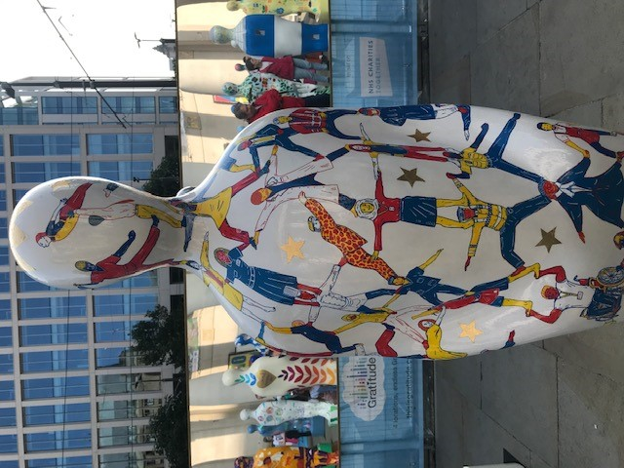
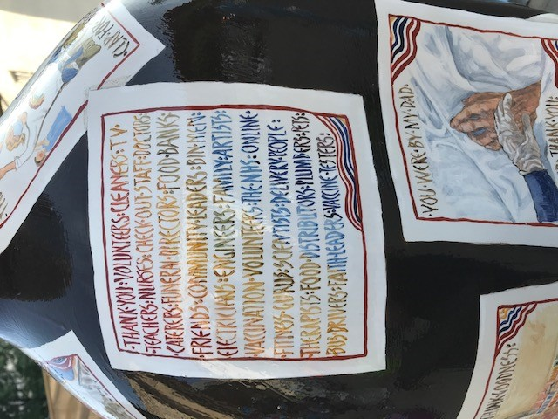
Gratitude touring show
Notes:
These two images are from a touring Art show Gratitude. I show it as it visually illustrates some of the issues that came up when discussing work with young people during the pandemic.
Highlight the interconnections between varied workers and how many of important roles were not those that might be defined conventionally as Decent Work, e.g. vaccination volunteers, delivery workers.

Slide 23
Enough to cover your expenses, enough to allow you to do like things you want to do like within reason. Then yeah to cover all your basic needs and then some. A lot of people need the security. Other people, although other people don’t want that and other people favour the flexibility. So it really does come down to the person and their individual definitions of decent work. Now although like the Deliveroo stuff and even a lot of the other jobs I’ve had in the past…even when they are really good and I recommend them, there are only some that I would class as decent work. Adam, Student cycling for Deliveroo

Slide 24
Decent work for me, being happy in your job, having good interactions with people, not feeling depressed, having enough to feed and house yourself and have some leisure time and kind of getting pleasure from your work, you know, yeah. And feel like you’re contributing to society and making people happy in some way, in whatever way it is. …What you’re doing, research, trying to help society, trying to help young workers. I think that’s decent work. Blake, self-employed artist

Slide 25


Selected References
Blustein, D. (2019). The importance of work in an age of uncertainty. Oxford, Oxford University Press.
Christie, F., & Swingewood, A. (2022). The impact of Covid-19 on Young Workers in England: young people navigating insecure work in Greater Manchester during the Covid-19 pandemic. MMU
Christie, F., Antoniadou, M., Albertson, K., & Crowder, M. (Eds.). (2021). Decent Work: Opportunities and Challenges.
Hooley, T. S., Ronald G. & Thomsen, Rie (2021). Five signposts to a socially just approach to career guidance. Journal of National Institute of Career Education and Counselling.
ILO (2019). Work for brighter future. Geneva.
Jones, K., Kumar, A. (2022). Idleness (the Five Giants). Agenda Publishing.
Resolution Foundation. (2022). Low Pay Britain 2022.

Slide 26


