Slide 1

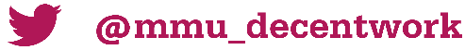

The Evaluation of a Youth Employment Project (Hidden Talent)
Dr Fiona Christie – Senior lecturer, Manchester Metropolitan University
f.christie@mmu.ac.uk; @FCChristie
National Research Conference for Careers Practitioners – 16th February 2023

Slide 2


Topics in this talk
What was Hidden Talent?
How was the evaluation conducted?
What did we find out?
What are the implications of the evaluation?

Slide 3



Greater Manchester Hidden Talent Hidden Talent (January-June 2022)
Employment support programme for young people aged 16-24 funded by the Community Renewal Fund (DLUHC)
A Delivery Partner in each Local Authority hosts a ‘Talent Coach’ who provides one-to-one holistic support
GM Chamber of Commerce (Employer Engagement partner); GM Youth Network (hosted the Youth Panel); Man Met Uni (Evaluation Partner)
Notes:
Explain NEET and Hidden and Talent – important for the project
Funding from Dept for Levelling up through a Community Renewal Fund. 1 of 9 in GM and we were given enhanced support by DWP
Delivery Partner is a community organisation that has excellent local connections and is embedded within the local community.
GMYN
Careers support very much bedded into a youth work model. Mixed qualifications and backgrounds of talent coaches.

Slide 4
Programme Delivery (incorporated good practice from previous projects)
Advisory Group, Delivery Partner and Talent Coach meetings
Expenses – ID, travel, equipment, clothes
Mental health support with 1:1 counselling
Accommodation, health & wellbeing and financial advice
Youth Panel carried out Youth Hub visits and presented findings
Notes:
Support for young people to help them into employment and/or in the direction of employment
Met regularly with DPs and TCs. Helped to keep them up to date with sharing ideas, overcoming challenges (eg. Finding it hard to engage or motivate some young people), keep the partners up to date. Advisory Group made up of local authorities, Good Employment Charter, GM Learning Provider Network, Housing Association, GMCA, DWP, Youth Panel and GMCC.
From other programmes have seen that access to ID, travel, equipment, travel and clothes can be an issue. Having access to “Beneficiary expenses” allows the young person to remove another barrier when trying to gain education, employment or training. Example of training course for parent to understand the young person’s condition.
One central database that was used on our last employability programme was amended. As well as employability support we could see what themes were being discussed in sessions and these had commonality across the partners. Accommodation issues, health and wellbeing and financial advice – namely debt management
The Youth Panel continued to be our Youth Voice and to ensure that we kept on track with what is important to them rather than what we think is important. So early in the programme the Youth Panel met with GMCC and highlighted that access to work experience is crucial if you haven’t had a job before. Even some entry level jobs ask for experience.
Now going to hand over to people who will tell you about their experience on Hidden Talent.

Slide 5
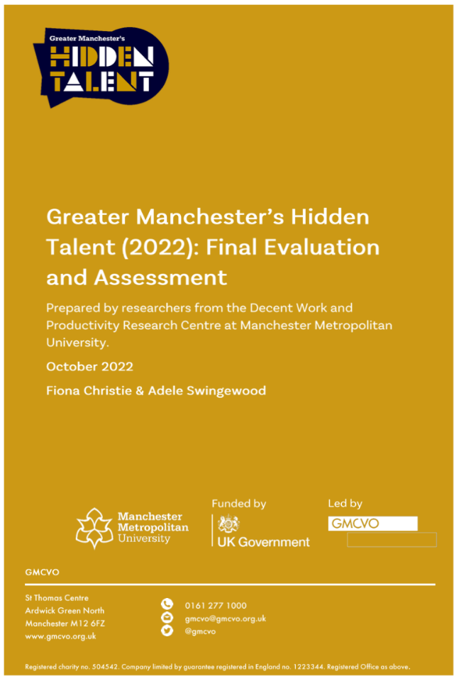
How was the evaluation conducted? (Markiewicz & Patrick, 2015).
Appropriateness
Efficiency
Impact
Sustainability
Effectiveness
Notes:
Our aims today
The evaluation report gives a lot of detail about how the project was managed and organised and what it achieved.
Used Markiewicz and Patrick’s five categories which mapped onto what GMCVO had said about the evaluation in their bid to government.
appropriateness of initial design
progress against targets
delivery and management
outcomes and impact
value for money
wider lessons learnt
On project commencement we undertook desk research about work to support young people who are NEET into the labour market. Lots of good work already done that has been reported upon. Youth Futures Foundation supported a large scale review. Talent match which was a national project between 2014-2018 that GMCVO was a partner to, had extensive findings and recommendations. On commencement of the evaluation, hard not to think that whatever we found out might not say anything different to what has already been written about. However, high level of scrutiny for projects of this kind meant that a thorough evaluation was expected.
Mindful that policy and practice landscape is very change-able. I may not be up-to-date with everything that is happening with current provision that has followed on in similar space of working with NEET YP. I am also influenced by other research undertaken and by my own experience of practice.

Slide 6
How the evaluation was conducted?
Stage One - GMCVO collected and reviewed monitoring data collated by them from delivery partners/talent coaches. This comprised detailed data about participation and outcomes.
Stage Two – MMU team conducted and fully transcribed individual /group interviews with young people (n-15), GMCVO project management team (n- 4), talent coaches (n-6), delivery partners (n-3), and Advisory Group (n-3). The Youth Panel (n-5) and Youth Panel co-ordinator (n-1) met more informally with the evaluator.
Evaluation team members also attended various meetings to gain insights about the context and operations of Hidden Talent.
Notes:
In addition to monitoring data collected, GMCVO adapted items that had been developed as part of the Talent Match project data framework and that was used to create a ‘proximity to the labour market’ (PLM) measure which estimates the different factors that contribute positively/negatively to young people who are NEET entering education, training, or employment. Sanderson, E., & Wilson, I. (2015). Talent Match Evaluation and Learning Contract: 2013-19 - Common Data Framework: Annual Report. Sheffield Hallam University.
Good practice to build on learning from previous evaluation. Can’t discuss today but use of this data is in the report.
Stage 2 - Some individuals held more than one role, e.g., acted as a talent coach as well as delivery partner.
Discuss important difference between monitoring and evaluation. Monitoring requires collection of data to help review programme but cannot explore why and how a project may have worked or not worked.

Slide 7
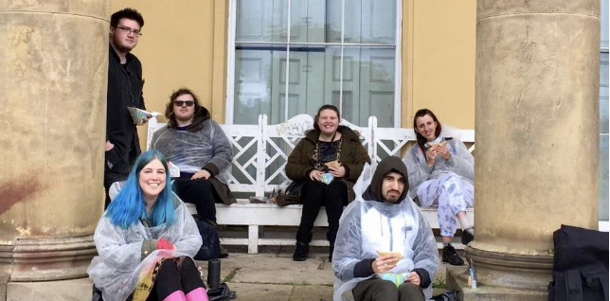
Reaching hidden young people
Of the 142 young people who participated, 51% were economically inactive (including hidden), 49% were registered as unemployed and receiving Benefits. 45% of the total were hidden.
More generally, the project was successful in reaching a diverse group of young people who were NEET or at risk of being NEET.
Notes:
Project aimed to reach young people known to have the most barriers to getting into the labour market: Hidden young people (Economically Inactive); Young people from ethnically diverse backgrounds; Young people diagnosed with a long-term health condition (including mental health); Disabled young people (including Learning Disability and Neurodiversity); Ex-offenders; Lone parents; Care leavers; Young people vulnerable to substance misuse; Homeless young people; Carers

Slide 8
Outcomes for young people – not just employment
142 people supported (target 124)
142
44 education and training outcomes were achieved (target 54) by 38 individual young people – 27% of young people
44
135 young people were supported with life skills (target 124) – 95% of young people
135
16 young people were supported to engage with the Benefits system (target 32) – 11% of young people
16
8 young people gained an Ofqual qualification (target 10) – 6% of young people
8
14 non-Ofqual qualifications were achieved by 11 young people (no target set) – 8% of young people
14
120 young people were supported to job search (target 82) - 85% of young people
120
41 employment outcomes were achieved (target 32) by 37 young people - 26% of young people
41
Notes:
The project reached eighteen more young people (n – 142) than planned for (n – 124). Virtually all young people (95%) were supported with life skills (135 young people supported against a target 124). 85% were assisted with job search skills (120 against a target of 82). 26% of beneficiaries (37 young people) achieved an employment outcome (n – 41, against target of 32).
The timing of the project and young people’s varied, and complex situations explain why some outcomes were lower than the original targets. 27% secured an education and training outcome (44 against a target of 54) and 6% gained an Ofqual qualification (8 against a target of 10). An additional 11 young people gained a qualification that advanced their progress to the labour market but was not Ofqual recognised (14 qualifications gained). 11% engaged with the Benefits system (16 against a target of 32), possibly an indicator of both an enduring resistance to engage with the Job Centre, but also due to many moving into a more positive outcome in education, employment, and training.
Short nature of project mean not possible to consider whether young people moved into and sustained good work.

Slide 9
Comparing outcomes of young people: hidden vs unemployed
Outcome | Hidden | Economically Inactive (including hidden) | Unemployed
Job Searching | 91% | 86% | 83%
Ofqual qualifications | 9% | 7% | 4%
Other qualifications | 8% | 4% | 11%
Engaging with the benefit system | 9% | 14% | 9%
Education and training | 23% | 23% | 33%
Life Skills | 94% | 96% | 94%
Employment | 34% | 35% | 17%
Notes:
Due to the project’s focus on hidden young people, outcomes across the different activity groups were compared. The outcomes of hidden young people surpass their unemployed peers in engagement with job searching (91% compared to 84%), gaining an Ofqual qualification (9% compared to 4%) and most notably 34% achieve an employment outcome compared to 17% of the unemployed. Figure 2 depicts this data graphically. Unemployed young people had higher outcomes than their peers in relation to education and training (33% compared to 23% of hidden). The outcomes achieved by hidden young people supports the urgency of actively seeking out these young people who are NEET with scope they can make more movement than those already engaged with the Benefits system.

Slide 10



Strong and trusting relationships with talent coaches lead to…
Growing self-reflection and self-efficacy
Responding to Adversity
Taking Action
Notes:
We asked a question If you hadn’t had the opportunity to work with the talent coach what would you be doing now? This evoked lots of interesting responses. Strong testimony of the effectiveness and professionalism of talent coaches in securing trust of young people.
Some quotes which illustrate three themes. Showing just three but these are indicative of themes that emerged across participants.
Cognitive
Behavioural
Emotional benefits

Slide 11
Other findings (connect to implications for partners)
Benefits to partners - Important to consider how these relationships continue if not members of a collaborative project.
The role of employers - Ongoing work is required to support the pipeline of young people who are NEET into the labour market.
The role of the DWP - Barriers to claim included the social stigma associated with being a claimant, an inaccessibility in making and sustaining a Benefits claim, and fears about the repercussions of sanctions.
Notes:
Mutual benefit for all parties through partnership working in enhancing planning and delivery of the project. The engagement of a diverse group of delivery partners as well as Advisory Group members meant the project drew upon diverse skills, knowledge, and experience. These partnerships can continue beyond project-end.
Partnerships with employers and DWP representatives on the Advisory Group allowed the project to be informed by, as well as influence, these important institutions for young people’s employment. Ongoing work is required with these groups to support the pipeline of young people who are NEET into the labour market.
Despite efforts by the DWP to improve take-up of Benefits and active engagement as a project partner, both young people and stakeholders had negative perceptions of the experience of making a claim for Universal Credit (or other Benefits) and attending the Job Centre. Barriers to claim included the social stigma associated with being a claimant, an inaccessibility in making and sustaining a Benefits claim, and fears about the repercussions of sanctions. With fears of poverty increasing, this low take-up of entitled Benefits is an urgent problem.

Slide 12


Other general insights with important implications
Mental health and wellbeing are an important factor in the development of young people’s sustainable employability and need to be recognised in any youth employment programme.
Despite the good outcomes achieved by the project, there were serious misgivings about such important work being allocated short-term funding.
Notes:
Some issues in take-up around mental health support across the project despite many young people reporting this. Slowness of systems but some YP already getting help elsewhere.
Recognition of importance of this but also that some more serious mental health issues are outside the scope of a project like this focused on youth employment.
Limitation of the time-limited project – e.g., inhibited ability to reach more new YP, concerns about leaving YP in the lurch when project finishes, dependent on partners being very nimble to find other sources of funding to continue to help YP etc.

Slide 13
Project legacy
Successive iterations of Hidden Talent support the importance of working with hidden young people.
01
Hidden Talent has provided a foundation for many delivery partners to continue their work through other funding.
02
The modelling of a youth-led approach is an important feature that will continue into other projects.
03

Slide 14
Concluding thoughts: Implications for future policy and practice
A long-term, sustainable strategy is required to support young people into the labour market. Policymakers can lead in creating a suitable funding and investment infrastructure for this.
Youth employment strategy needs to focus not just on young people but on employers.
Recognition is required of unique needs of young people and the benefits to individuals and society of timely assistance in accessing education, employment and training.
Integration of specialist careers advice and guidance expertise to strengthen projects.

Slide 15


