Slide 1
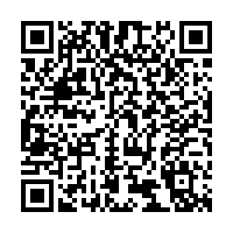
‘We’re not in Kansas anymore’: Identifying our ‘New Normal’ in Legal Education
Catherine Shephard, Reader in Practice-Informed Education
Vicky Martin, Senior Lecturer
Socio-Legal Studies Association
Annual Conference 2023
5 April 2023

Slide 2
‘We’re not in Kansas anymore’: Identifying our ‘New Normal’ in Legal Education
Dr Norah Burns, Dr Martin Regan, Dr Paulina E. Wilson
Queen’s University Belfast.
SHAPING A
BETTER WORLD
SINCE 1845

Slide 3
Research question
If we are not going ‘back to normal’…
What is our ‘New Normal’?...
…and can we acknowledge the challenges and opportunities we are experiencing in our classrooms?

Slide 4
Methodology
Conceptual paper
Micro level: narrative case-studies
Macro level: theoretical analysis

Slide 5
New Normal?
Attendance
Engagement
Confidence
Connection
Wellbeing
Mental health
HR
Technology
Assessment
Grade inflation
Academic Misconduct
AI
Attainment gaps
Deregulation
Widening Participation
CLE
Cost of living
Internationalisation
Globalisation

Slide 6
Current Debate
Shephard, C., Burns, N., Regan, M., Vincent, M., Wilson, P. (2022) 'Roundtable -‘Covid Keepers’ –Practical innovations inside and outside our classrooms.' In Annual Conference of the Irish Association of Law Teachers 2022. Queen's University Belfast, 11/11/2022 - 13/11/2022.
Slorach, S., Embley, J., Goodchild, P., Shephard, C. (2023) Legal Systems and Skills 5th Ed.. Oxford University Press.
Goodwin, M. (2023) 'Tales From the Classroom. How lockdown wrecked young lives’, The Sunday Times, 5 March 2023.
Snepvangers, P. (2023) ‘Number of students cheating at Russell Group universities has more than doubled since 2019’, The Tab, 20 Feb 2023.

Slide 7
Literature Review
Investigating the learning of our own students (Trigwell, 2000)
Wicked problems (Rittel and Webber, 1973)
Signature pedagogies (Shulman, 2005)
Threshold concepts (Meyer and Land, 2003)
Communicating about learning, with transparency (Healey, 2000)
Radical change agenda (Elton, 1999)

Slide 8
Opportunity for Further Research
What is now required
to support the continued delivery of excellence in legal education
in our newly articulated ‘New Normal’?

Slide 9
Student mental health, wellbeing, and personal tutoring support post Covid-19
Vicky Martin

Slide 10
Key Themes
Increase in mental health issues, both diagnosed and not – had already been an issue pre COVID now exacerbated
Social Isolation/ loneliness
Lack of confidence
Disengagement
Not wanting to ask for help
Fear of being judged
Lack of swift help from other services
Students want and need additional support – who and how?

Slide 11
Useful References
Student Mental Health: Life in a Pandemic, Wave III Findings (Jan 2022) www.studentminds.org.uk/student-mental-health-in-a-pandemic.html accessed 16th March 2023
Danielle Burns, Neil Dagnall and Maxine Holt Assessing the impact of the COVID-19 Pandemic on Student Wellbeing at Universities in the United Kingdom: A conceptual Analysis 2020 5 Frontiers in Education
Vincenza Capone , Daniela Caso , Anna Rosa Donizzetti and Fortuna Procentese University Student Mental Well-Being during COVID-19 Outbreak: What Are the Relationships between Information Seeking, Perceived Risk and Personal Resources Related to the Academic Context 2020 12, 7039 Sustainability
Brittany L Lindsey, Emily Bernier, Jennifer Bowman and Melissa Boyce Understanding the Connection between Student Wellbeing and Teaching and Learning at a Canadian Research University: A Qualitative Student Perspective 2023 Pedagogy in Health Promotion pp 5- 16
Macaskill, Ann . The mental health of university students in the United Kingdom. 2012 41 (4), British Journal of Guidance and Counselling, pp 426-441.
Martinez, Amanda, and Sophie Nguyen. "The impact of COVID-19 on college student well-being." (2020).The Impact of Covid-19 on College Student Well-Being
Morris Brenda L et al. Responding to student mental health challenges during and post COVID-19 2022 41(8) Social Work Education pp1821-1838
Zacahary Patterson et al. The influence of Covid-19 on Stress, Substance Use, and Mental Health Among Postsecondary Students 2021 9(5) Emerging Adulthood pp 516-530
Pawar, Manahor The global impact of and responses to the COVID-19 Pandemic. 2020 2(2) The International Journal of Community and Social Development, pp 111–120
Scanlon, Lesley., Rowling, Louise., & Weber, Zita. 'You don't have an identity… you are just lost in a crowd': Forming a student identity in the first-year transition to university. 2010 (10) Journal of Youth Studies, pp 223-241

Slide 12
Covid – 19 and Mentoring Programmes
Dr Norah Burns
SLSA 2023

Slide 13
The pre Covid 19 landscape
Alumni Mentoring Programme 2019/2020.
On site in person visits – challenges for Alumni to visit.
Could only consider Alumni based in the country.
Programme developed to help students to establish links with those particularly in the professions – demonstrated student desire for this.
Logistical and expense considerations.
Environmental impact.

Slide 14
Covid – 19 and the move to online…
2020–2021
Alumni Mentoring Programme – move to online – MS Teams
Could expand out the Programme to have more mentors in other countries represented on the Programme.
Could facilitate evening meetings online.
Facilitated recent graduate mentors being part of the Programme who were training and would not be able to leave work/ professional training courses during the day.
Work / Caring Responsibilities.
2021–2022
Transition Skills Programme QUB – mix of in person and online
Student Skills Assistants.
Peer Mentoring.
Flexibility for students living at home due to cost of living.
One to one in person meetings and small group meetings online.
Cost effective.

Slide 15
Global Legal Education in the ‘New Normal’
Dr Paulina E. Wilson
Socio-Legal Studies Association conference 2023

Slide 16
LEGAL EDUCATION: typically monojural & domestic law-oriented
Meanwhile, a survey completed by 98 MLaw (QLD) students at Queen’s University Belfast 2019-2022 revealed that:
78% students intended to practice law, 22% would consider law practice
59% in Northern Ireland
14% in another jurisdiction
27% in multiple jurisdictions/ globally

Slide 17
Global Legal Education & the New Normal
Limited comparative/foreign law learning opportunities compounded by fewer opportunities for immersive (bottom-up) learning or students not availing of them:
unconscious incompetence
VLE and remote working environments create greater linguistic/ cultural distance between the domestic and the foreign (in the international context):
passive learning
limited opportunities for feedback
impact on the development of communication skills

Slide 18
Skills required of Law Students/Graduates in the ‘New Normal’
A higher degree of independent and active learning, particularly in relation to legal research and critical analysis in multilingual/ cross-border contexts
Development of bilateral communication skills, including translation

Slide 19
Thank you
Paulina.Wilson@qub.ac.uk
Twitter: DrPaulinaWilson
Husa J ‘Comparative law in legal education – building a legal mind for a transnational world’ (2018) 52 The Law Teacher 201
Lynch M, ‘Importance of Experiential Learning for Development of Essential Skills in Cross-Cultural and Intercultural Effectiveness’ (2014) 1 J Experiential Learning [i]
Lyster R and Genesee F, ‘Immersion Education’ in Chapelle CA (ed), The Encyclopedia of Applied Linguistics (John Wiley & Sons, Ltd 2020)
O'Sullivan C and McNamara J, ‘Creating a Global Law Graduate: The Need, Benefits and Practical Approaches to Internationalise the Curriculum’ (2015) 8 Journal of Learning Design 53
Wilson PE, ‘Comparative Law Outside the Ivory Tower: an Interdisciplinary Perspective’ [2023] Legal Studies (open access)

Slide 20
Group work and Problem-based learning in the ‘New Normal’
Dr Martin Regan
Socio-Legal Studies Association conference 2023

Slide 21
Group work/PBL
In-person:
Interaction and non-verbal communication (NVC)
Group cohesiveness – member characteristics
Suitable for smaller class sizes
Managing levels of participation within/between groups
Physical setting important for productivity
Language issues

Slide 22
Group work/PBL
Online:
Democratisation of student contributions (e.g. chat function)
Lack of NVC cues – difficulties in judging levels of engagement (student-student and tutor-student)
Collaborative opportunities (production of documents and presentations)
Suitable for both large and small classes

Slide 23
Group work/PBL
Post-Covid blended approaches
Utilise advantages of the online environment
In-person sessions supplemented by ‘virtual office’ space for students
Enhanced collaboration opportunities in class and beyond
Promotes more independent learning

Slide 24
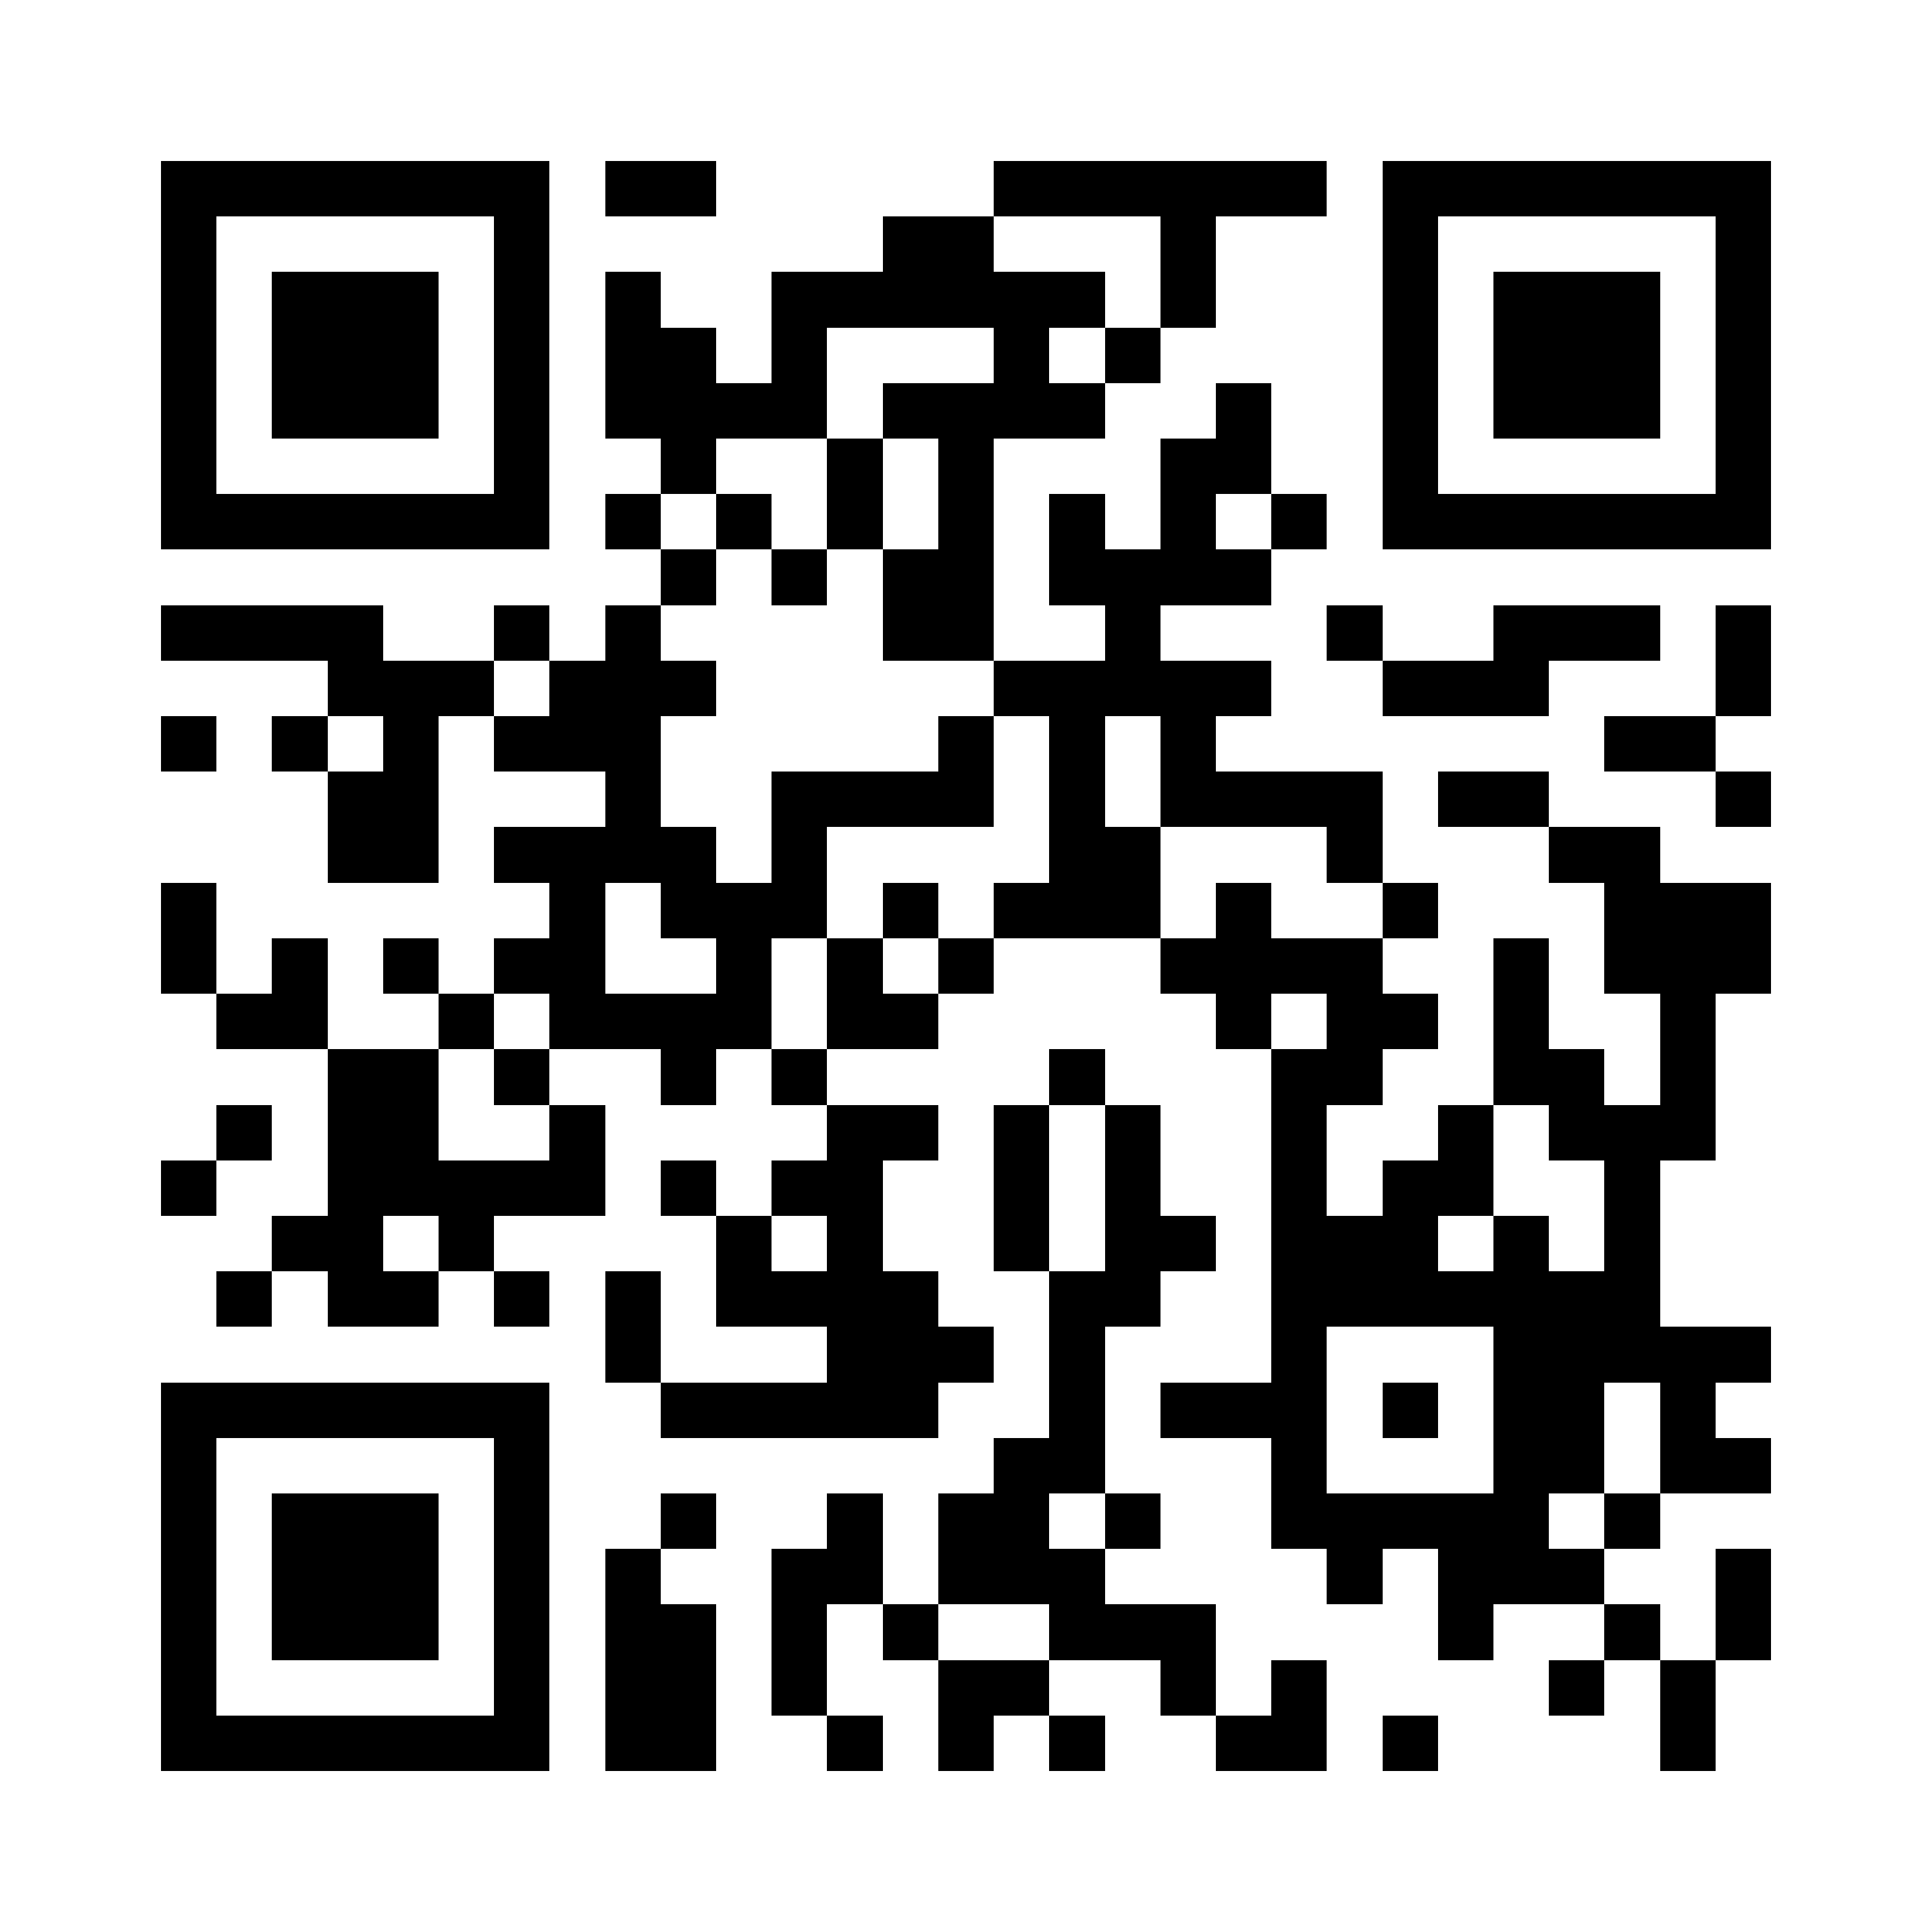
Thank you.
Please feel free to ask questions...and here are some we would like to ask you.

