Slide 1
Roundtable. Covid Keepers: Practical Innovations Inside and Outside our Classrooms
Dr Norah Burns, Dr Martin Regan, Dr Michael Vincent, Dr Paulina E. Wilson
Queen’s University Belfast.
Catherine Shephard, Manchester Metropolitan University (Chair)
SHAPING A
BETTER WORLD
SINCE 1845

Slide 2
Introduction and literature review
Catherine Shephard, Manchester Metropolitan University

Slide 3
Finding the positive in the pandemic
Challenges to Teaching and Learning in HE
Our submission:
Revealed existing exclusions and omissions in legal education
Created opportunities to innovate and address them
Learning Outcome:
Identify those exclusions, omissions and opportunities
Identify the innovation we want to retain: Covid Keepers
Anticipate new challenges ahead

Slide 4
Literature Review
Investigating the learning of our own students (Trigwell, 2000)
Wicked problems (Rittel and Webber, 1973)
Signature pedagogies (Shulman, 2005)
Threshold concepts (Meyer and Land, 2003)
Communicating about learning, with transparency (Healey, 2000)
Radical change agenda (Elton, 1999)

Slide 5
MS Teams: a Covid Keeper
Dr Martin Regan, Queen’s University Belfast
Catherine Shephard, Manchester Metropolitan University
SHAPING A
BETTER WORLD
SINCE 1845

Slide 6
Group work: In person
Interaction and non-verbal communication (NVC)
Group cohesiveness – member characteristics
Suitable for smaller class sizes
Managing levels of participation within/between groups
Physical setting important for productivity
Language issues

Slide 7
Group work: Online
Democratisation of student contributions (e.g. chat function)
Suitable for large and small classes
Collaborative opportunities (production of documents and presentations)
Feedback opportunities (writing and content, peer and tutor)
Class notes and ownership of materials
Student names
Accessibility
But…
Lack of NVC cues – difficulties in judging levels of engagement (student-student and tutor-student); digital empathy
Digital natives?
Wifi dependent

Slide 8
Group work: Post-Covid blended approaches
Utilise advantages of the online environment
In-person sessions supplemented by ‘virtual office’ space for students
Enhanced collaboration opportunities in class and beyond
Promotes more independent learning
Validates engagement with preparation
Guest speaker potential

Slide 9
Linguistic Insights into Legal Education: Exclusions & Omissions
Dr Paulina E. Wilson,
Queen’s University Belfast
SHAPING A
BETTER WORLD
SINCE 1845

Slide 10
Legal Education
Typically domestic law-oriented, resulting in mono-epistemic embedding of legal concepts learnt (domestic law as ‘the normal’)
Does not address globalised law practice (e.g. conceptual variation between jurisdictions/conceptual incommensurability)
Mono-jural: limited opportunities for conducting law comparisons or learning about foreign laws

Slide 11
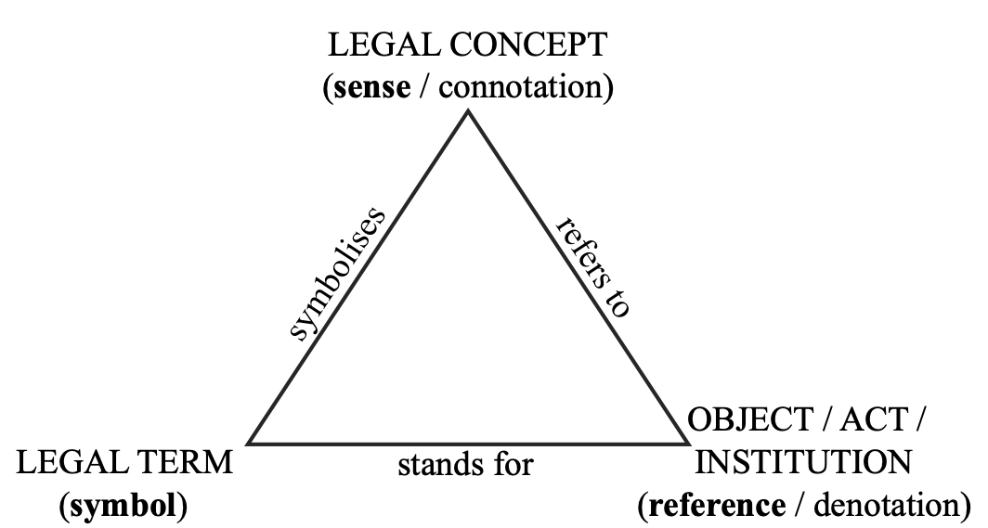
Language of the Law: Issues of Meaning
Inextricable link between law and language
Technolect ≠ vernacular
System-specific meaning
Intralingual translation:
Study of domestic law
Communication with clients in domestic law practice
Interlingual translation:
Study of foreign law
Communication with foreign clients/lawyers in interjurisdictional law practice

Slide 12
Going online during and post Covid-19 pandemic: Exclusions & Omissions
Legal education:
Fewer opportunities for immersive learning of legal terms and concepts (top-down learning)
Greater linguistic/cultural distance between the domestic and the foreign (in the international context)
Legal practice (work experience):
Fewer opportunities for immersive experience of legal practice
Distorted perception of Court settings, incl. procedures and advocacy skills (e.g. solemnity, language register, pragmatic meaning)

Slide 13
Opportunities (Covid keepers)
Virtual observations of Court proceedings (in addition to in-person experience)
Terminology
IRAC technique
Advocacy skills (examples of good practice)
Court etiquette
Virtual tours
E.g. Virtual tour of the UK Supreme Court
Greater accessibility
Guest speakers
Complementing module content (substantive law or legal skills practice)
Overview of legal careers
Greater availability/accessibility: remote attendance now a popular option
Introduction to Comparative Law & Legal Communication
As part of Legal Methods & Skills module or Induction
Inclusion of linguistic insights (language of the law, plain English, language and persuasion in the courtroom, cross-cultural communication: law in translation, etc.)

Slide 14
Covid-19 and Mentoring Programmes
Dr Norah Burns, Queen’s University Belfast
SHAPING A
BETTER WORLD
SINCE 1845

Slide 15
The pre Covid 19 landscape
Alumni Mentoring Programme 2019/2020.
On site in person visits – challenges for Alumni to visit.
Could only consider Alumni based in the country.
Programme developed to help students to establish links with those particularly in the professions – demonstrated student desire for this.
Logistical and expense considerations.
Environmental impact.

Slide 16
Covid – 19 and the move to online
2020–2021
Alumni Mentoring Programme – move to online – MS Teams
Could expand out the Programme to have more mentors in other countries represented on the Programme.
Could facilitate evening meetings online.
Facilitated recent graduate mentors being part of the Programme who were training and would not be able to leave work/ professional training courses during the day.
2021–2022
Transition Skills Programme QUB – mix of in person and online
Student Skills Assistants.
Peer Mentoring.
Flexibility for students living at home due to cost of living.
One to one in person meetings and small group meetings online.
Cost effective.
Work / Caring Responsibilities.

Slide 17
Covid & The Legal Technology Placement
Dr Michael Vincent, Queen’s University Belfast
SHAPING A
BETTER WORLD
SINCE 1845

Slide 18
Post-Crash / Pre-Pandemic Legal Services Market
Clients are asking law firms - where is the value for money?
Competition is increasing in light of liberalisation of the legal services market due to the LSA 2007
Established firms having to compete against increasingly powerful in-house teams and ambitious new entrants to the market (ABSs such as Legal Zoom).
ABSs are applying proven business techniques, focusing on service, process, and the use of technology to deliver consistency and reduce cost.
New entrants are relegating large areas of the law firm service portfolio to commodity status.
Susskind, R. (2013) Tomorrow’s Lawyers An Introduction to Your Future. (Oxford University Press, 2013 1st ed.) – advocated the need for undergraduate courses in legal technology.

Slide 19
Pre-Pandemic
Autumn 2019 Bristol University and Osborne Clarke LLP (OC) began collaborating on one of the first the first legal technology internships in the UK.
Two week placements to be awarded on an annual basis to students from technology disciplines and law.
Placements would be based inside the firm’s IT team, and involve training in coding, and development of AI technology in-house. Specifically to help support commercial litigation clients.
‘Exclusion/Omissions’ – law students failing in role. Why? Too much expectation, coupled with IT managers who were not always best trainers for law students in a busy environment.

Slide 20
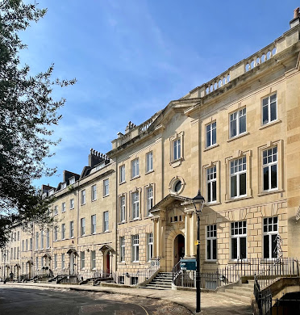
The 2022/23 Placement Intake
A complete overhaul and recalibration of the placement – shifting its focus completely away from engagement in the actual design and delivery of technology...
“these technology-focussed placements will allow students to evaluate legal and emerging technologies and assess if they are viable and of use to Osborne Clarke. While these roles will be based in their IT team, it will be necessary for students to work with a cross-section of individuals, from associate to partner, as well as their OC Solutions and business support teams.” (2022 internal advertising literature) Why the shift in emphasis?
Greater competition from other large law firms leading to the outsourcing of design and development of technology considerably increased by Covid redundancies and cost-cuts
Therefore more effective / cost-effective utilisation of law students’ existing skills sets developed at university required.
‘Covid-Keeper’ - more investment by O.C into the in-house clinical education programme at Bristol (i.e. grass-roots) to support the development of clinic IT infrastructure and systems and overseen by trained clinic staff.

Slide 21
SHAPING A
BETTER WORLD
SINCE 1845

