Slide 1
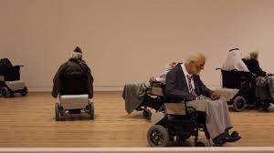
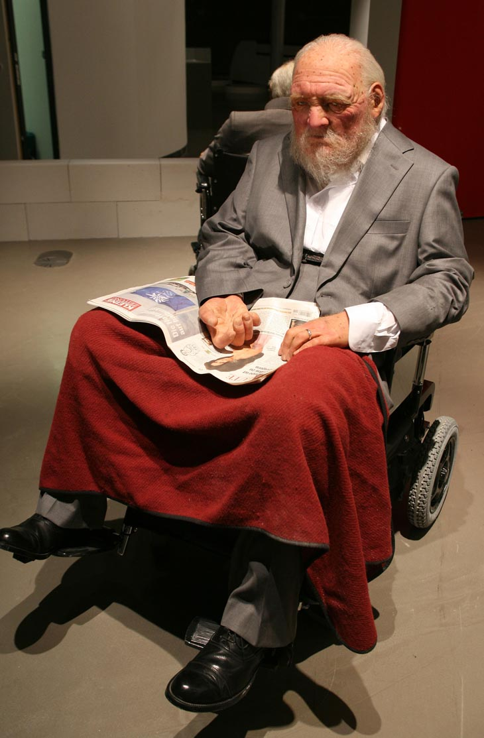
Sensing the atmosphere within dementia care settings: Stories of everyday care told through the bodies of men.
Dr Sarah Campbell, Senior Lecturer. Integrated Health and Social Care.

Slide 2
A full-bodied and emplaced approach to dementia Research
‘Selfhood is embodied and manifests itself in socio-culturally specific ways of being-in-the-world’. (Kontos, 2004, p842).
‘Gender is a neglected dimension in public discourse related to people with dementia. Those living with this condition are typically portrayed in policies and strategies in gender neutral terms as ‘people with dementia’ and ‘family carers’ as if gender does not matter, when clearly it does’. (Bartlett et al, 2018 p14).
‘A place thrown together as a sensory composition is an infrastructure of feeling and sociality that slowly comes to pass as common habits and shared reactions in lives and attitudes. It happens to degrees and in singularities that create proliferating multiplicities. It lodges in bodies, characters, and habits’. (Stewart, 2015, p211).

Slide 3
Analysing Everyday lives and care
Our personal narratives are told through our bodies as part of the performances of everyday life (Baldwin, 2008)
‘To communicate embodied and lived stories; that is, to move beyond telling stories of having bodies, to seeing/feeling/hearing/tasting/smelling as bodies-emplaced and whose movements and sensations are crucial to our learning, knowing and understanding’. (Lisahunter and Emerald, 2016)

Slide 4
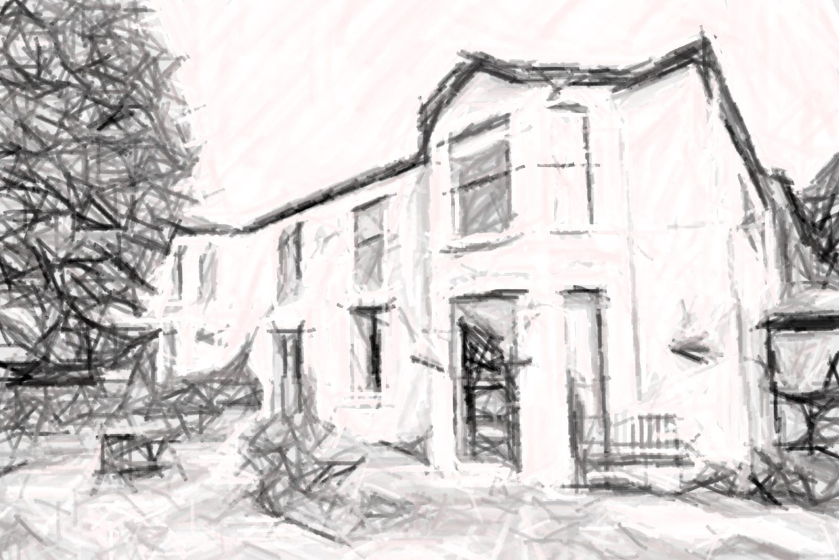
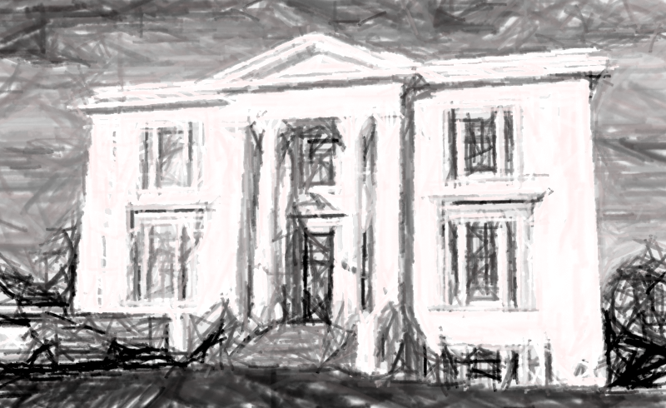
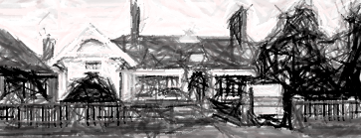
Field sites and PArticipants
Fieldsite no. | Name of fieldsite | Type of setting | Observation locations. | Participants
1 | Forest Fields: Primrose Residential Dementia Unit. | Residential and Nursing Care Home. Locked Dementia Unit. | Bedroom (Samuel), Bathroom (Bryn), communal areas. | Samuel and Brynn
2 | Old Bay Hospital: Sandbridge Ward | Mental health NHS dementia Hospital. In-Patient Ward. | Communal areas, Bathroom (Larry), Bedroom (Don) | Larry and Don
3 | Lincoln Manor | Care home (with nursing). Home for ex-service personnel. Communal areas. | Communal areas, Bedroom (Harry and Charlie). | Charlie, Harry and Bert

Slide 5
Normative Structures and Regulations of care spaces
Order and structure of time: ‘institutional time’ & ‘in-between time’
Work-place versus home-place
Control and management of bodies
Gendered atmospheres
‘well, recently, the mixture of patients has been very, very difficult, you know, because [the male] ward closed and we have these quite difficult men to deal with. And it is … that mixture, with the vulnerable patients, that has been very, very difficult, very stressful, and sometimes not having enough staff .’
Nursing Assistant. Sandbridge Ward.

Slide 6
Atmospheric moments of resistance
‘Waiting and Institutional Uncertainty
Resistance stories: ‘What about the dad’s?’
Temporal Resistance: ‘Lived Time’

Slide 7
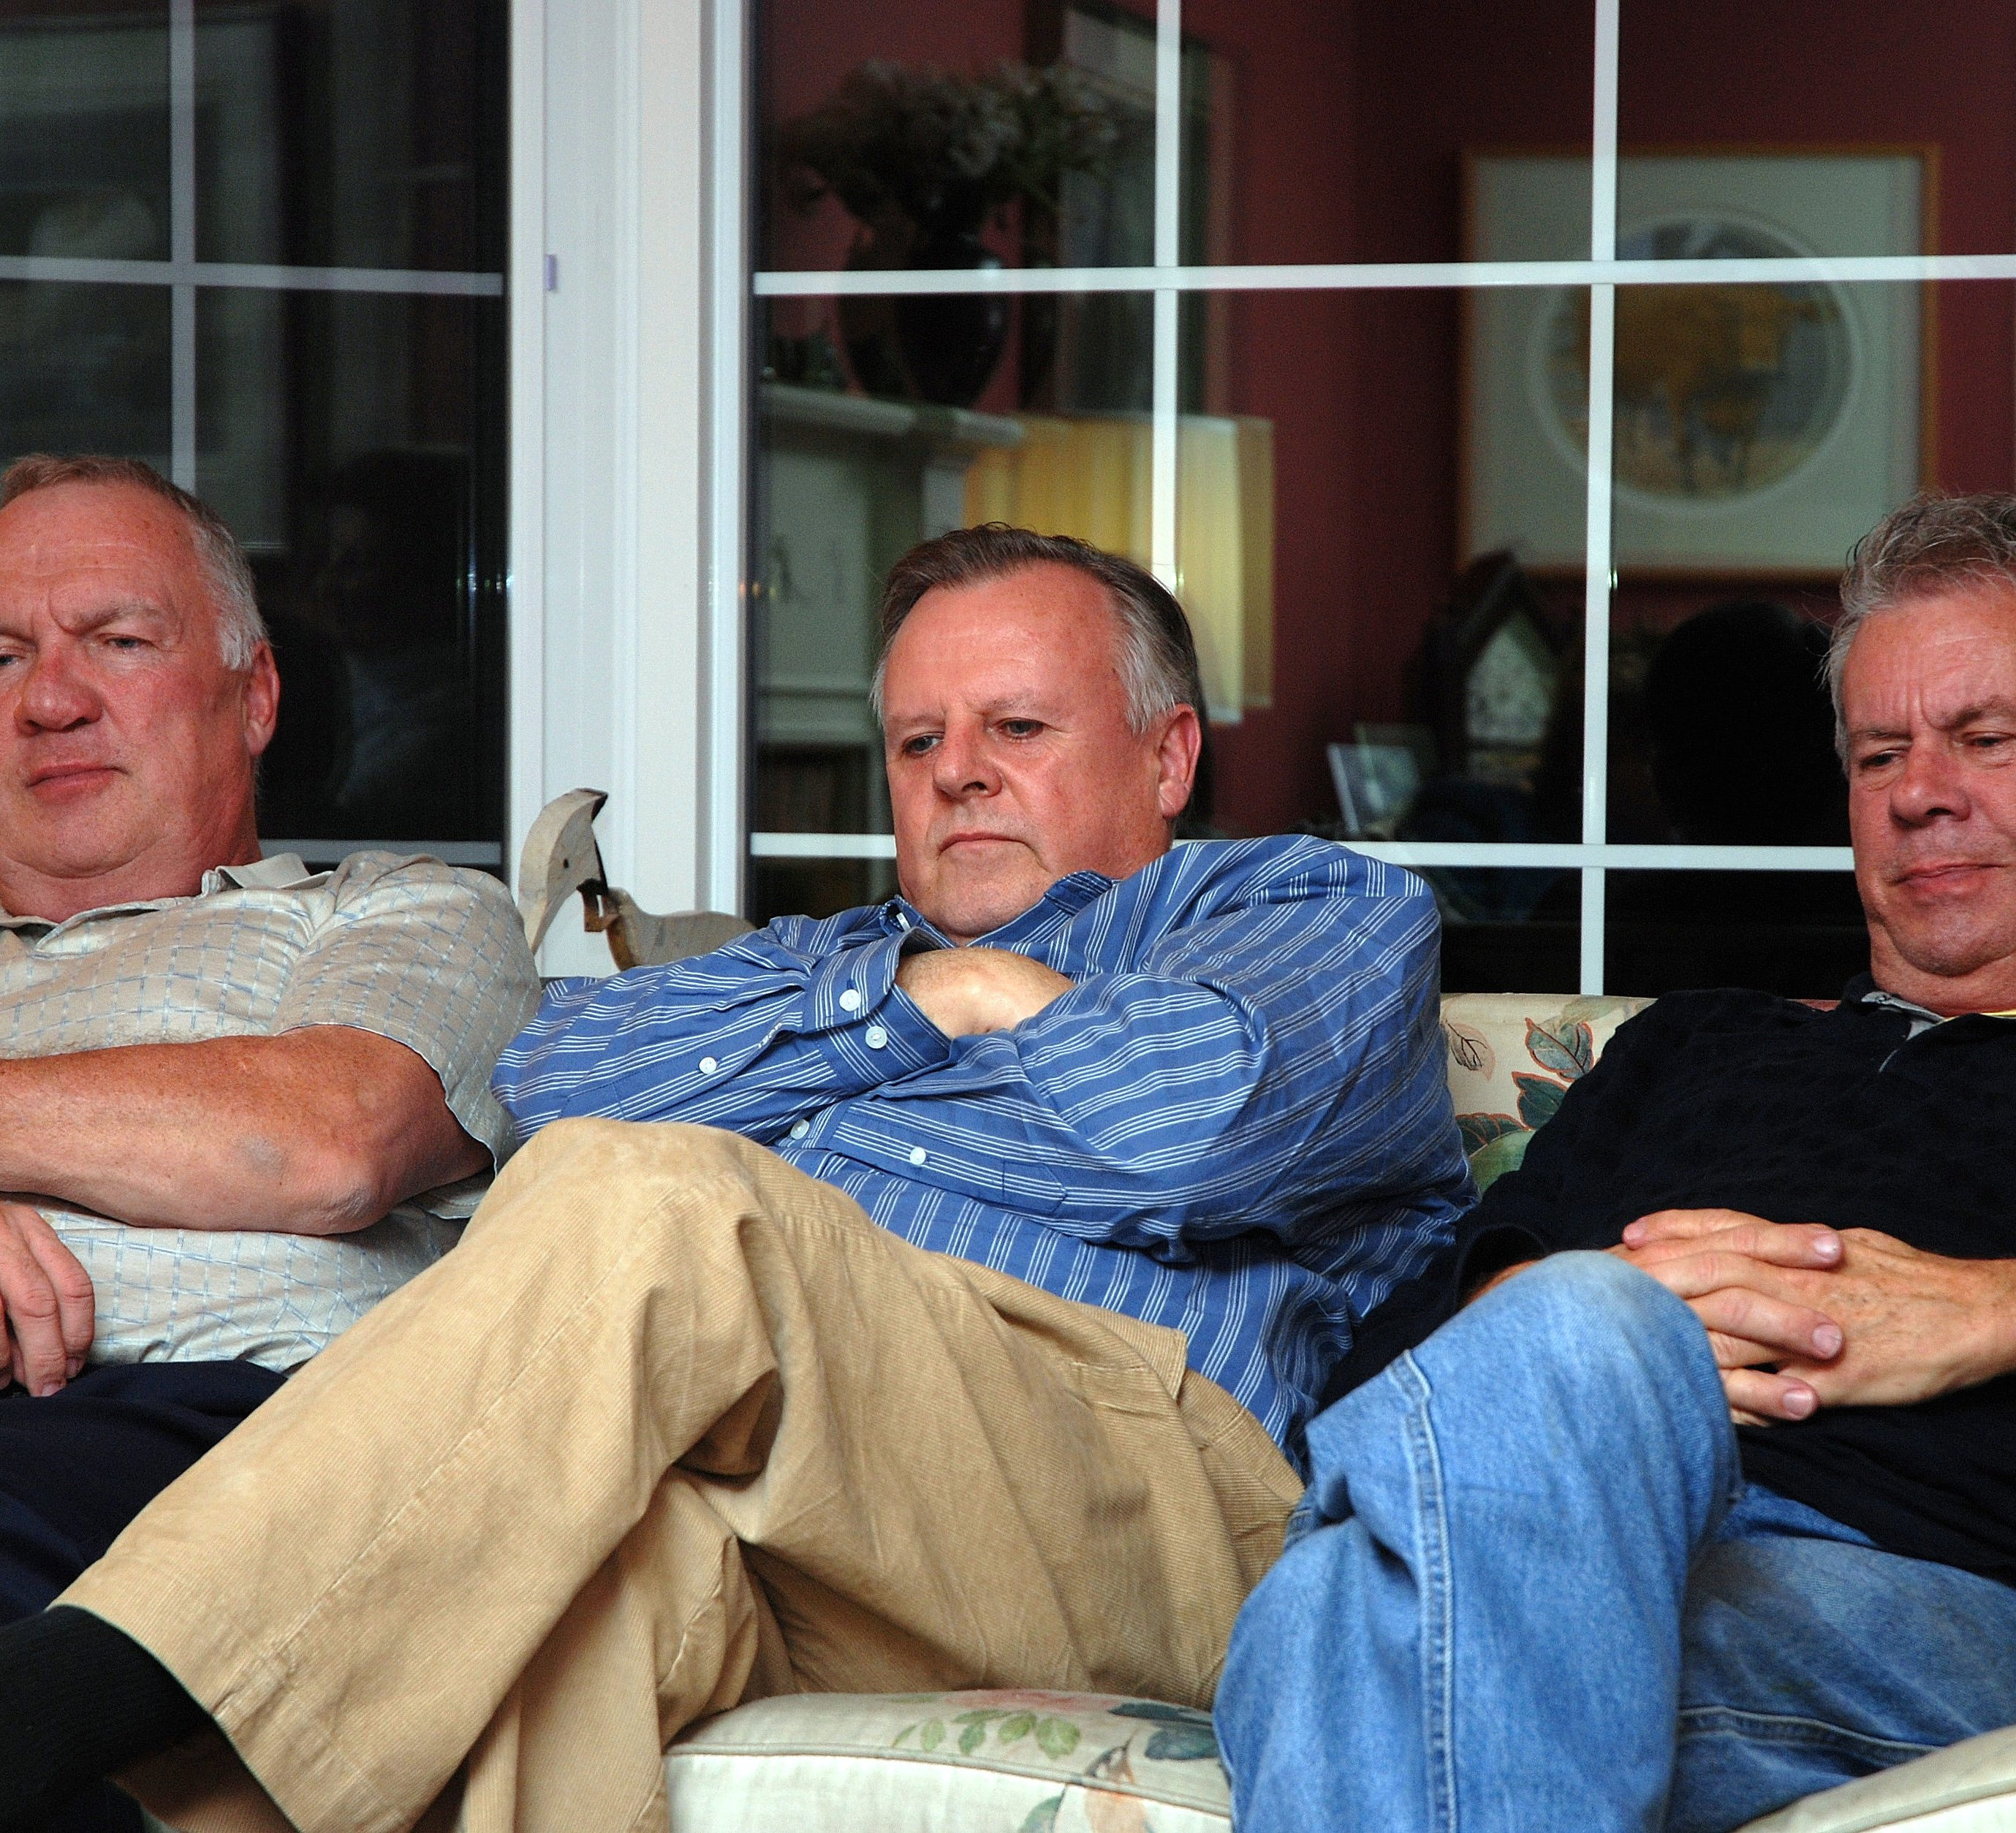
Restorative atmospheric moments
Gatherings of men:
Charlie comes to every little while [he appears to be sleeping] and asks something. He looks at Harry and his lips move, Harry takes out a mint, he has a new packet of peppermints, and he offers one to Charlie, he takes it and Harry says ‘that’s what friends are for’. Charlie says ‘right’ and sits back down again.
Appearance assemblages:
‘the room smells of men’s toiletries – of the shaving foam’

Slide 8
The language of atmosphere in care
“Brookfield is located in Huntingdon, Cambridgeshire and offers a ‘homely atmosphere’ set in scenic grounds, which includes a listed coach-house building and enclosed landscaped gardens with wheel-chair friendly access”
“Our aim is to create a ‘family atmosphere’ for all our residents”
‘It is important that care homes present a ‘homely’ rather than ‘institutional’ (Centre for Ageing Policy, 2012).

Slide 9
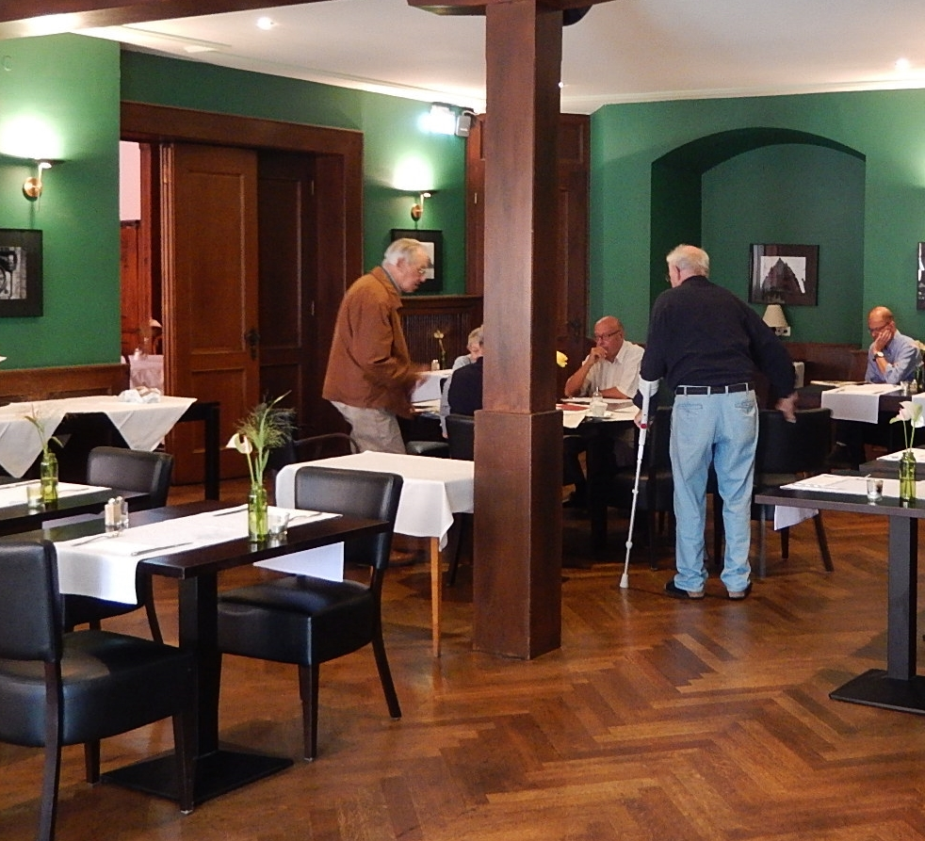
understanding sensory and embodied experiences as collective atmospheric moments
Insight into the collective experience of care.
Allow insight into how the structural aspects of care have affect and produce atmosphere at an everyday level.
Opportunities to support more restorative atmospherics.
Opportunities to see how the small stories of everyday life have wider impact.
Recognition that gender permeates relationships in care – and that a gendered atmospheric lens can illuminate these.

Slide 10
References
Armstrong, P. and Braedley, S. eds. (2013). Troubling care: Critical perspectives on research and practices. Canadian Scholars’ Press.
Baldwin, C. and Group, B.D. (2008). Narrative (,) citizenship and dementia: The personal and the political. Journal of Aging Studies, 22(3), pp.222-228.
Bartlett, R., Gjernes, T., Lotherington, A.T. and Obstefelder, A. (2018). Gender, citizenship and dementia care: a scoping review of studies to inform policy and future research.Health & social care in the community, 26(1), pp.14-26.
Kontos, P.C. (2004). Ethnographic reflections on selfhood, embodiment and Alzheimer's disease. Ageing & Society,24(6), pp.829-849.
Lisahunter and Emerald, E. (2016). Sensory narratives: Capturing embodiment in narratives of movement, sport, leisure and health. Sport, Education and Society, 21(1), pp.28-46.
Mason, J. (2018). Affinities: Potent Connections in Personal Life. John Wiley & Sons.
Pink, S. (2009). Doing sensory ethnography. London: Sage.
Stewart, K. (2015). Place and Sensory Composition in Malpas, J. ed., (2015). The intelligence of place: Topographies and poetics. London and New York: Bloomsbury Publishing. (pp205-221).
Stewart, K. (2007). Ordinary affects. Durham, NC: Duke University Press.
Photographs: ‘Old People’s Home’: Sun Yuan and Peng Yu. Satchi Gallery.
Other images from Flickr, Commons Licence images.

Slide 11
Thank you.
Any Questions?
Contact: Sarah.Campbell@mmu.ac.uk
@DrSarahCampbell

