Slide 1
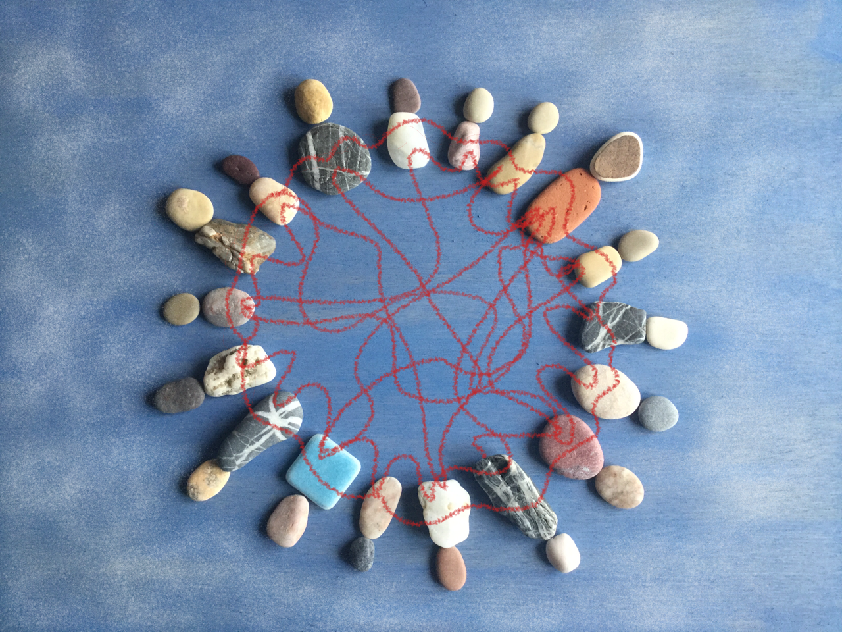
Growing ideas – Creativity in Leadership
Chrissi Nerantzi & Haleh Moravej
University
Teaching Academy
Environment
Team
Notes:
Purpose: To reflect on ourselves us creative leaders and discuss with others leaders how we can adapt more creative strategies to empower our colleagues
Little things can make a big difference. We will immerse ourselves into three activities. We will work individually and in groups to open-up and share.
Warning: You may feel discomfort, this is normal and part of the creative process.

Slide 3
Pick & Share
How do you see creativity in your role as a leader?
Come up
with a title

Slide 4
Reflect, Fill & Decorate
What are the challenges and opportunities to be a (more) creative leader?
https://www.pixelsquid.com/png/crumpled-paper-1060359605776815878?image=G15
https://www.publicdomainpictures.net/en/view-image.php?image=81061&picture=carton
opportunities
challenges

Slide 5
Make & Speed dating Who do you want to be(come) as a creative leader?

Slide 6
Growing ideas – Creativity in Leadership
Chrissi Nerantzi & Haleh Moravej
Thank you

Slide 7
Growing ideas – Creativity in Leadership using P(hotos) – B(oxes) – L(ego)
Chrissi Nerantzi and Haleh Moravej
Purpose: To reflect on ourselves us creative leaders and discuss with others leaders how we can adapt more creative strategies to empower our colleagues
Little things can make a big difference. We will immerse ourselves into three activities. We will work individually and in groups to open-up and share.
Warning: You may feel discomfort, this is normal and part of the creative process.
Notes:
Summary: Join us for this interactive playshop to feel energised! Immerse yourself into creative explorations, that will generate new insights and trigger novel ideas to transform your practice and promote openness, sharing and collaboration within your teams and in your role as a leader. Develop strategies to celebrate diversity, nurture and grow a culture of creativity and innovation within your teams that is empowering and will bring about positive change.

Slide 8
Beginning (C) >>> Photos >>> What does creativity mean to you as a leader? (individual)
Use photo flashcards, spread on the floor, ask colleagues to pick one, sticky note to explain it
Create a gallery with photos and sticky notes

Slide 9
Middle (H) >>> BOX (big in groups)
Colleagues are split into 4 groups
They discuss challenges and opportunities to be a creative leader.
Then add their collective thoughts to the big box.
Outside: Opportunities
Inside: Challenges
Facilitators quickly summarise responses.
Notes:
We also need markers

Slide 10
Middle (H) >>> BOXES (small groups)
Colleagues get a small box each
Inside: what are your challenges to be a creative leader:
Outside: What opportunities are there? Add them outside the box
Discuss in groups of 4-5
Big box: add commitment to change. One idea from everybody (use same box for all 3 workshops)
Notes:
We also need markers

Slide 11
End (C + H) >>> LEGO: Who do you want to be as a creative leader? (pairs)
Create a mini model of… using LEGO
Speed dating, share with at least 2 colleagues
Hand out freezer bags to take away

Slide 12
Share creativity manifesto
As colleagues are leaving, A4 sheet of paper

Slide 13
(Parkin, 2019, online)
Notes:
https://www.advance-he.ac.uk/news-and-views/Introducing-the-Rainbow-Model-of-Creative-Leadership

