Slide 1
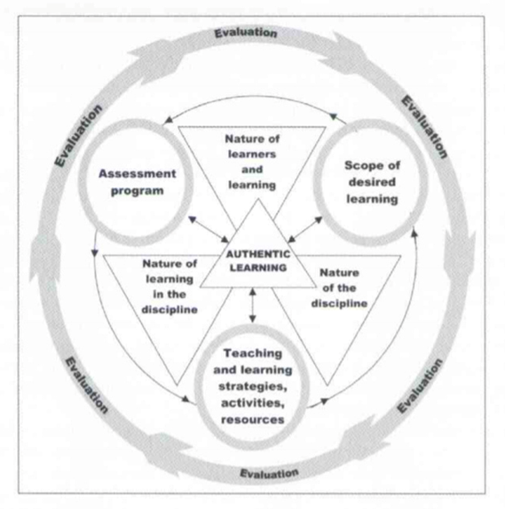
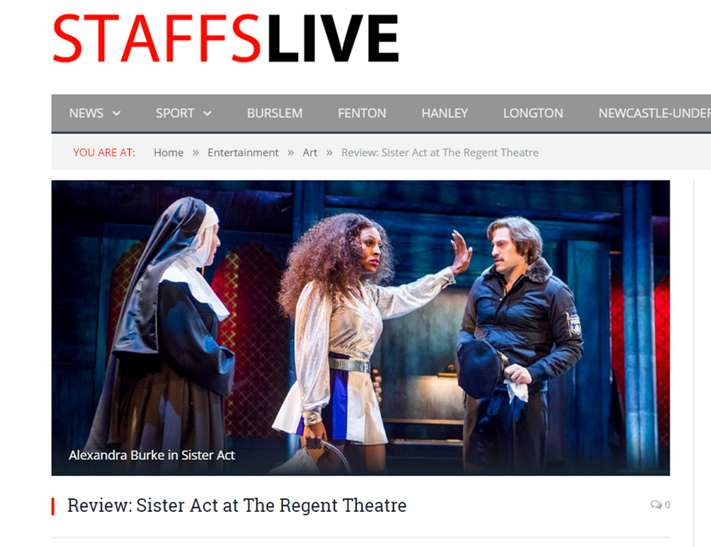
Digital skills, confidence and motivation:
technology supported authentic learning in journalism education
Audio
Carmel Thomason carmel.thomason@staffs.ac.uk
1. Introduction
This study explores the use of technology to incorporate authentic learning practices into the Review and Lifestyle Journalism module at Staffordshire University. The research takes a constructivist view, considering both tutor observation and student feedback to evaluate an experiential journalism project, StaffsLive Reviews, developed in the academic year 2016-17. Here authentic learning is defined as designing activities to provide meaningful, ‘real-life’ situations which are relevant from a student’s perspective, while providing protective scaffolding to support learning (Icuc and Marin 2014 and Stein 2004). This encapsulates a broader institutional focus on employability, by designing activities that closely match ‘real-world’ tasks of media professionals (Lombardi 2007).
2. Context
4. Findings
5. Discussion
The 21st century continues to experience rapid change in digital technologies, and government policy makers are considering the current skills of the UK’s workforce to understand what skills might be needed in the future (Foresight project 2017). As part of the UK’s Digital Strategy (2017), higher education is placing increasing importance on both digital skills training and encouragement of lifelong learning.
Evidence shows access to technology does not in itself generate a propensity to learn (White and Selwyn 2012). However, it creates opportunities for meaningful, ‘real-world’ engagement in learning that previously would not have been possible.
In journalism, digital platforms have enabled students to publish and share work with a wider community outside of their university course. Authentic learning in this way enables students to use their skills and knowledge in the same way a professional would. The main difference being, activities are developed with the space and support for learning in a way that is often not available in the workplace.
There was positive engagement from students of all backgrounds. Many students continued to be involved outside of the module or any course assessment.
The project had a positive influence on students’ motivation, confidence and enjoyment of their studies. Other outcomes valued by students included portfolio building, working alongside professionals, gaining ‘real-world’ experience, and working to deadline. This reflects similar outcomes to authentic experiential projects at other universities (St Clair 2015; Baines 2012, Steel et al. 2007).
There were additional benefits in linking students and the university with the wider community in Staffordshire (88% of students said that the review list had encouraged them to experience something new).
Students choosing to stay involved in the project outside of any formal assessment indicates a deeper level learning that could positively influence a propensity for life-long learning (Foresight 2017). Matching relevant study to students’ interests as well as expanding their experiences appear to be important factors in developing motivation to learn.
In common with other experiential projects neither the learning nor support fits into neat timetabled boxes (St Clair 2015). If authentic learning is to be adopted on a larger scale, organising tutor workloads to accommodate this type of support needs to be considered.
I try a lot harder because of the people who can see it.
It’s there for anyone to see and then, when you come to get jobs, you’ve got your own portfolio.
It has had a huge impact on my confidence levels and gave me some amazing real world experience! And it was a lot of fun!
Student comments
Absolutely loved reviewing!
It was great to write in the company of other journalists.
Good experience for the work place.
I feel like the more I do on
StaffsLive the more confident I get.
Research shows students feel more confident about their journalism practice after engaging in authentic experiential activities (Baines, 2012). It also shows that unstructured and unsupported work experiences can have a negative impact on learning (Hanna and Sanders 2007).
To ensure learning remained the central focus of this study the project was designed using a theoretical model developed by Stein et al. (2004), which highlights what to consider when designing, developing and implementing authentic curricula.
Having a review published on StaffsLive has given me confidence in my writing.
6. Recommendations
Carry out more detailed qualitative studies because numbers are restricted due to class size and capacity on authentic projects, making statistical significance difficult to achieve.
Explore ways in which staff time can be recognised in work allocation to enable the growth and sustainability of this and other authentic learning projects.
Study the impact of the project in terms of students’ growing experience of the arts as well as their view of the surrounding community, to evaluate early indications that building stronger links and encouraging students to get involved with the wider community has positive benefits for students, the University and the region. This could also have a positive influence on student recruitment.
Writing reviews for StaffsLive has encouraged me to write to deadline.
Stein’s theoretical model for developing authentic curricula
3. Methodology
The StaffsLive Reviews project was developed to allow students press access to venues and events, where they work alongside professional journalists and public relations staff and must produce and publish work to a deadline. Students use a live content management system, developed from WordPress, to upload their work and there is a bespoke feedback system built-in to allow tutors to comment on and edit work before publication. Use of social media tools were also integrated.
The StaffsLive Reviews project has encouraged me to experience something new.
7. References
Baines, D. (2012) ‘Hyper-local learning: Enhancing employability, sustaining professional practice.’ Journalism, Vol. 1, No. 1: 35-47.
Beetham, H. and Sharpe R. eds. (2013) Rethinking Pedagogy for a Digital Age: Designing for 21st Century Learning. Routledge.
Department for Culture, Media & Sport and The Rt Hon Karen Bradley (2017) UK Digital Strategy. Policy Paper https://www.gov.uk/government/publications/uk-digital-strategy
Foresight project exploring the future of skills and lifelong learning in a changing world (2017) Government Office for Science https://www.gov.uk/government/collections/future-of-skills-and-lifelong-learning
Hanna, Mark and Sanders, Karen (2007) Journalism Education in Britain: who are the students and what do they want?, Journalism Practice, 1, 3:404-20.
Iucu, R.B and Marin E. (2014) Authentic Learning in Adult Education. Social and Behavioural Sciences 142: 410-415.
Jonassen, D. Howland, J. Marra, R.M. and Crismond, D. (2012) Meaningful learning with technology (4th ed.) Upper Saddle River: Pearson Education, Inc.
Lombardi, M.M. (2007) Approaches That Work: How Authentic Learning Is Transforming Higher Education (Boulder, CO: EDUCAUSE Learning Initiative), https://net.educause.edu/ir/library/pdf/ELI3013.pdf
Lombardi, M.M. (2007) Authentic Learning for the 21st Century: An Overview. (Boulder, CO: EDUCAUSE Learning Initiative), https://net.educause.edu/ir/library/pdf/ELI3009.pdf
Pegg, A. Waldock, Hendy-Isaac, S. and Lawton R. (2012) Pedagogy for employability. The Higher Education Academy. https://www.heacademy.ac.uk/system/files/pedagogy_for_employability_update_2012.pdf
St Clair, J. (2015) Doing it for real: designing experiential journalism curricula that prepare students for the new and uncertain world of journalism work.’ Coolabah, No.16 ISSN 1988-5946, Observatori: Centre d’Estudia Australians / Australian Studies Centre, Universitat de Barcelona.
Stein, S.J. Isaacs G. and Andrews T (2004) Incorporating authentic learning experiences within a university course. Studies in Higher Education, 29:2 239-258.
Steel, J. Carmichael, B. Holmes, D. Kinse, M and Sanders, K. (2007) “Experiential learning and journalism education. Lessons learned in the practice of teaching journalism.” Education and Training Vol. 49 Issue 4: 325-334.
Weller S. (2016) Academic Practice: Developing as a Professional in Higher Education. Sage.
White, P and Selwyn, N. (2012) Learning online: Educational internet use and participation in adult learning 2002-2010 Education Review 64, 4:451-469.
I enjoy the challenge of learning in a real-world environment.
www.staffslive.co.uk
On the request of other staff, the project was opened to students across all journalism courses. Evaluation methods included observation, focus group interviews and student surveys.
On a scale from 0-10, how likely are you to recommend volunteering to review for StaffsLive to another student?

