Slide 1
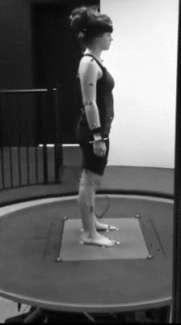
Figure 1
a
0.25 Hz
0.5 Hz
0.61 Hz
Transition State
Platform
TA
G
Q
H
Time
0.5 Hz
b
c
AI = -0.1
AI = 0.3
Transition
Steady State
Transition
Steady State
Notes:
Figure 1 - Perturbation protocol depicting platform oscillation and corresponding EMG signals (a) from tibialis anterior (TA), gastrocnemius (G), quadriceps (Q), and hamstring (H) muscles during the transition and steady state periods at 0.5Hz. Panel (b) depicts a participant’s posture during backward platform displacement at 0.5 Hz in transition (left) and steady (right) states. Expanded head-neck stick figure shows an example of a shift from Head Stabilized on Trunk (AI = -0.1) to Head Stabilization in Space Strategy (AI = 0.3). Panel (c) A participant with markers and EMG electrodes. (Adapted with permission from [12])

