Slide 1
Using social enterprise to advance responsible management education at MMU Dr. Mike Bull Manchester Metropolitan University

Slide 2
Overview – MMU and PRME
MMU signed up for PRME in December 2010
Jonathon Porritt formally launched SEEG (our Sustainable and Ethical Enterprise Group)
Hosted the 2nd World Symposium on Sustainable Development.
Introduced a series of lectures which are presented to all our level 4 students across all our programmes introducing them to the PRME and topics including Stakeholder Engagement and the Triple Bottom Line.
Further all our programmes, undergraduate and postgraduate, have been reviewed and now include ethics and sustainability learning objectives.

Slide 3
People
Effects
Actions
Planet
Effects
Actions
Profit
Effects
Actions
Displacement
Globalisation
Rights
Democracy
Eco-systems
Climate change
Circular economy
Supply chain
Neo-liberalism
Poverty
Fairer society
Ethics

Slide 4
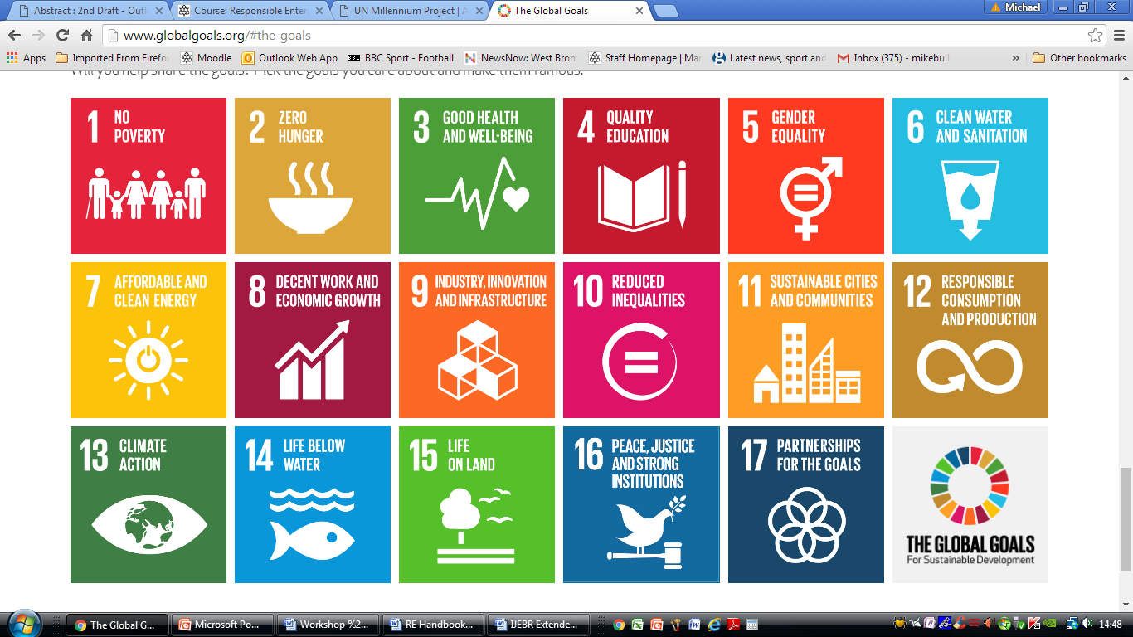

Slide 5
Green Economics

Slide 6
Green Economics (Scott-Cato 2009)
Green economics is distinct from the dominant economic paradigm as practised by politicians and taught in the universities in three main ways:
1. It is inherently concerned with social justice. For mainstream economics ‘welfare economics’ is an add-on. For a green economist equality and justice are at the heart of what they do.
2. Green economics has emerged from environmental campaigners and green politicians because of their need for it. It has grown from the bottom up and from those who are building a sustainable economy in practice rather than from abstract theories.
3 Green economics is not, as yet, an academic discipline with a major place in universities.

Slide 7
Green Economics (Scott-Cato 2009)

Slide 8
Green Economics (Scott-Cato 2009)
From economic growth to a balanced economy & quality of life?
The major objective of the economy is to grow, and the more it grows, the happier the politicians are.
In the capitalist ideology it does not matter that economic growth is destructive and does not increase human well-being; it only matters that there is more money changing hands in the global market.
There is too much emphasis on standard of living, usually measured in purely material terms, and not enough on quality of life.
For green economists growth is the major problem, not only because it is usually bought at the expense of the planet, but also because it is actually reducing our quality of life.
The lifestyles we expect in the 21st century have caused the extinction of species on a massive scale, and by causing climate change are actually threatening our future as a species.

Slide 9
Challenges...
Breadth
Focus on planet, profit...... people

Slide 10
Business as usual...
Notes:
Source: http://www.dailykos.com/story/2015/07/28/1405929/-The-latest-AEI-economic-messaging-What-s-wrong-with-it-and-a-better-vision
Businesses owned and controlled from the top.
Wealth is distributed on the basis on ownership and shares.
In many businesses people and planet are exploited in the pursuit of wealth creation

Slide 11
New ways of doing business...
Social Enterprises work towards the desired
Power redistribution Wealth redistribution
Equality Poverty alleviation
Decision making Empowerment
Control People and Planet

Slide 12
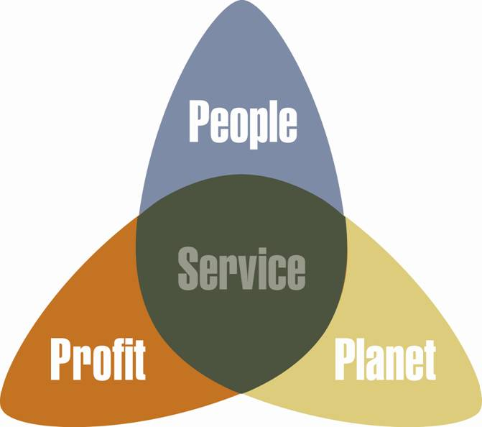
So what is it? How does it work?
Notes:
Image source: http://www.socialenterprise.net/assets/images/image001.jpg

Slide 13
New ways of doing business...
A dynamic movement: 3 times more business start ups are now social enterprises than mainstream businesses.
At the forefront of economic recovery: The proportion of social enterprises that grew their turnover over the past 12 months is 52%. (compared to mainstream SMEs (40%).
Making a profit, making a difference: 50% of social enterprises reported a profit, Almost all use the majority of those profits to further their social or environmental goals.
Innovation pioneers: The number of social enterprises introducing a new product or service in the last 12 months has increased to 59%. Among SMEs it has fallen to 38%.
Paying fair: The average pay ratio between social enterprise CEO pay and the lowest paid is just 3.6:1 – for FTSE 100 CEOs, this ratio stands at 150:1.
Notes:
Source: http://www.socialenterprise.org.uk/advice-services/publications/state-social-enterprise-report-2015

Slide 14
Meeting the challenge of Sustainable Development
1. Co-operatives and Mutuals (using the principle of solidarity to positively impact on the well-being of workers, customers, the local community and environment).
2. Social Business (adapting private sector practices and business models to make the well-being of individuals, communities and the natural environment a higher priority than profit maximisation).
3. Philanthropic Trading (to improve the economic sustainability of social ventures that prioritise improvements to social and environmental well-being)
Notes:
Source: Ridley-Duff and Bull (2015) ‘Understanding Social Enterprise: Theory & Practice’. Sage

Slide 15
Conclusions...
Paradigm shift?
Business as usual, CSR.
Breadth not depth +
More students ‘touched’ – maybe enough on a general business degree – some thrive/radicalise – many more go through motions
Breadth not depth –
Over-focus on green issues, less on radical solutions
Where’s the ‘social’ in RB education?
How can SE fill the gap?

