Slide 1
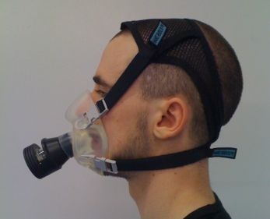
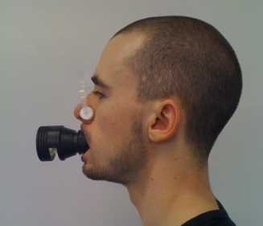
The use of Facemask or Mouthpiece-nose Clip Fixtures for the Assessment of VO_{2max}: An Examination of Limits of Agreement.
Sims, D¹ and Pheasey, C¹
Manchester Metropolitan University¹
Results:
Introduction:
The attainment of VO_{2max} as an assessment of aerobic power has long been accepted as a valid measurement due to the central and peripheral cardio vascular components (Roels et al., 2005). The equipment used in the assessment of VO_{2max} varies greatly but little investigation on collection methods at maximal workloads has been conducted; with most focusing on sub maximal workloads or rest (Evans et al., 1995; Hirsch et al., 1969; Saey et al., 2006).
Aim:
The current study aimed to validate the use of facemask and mouthpiece-nose clip fixtures to collect expired air for the subsequent assessment of VO_{2max}.
Method:
Twenty volunteers (mean [±SD] age, 21.0 years [±1.4], height, 175.0cm [±5.6], weight, 75.6kg [±6.5]) participated in a repeated measures design. Twice performing a cycle VO_{2max} test, either time using mouthpiece-nose clip or facemask in a randomised order, respectively. Participants cycled between 80-100rev·min⁻¹ on an electronically braked cycle ergometer (ergoline type 800), with a cadence increase of 0.5W∙s⁻¹. VO₂ was assessed by a breath-by-breath portable gas analyser (MetaMax 3B) with VO_{2max} verified with at least two of five BASES VO_{2max} lab guidelines.
Analysis:
Data was presented as descriptive statistics. A Bland-Altman limits of agreement plot was used between the fixtures and VO_{2max}. VO_{2max}, minute ventilation (V_{E}), tidal volume (V_{t}), breathing frequency (V_{f}), 5minute post blood lactate (BLa) and time to exhaustion (TTE) were analysed by a repeated measures dependent t-test (P≤0.05).
Figure 1: Bland-Altman limit of agreement plot of VO_{2max} between facemask and mouthpiece-nose clip
Table 1: Descriptive results shown as means (±SD)
 | Facemask | Mouthpiece-nose clip
VO_{2max} (mL·kg⁻¹·min⁻¹) | 51 (±8.2) | 52.6 (±7.7)
V_{E} (L·min⁻¹) | 125.6 (±18.2) * | 115.2 (±15.9)
V_{t} (L·min⁻¹) | 2.6 (±0.4) | 2.8 (±0.6) **
V_{f} (breath·min⁻¹) | 50.8 (±9.5) ** | 44.2 (±9.6)
Bla (mmol·L⁻¹) | 8.14 (±1.76) | 7.81 (±1.53)
TTE (s) | 598.1 (±83.9) | 597.1 (±67.5)
Significant difference * P=0.04 **P=0.01
Figure 2: Side and front view of facemask (left) and mouthpiece-nose clip (right) with turbine.
Discussion:
This study investigated the agreement of facemask and mouthpiece-nose clip in the collection of VO_{2max} using twenty healthy males. Results indicated the methods do not agree sufficiently (mean bias -1.63mL·kg⁻¹·min⁻¹ [±8.05]), although the measurements are not significantly different (P=0.09). Further development of the methods discussed needs to be implemented to increase validity between the two methods of collecting VO₂.
Evans, B. W., & Potteiger, J. A. (1995). Metabolic and ventilator responses to sub-maximal and maximal exercise using different breathing assemblies. Journal of Sports Medicine and Physical Fitness, 35, 93-98.
Hirsch, J. A., & Bishop, B. (1982). Human breathing patterns on mouthpiece or face mask during air, CO₂, or low O₂. Journal of Applied Physiology, 53, 1281-1290.
Roels, B., Schmitt, L., Libicz, S., Bentley, D., Richalet, J-P., & Millet, G. (2005). Specificity of VO_{2max} and the ventilator threshold in free swimming and cycle ergometry: comparison between triathletes and swimmers. British Journal of Sports Medicine, 39, 965-968.
Saey, D., Pepin, V., Brodeur, J., Lizotte, J., Gagnon, P., La Violette, L., Nadreau, É., Leblanc, P., & Maltais, F. (2006). Use of facemask and mouthpiece to assess constant-work rate exercise capacity in COPD. Medicine and Science in Sports and Exercise,38(2), 223-230.

